Slide 1
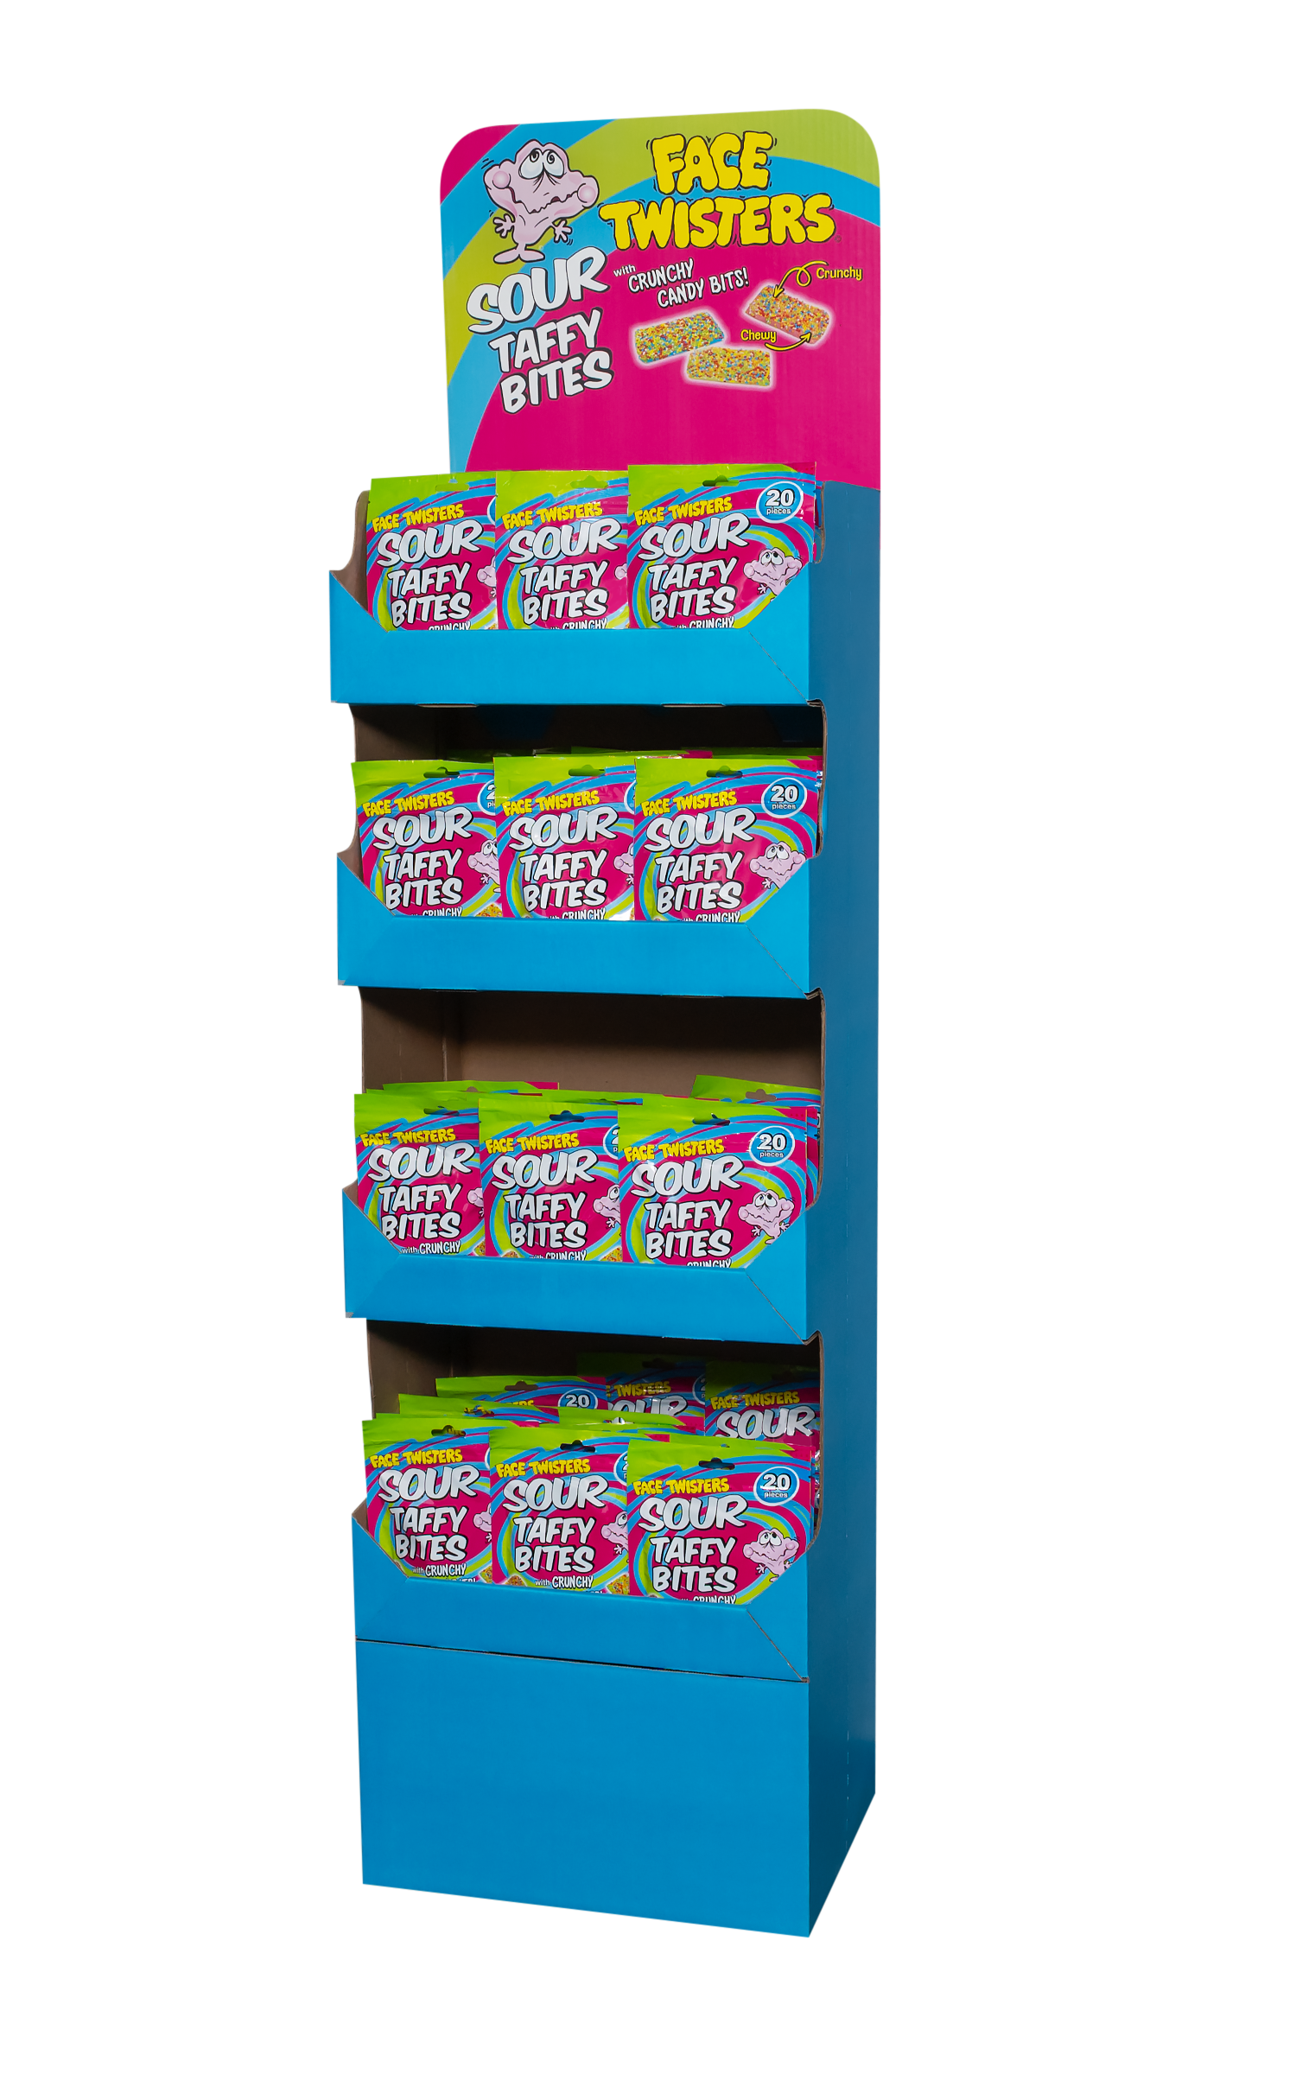
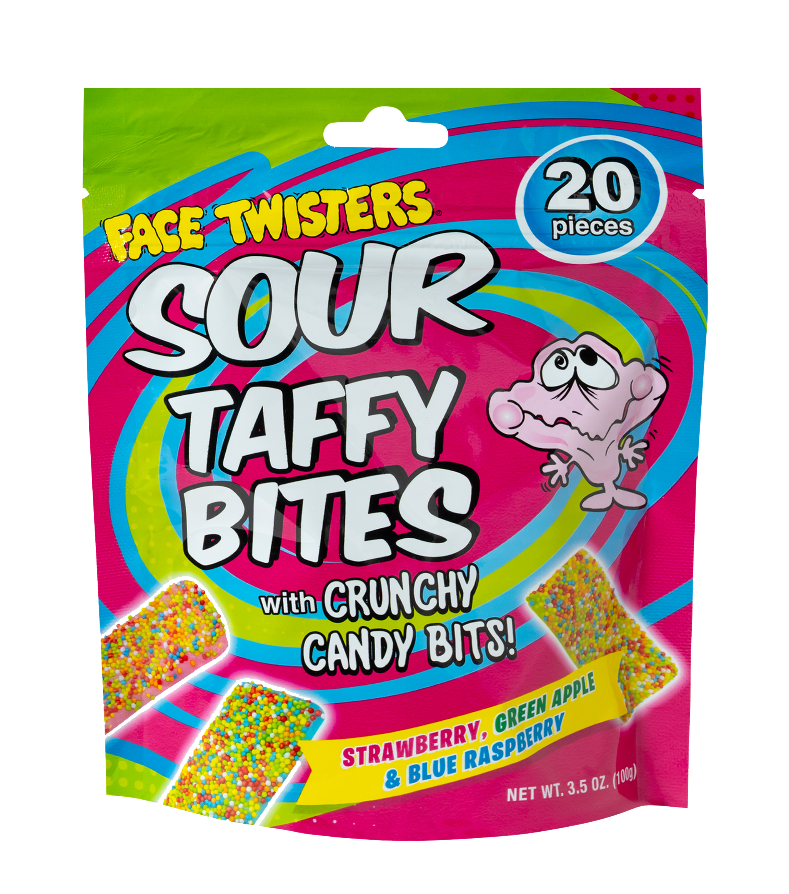
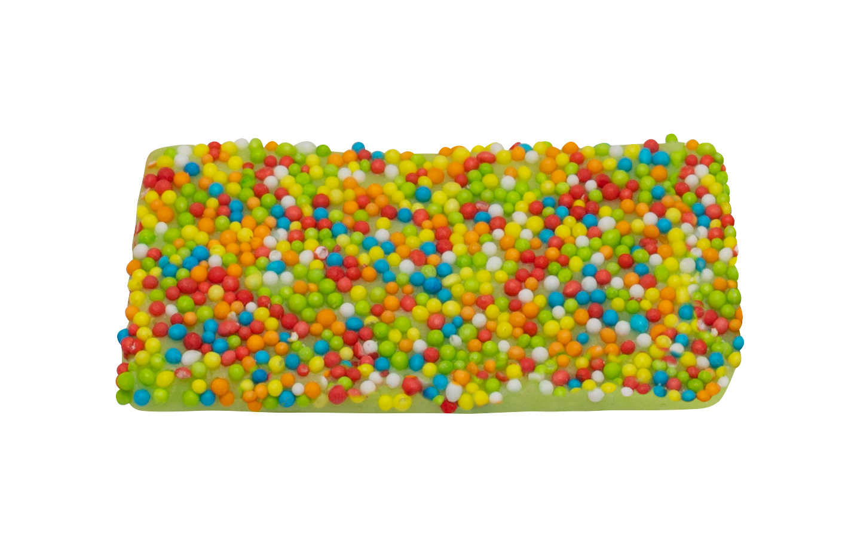
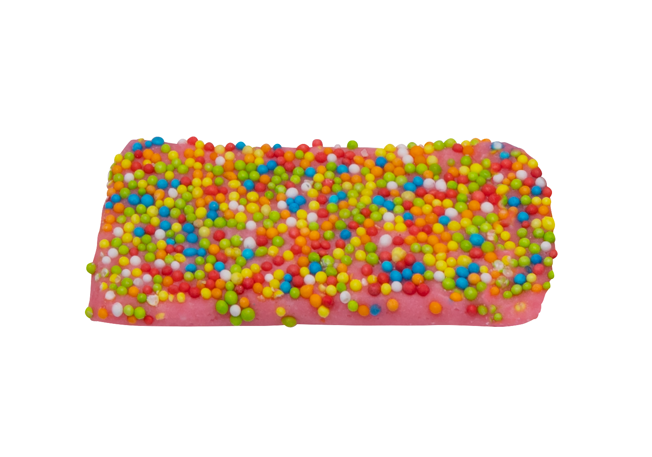
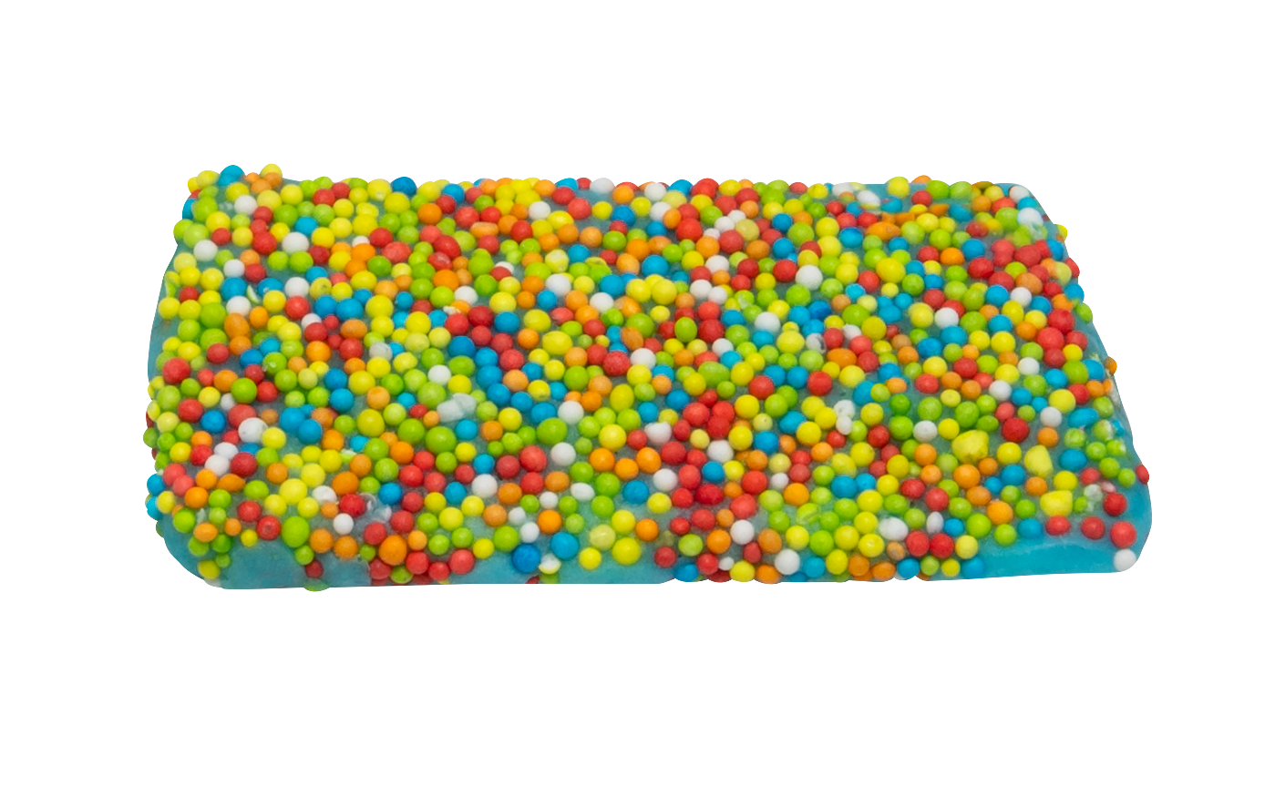
NEW!
48 ct SOUR TAFFY BITES FLOOR SHIPPER
Individually wrapped bite sized pieces of our sour Strawberry + Blue Raspberry + Green Apple , flavored taffy topped with crunchy candy bits
Item # 54000
3.5 oz (100g)
Unit Cost | $ 1.75
Case Cost | $ 84.00
Individually Wrapped
Case GTIN | 007-93216-54000-1
Unit UPC | 7-93216-53020-0
Case Dimensions | 47” L x 15.5” W x 9.5” H
Case Weight | 22.4 LBS
Case Cube | 4.00

