Slide 1
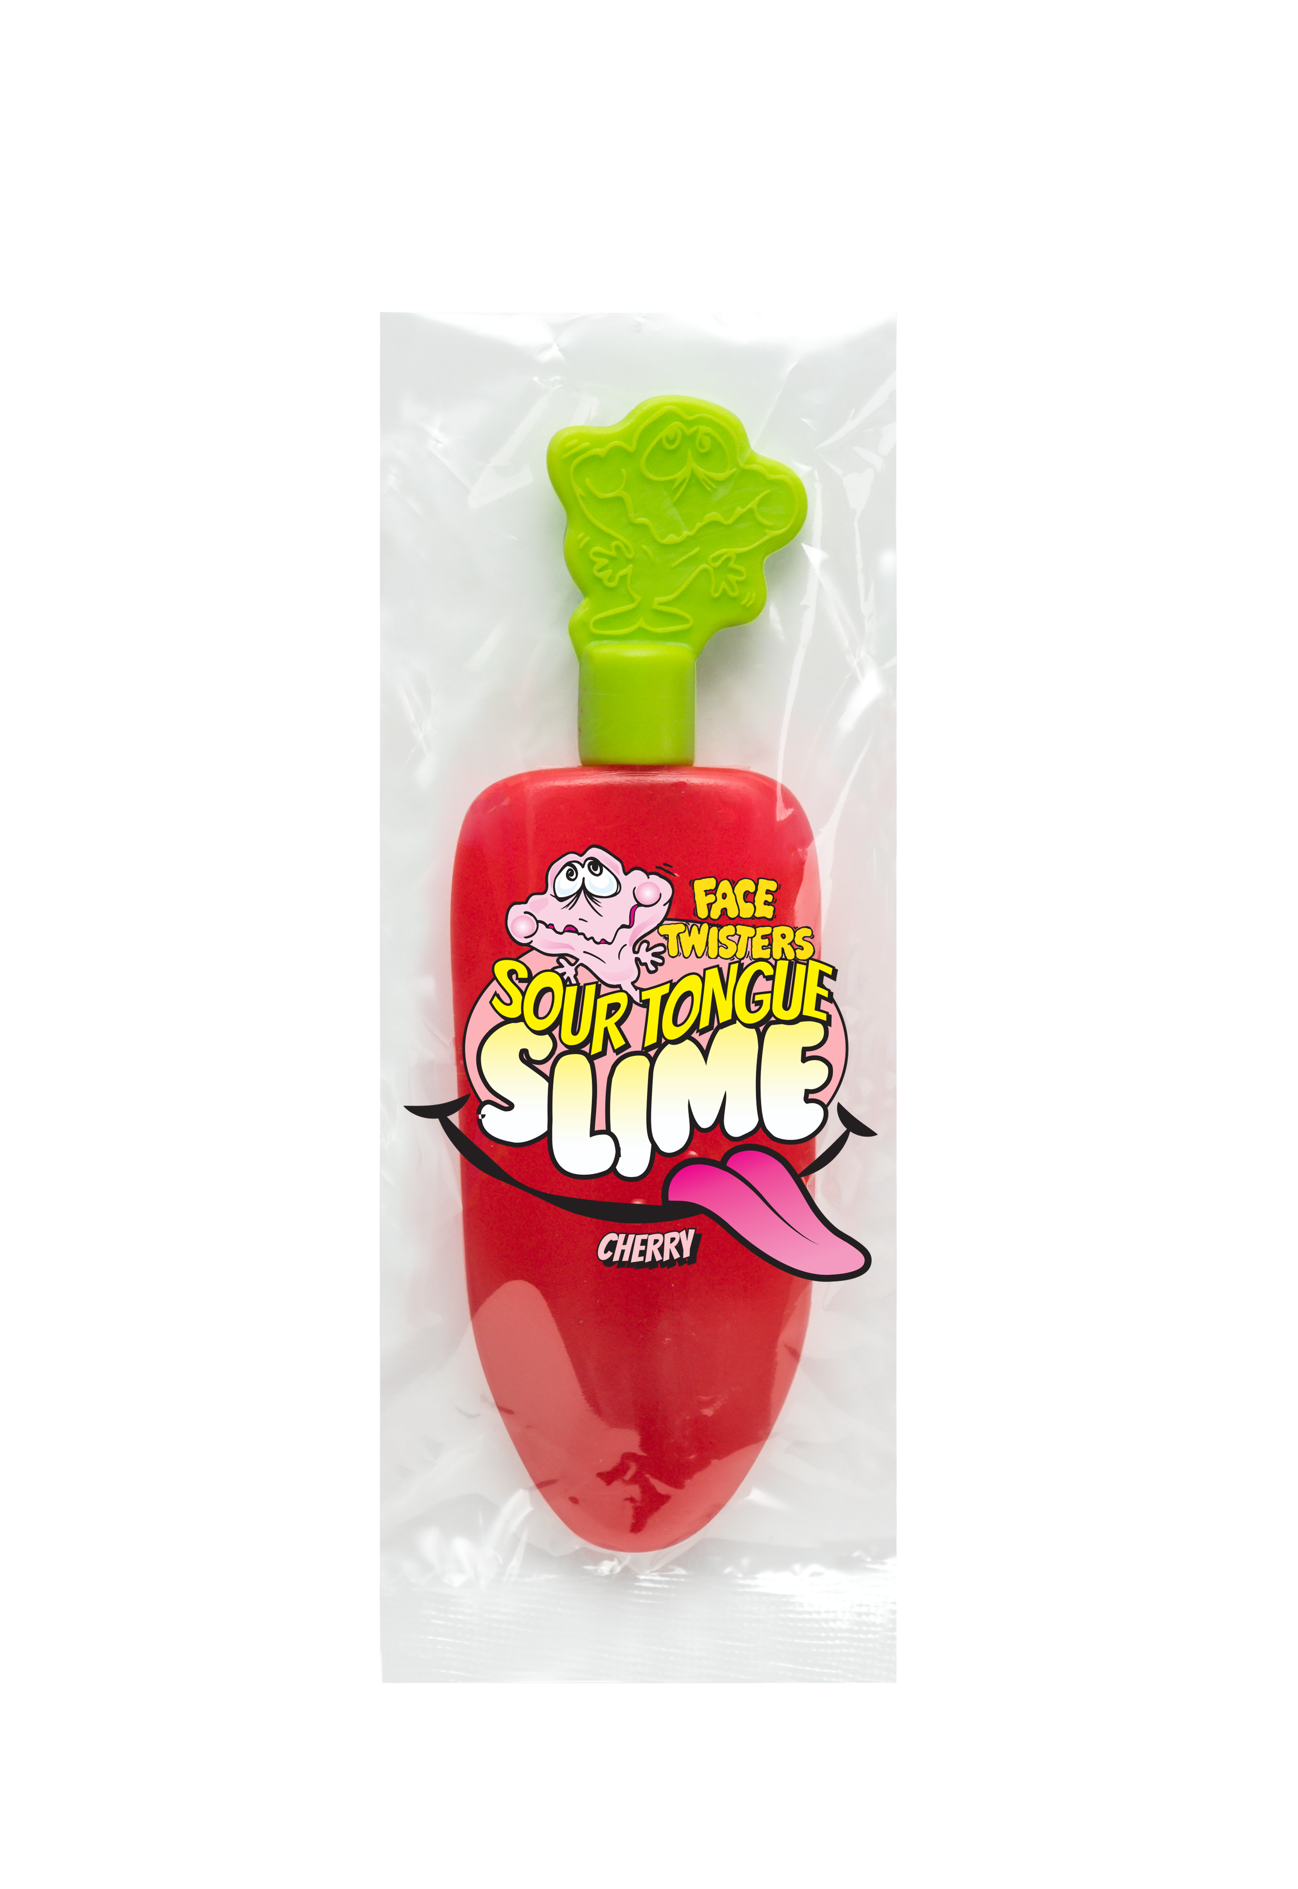
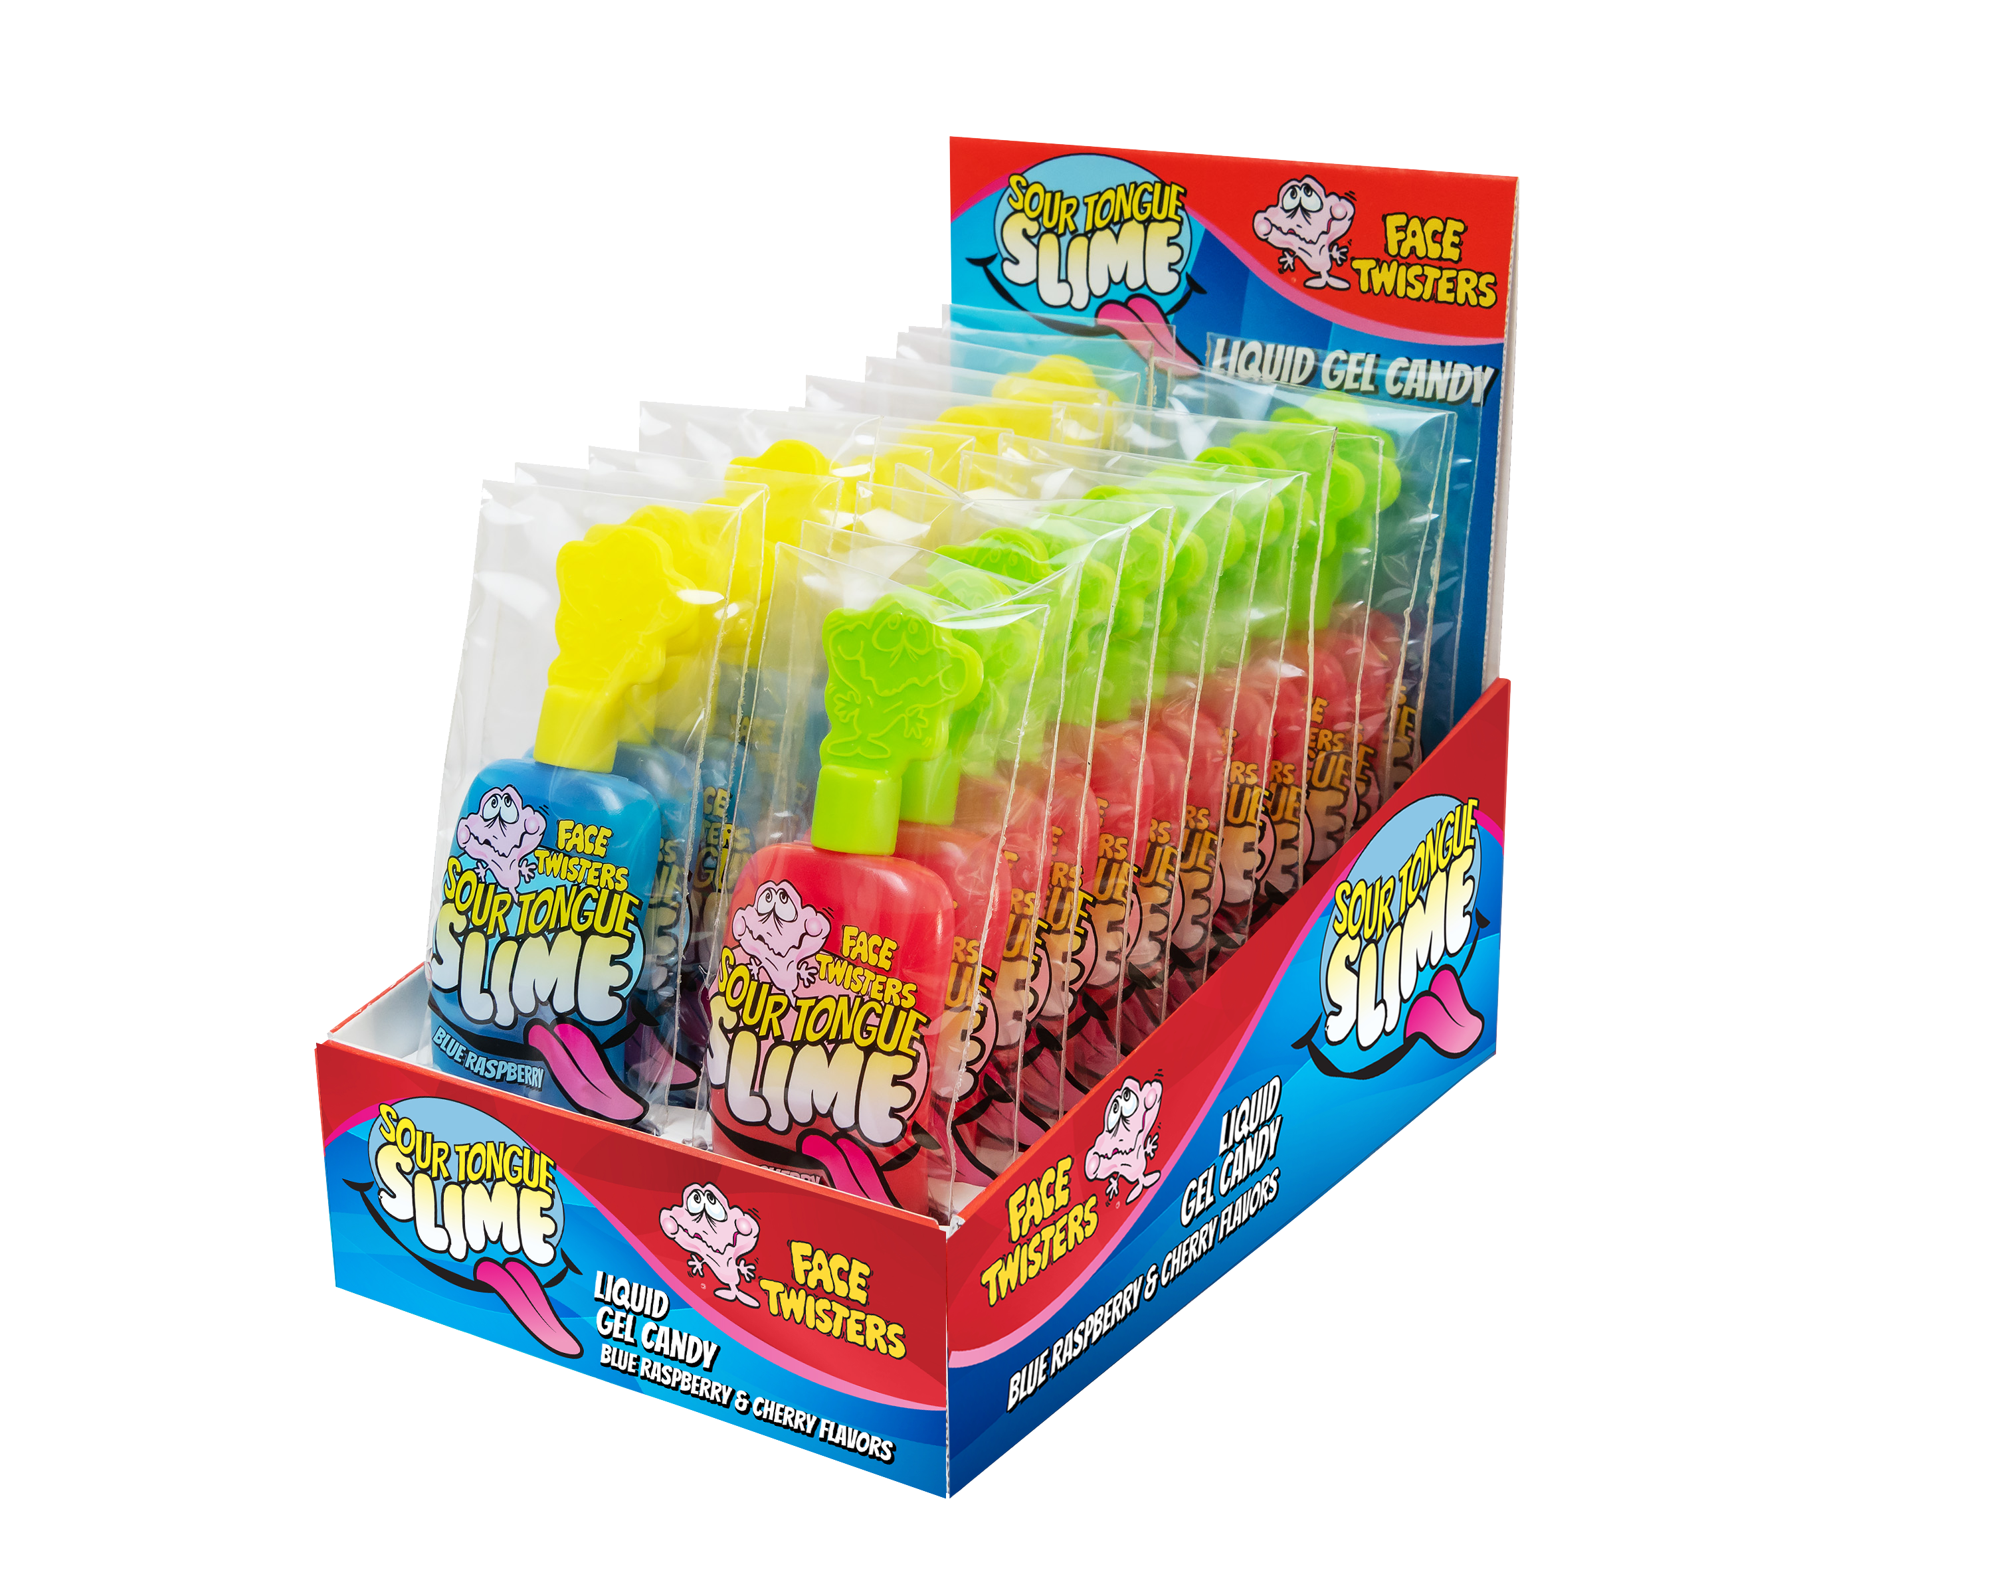
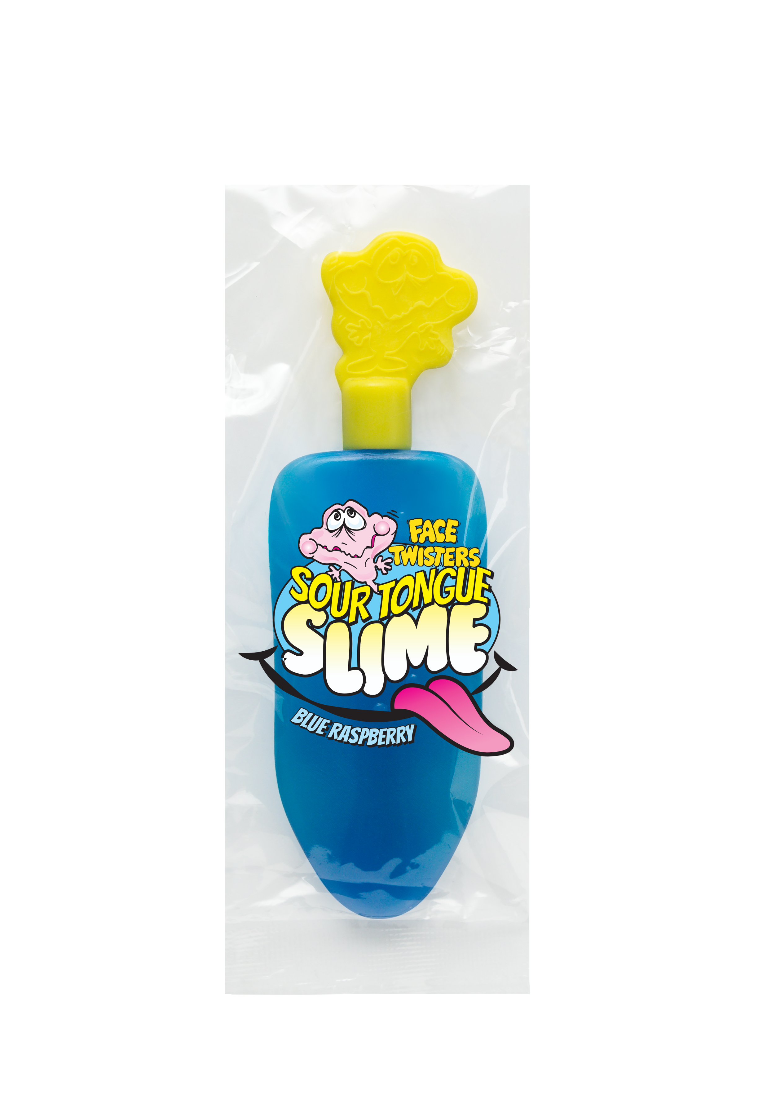
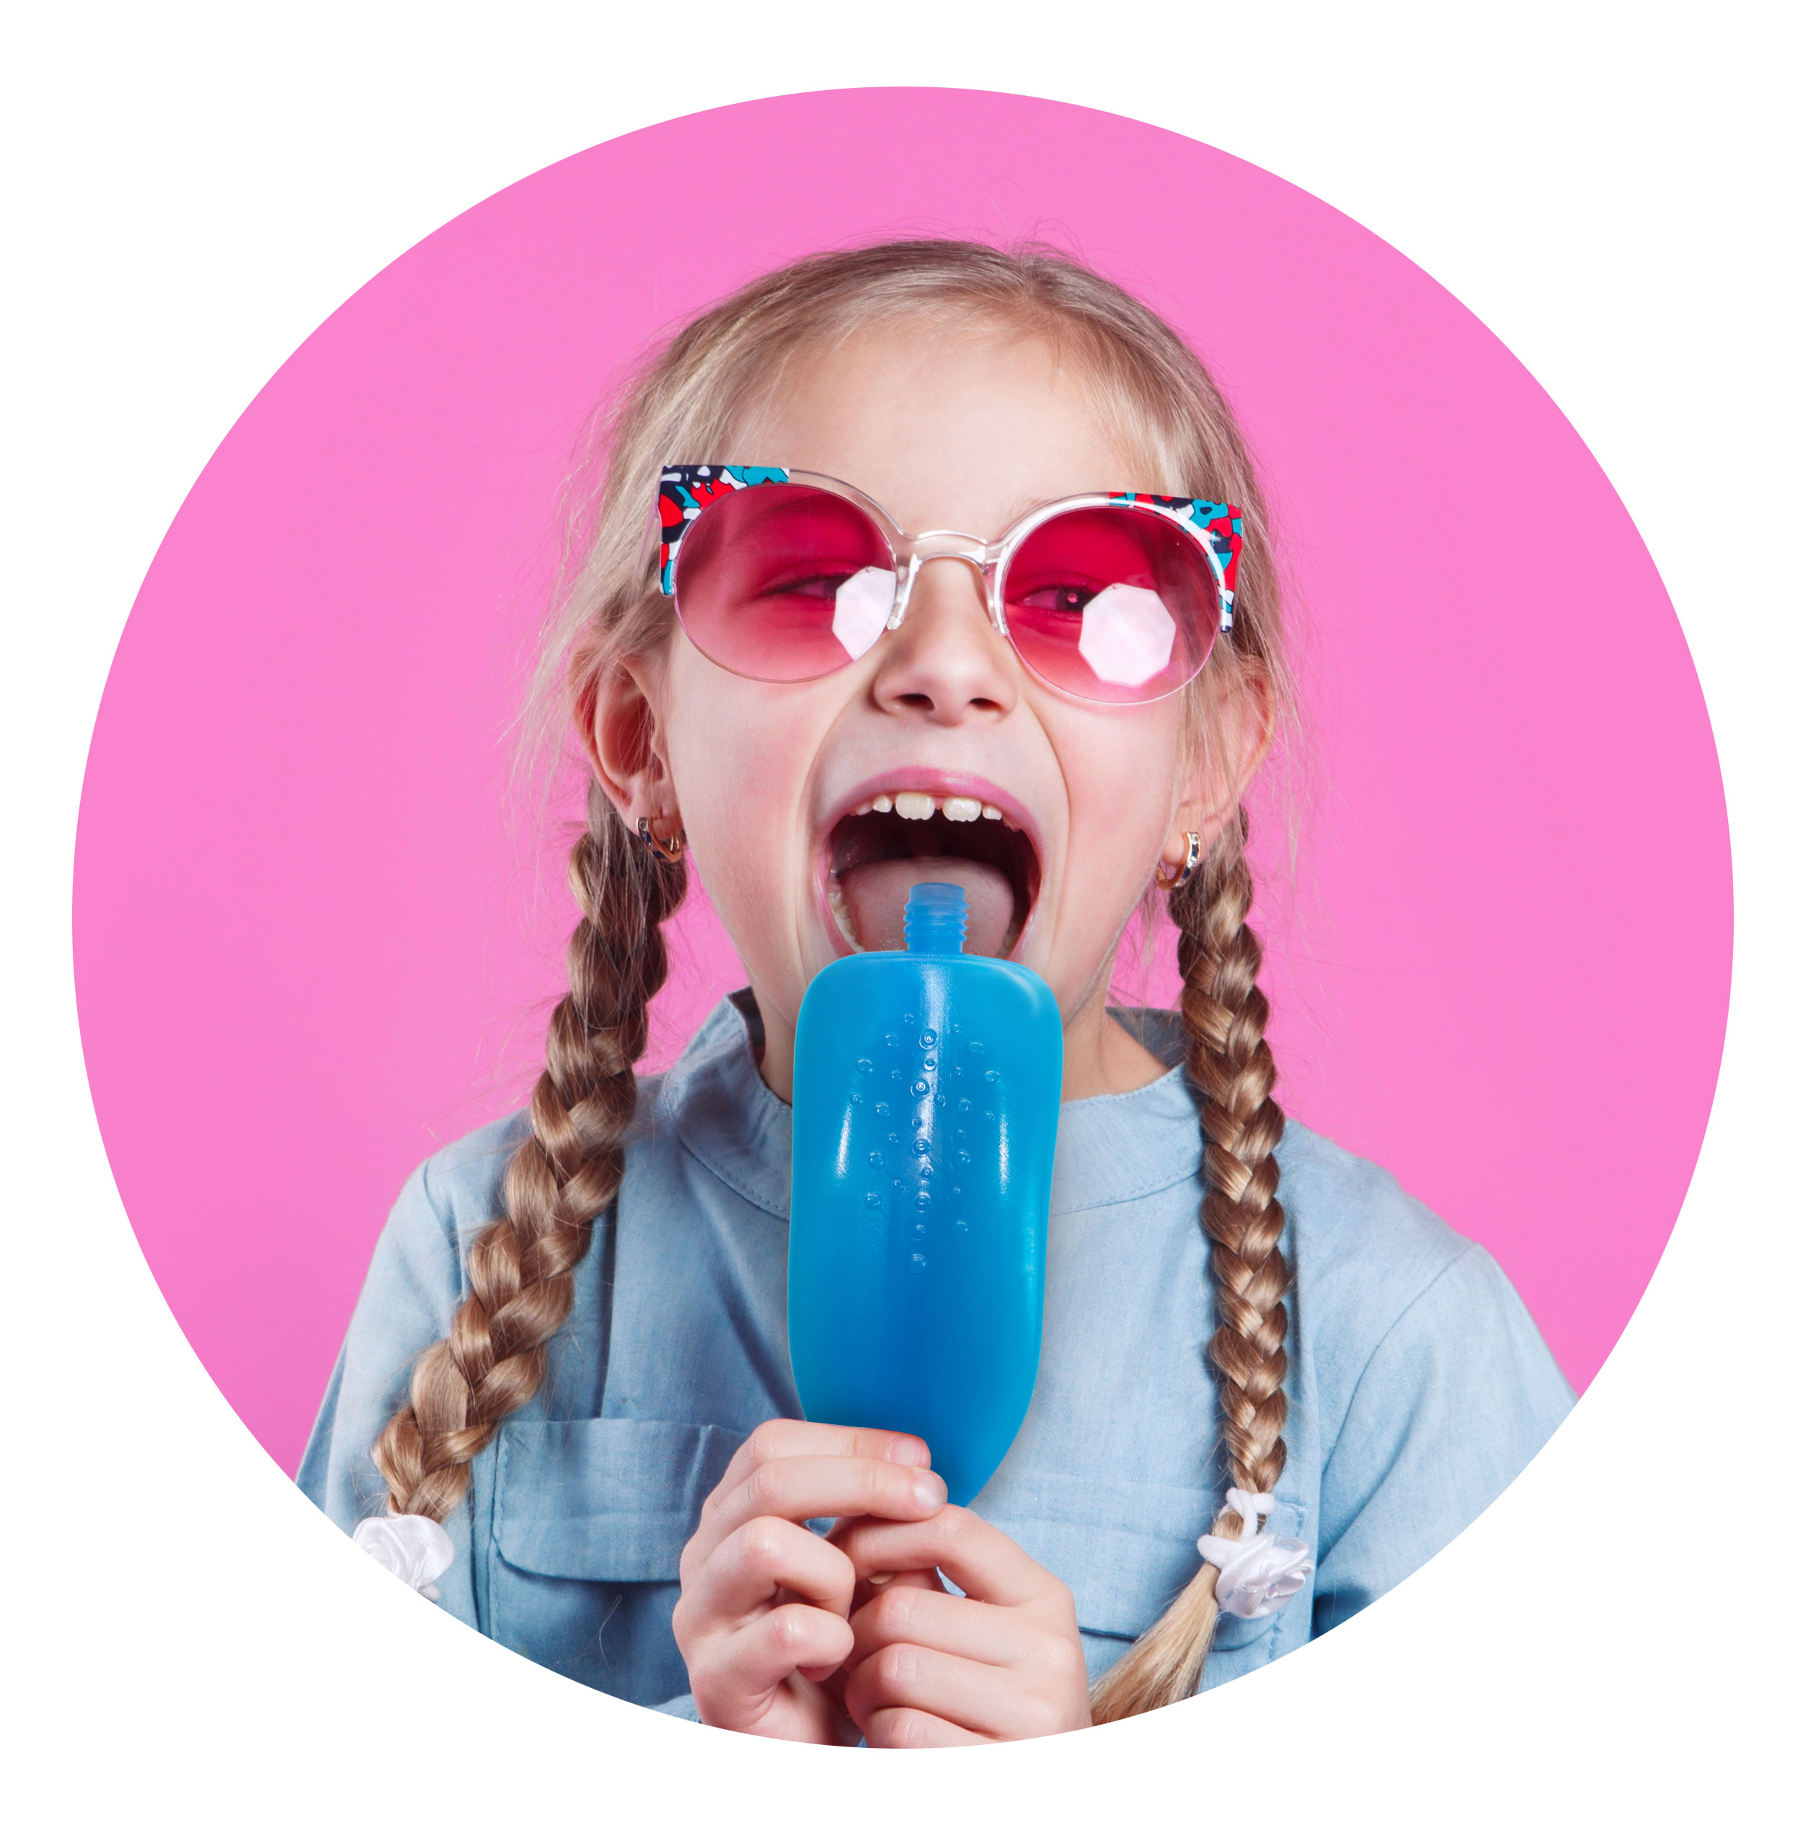
SOUR TONGUE SLIME™
BLUE RASPBERRY & CHERRY 6/24 ct Case
Item #: 16010
Sour liquid gel candy in a squeezable tongue shaped dispenser. Available in a combo display of Blue Raspberry + Cherry flavors.
Unit Cost | $ 1.37
Case Cost | $ 197.28
ITEM | UNIT UPC
Blue Raspberry Flavor Tongue Slime™ | 7-93216-16030-8
Cherry Flavor Tongue Slime™ | 7-93216-16030-8
Case GTIN | 007-93216-16010-0
Case Dimensions | 17.67” L x 17.51” W x 6.88” H
Case Weight | 20.4 lbs
Case Cube | 1.23

