Slide 1
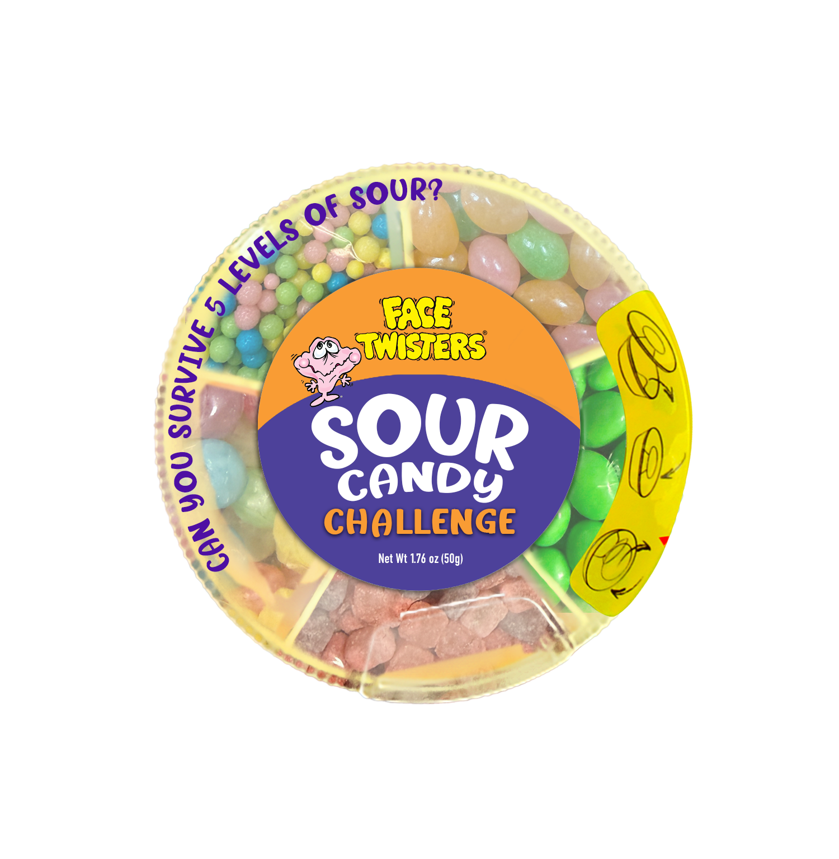
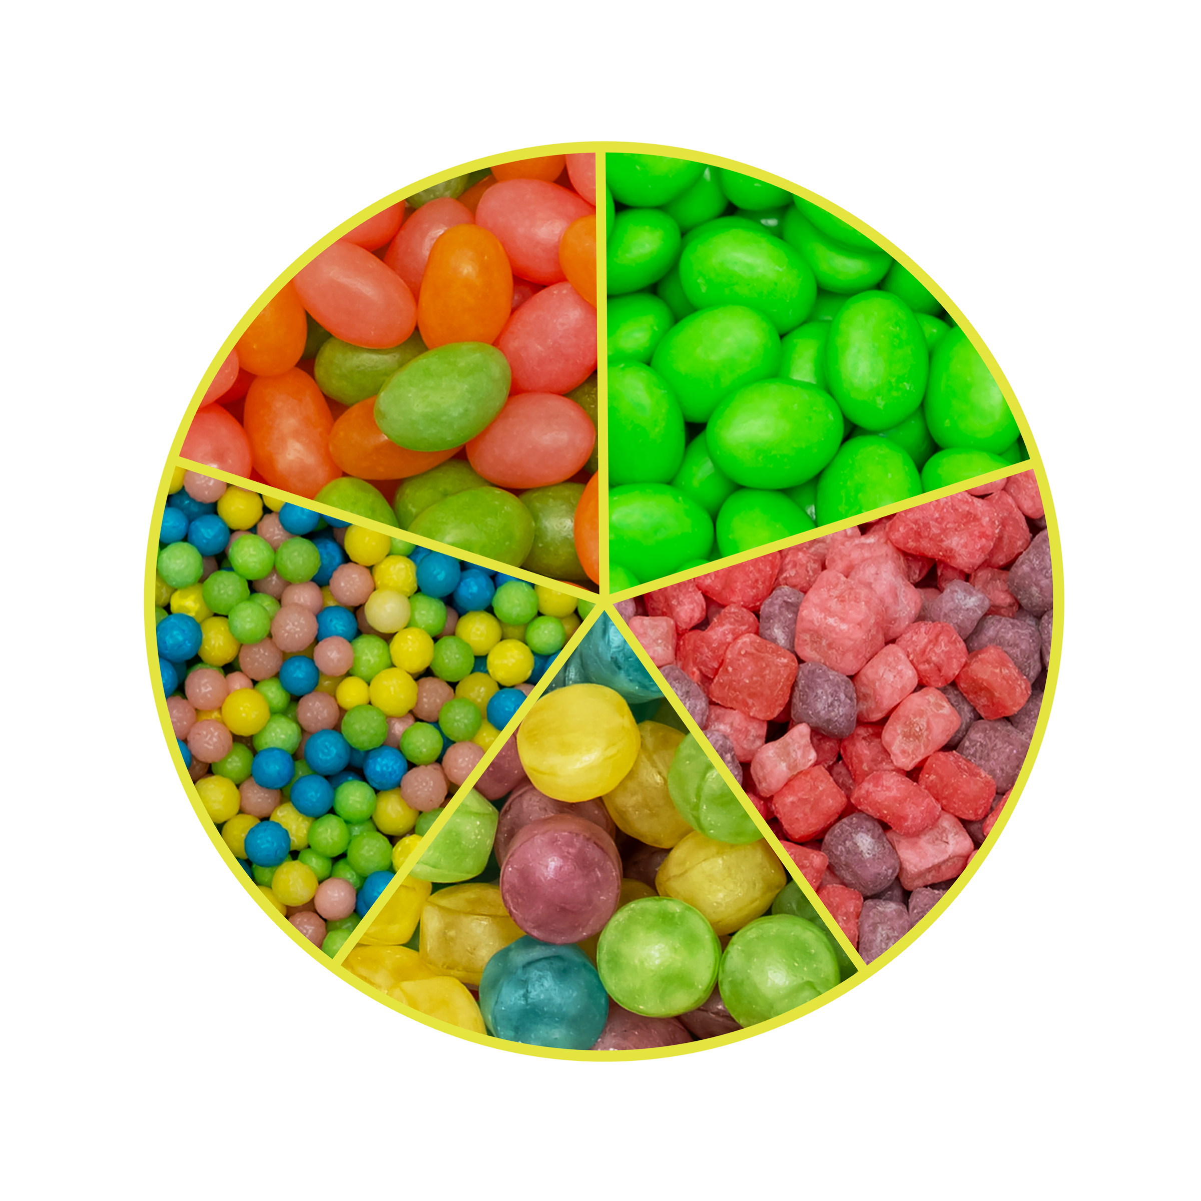
SOUR CANDY CHALLENGE
6 - 6 ct Case
NEW!
Fruit-flavored candy –
CAN YOU SURVIVE 5 LEVELS OF SOUR?
Item #18010
1.76 oz (50g)
Unit Cost | $ 1.25
Case Cost | $ 45.00
ITEM | UNIT UPC
Sour Candy Challenge | 7-93216-18030-6
Case GTIN | 007-93216-18010-8
Case Dimensions | 11.33” L x 8.19” W x 8.74” H
Case Weight | 8.1 lbs
Case Cube | 0.47

