Slide 1
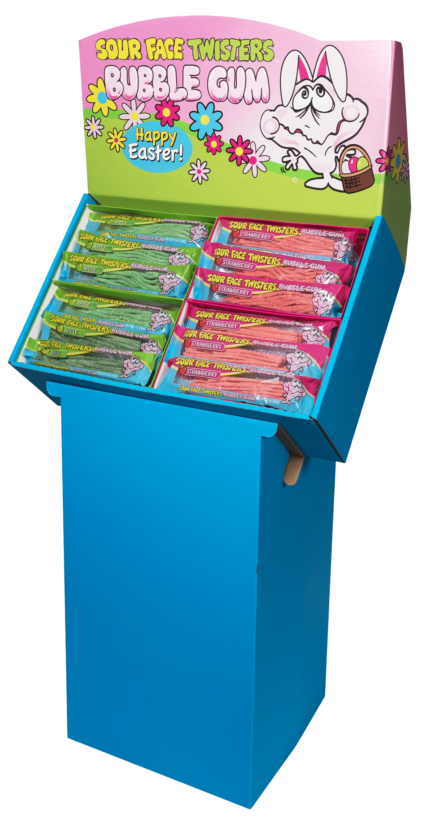
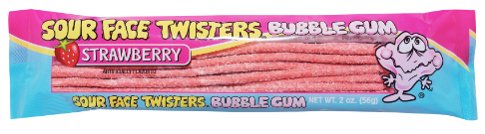
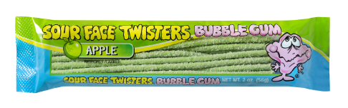
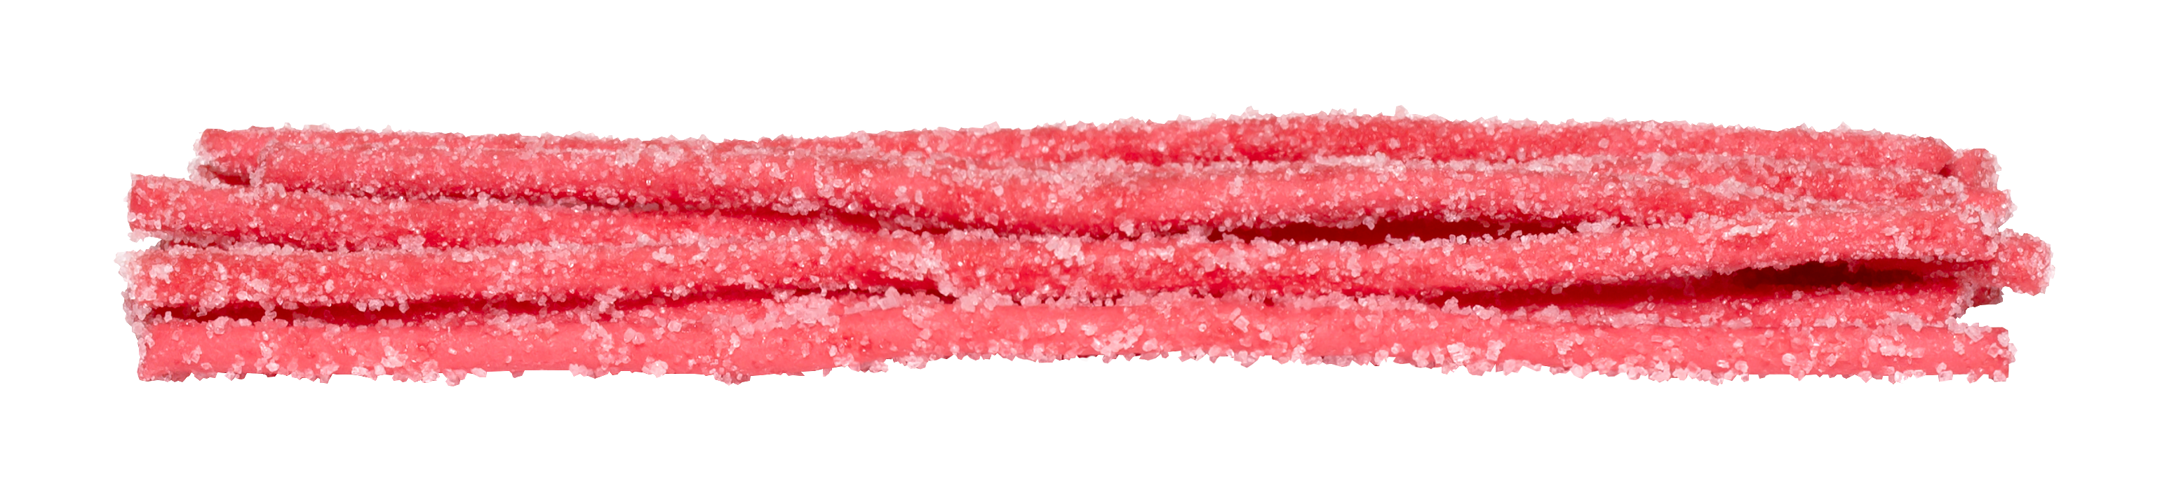
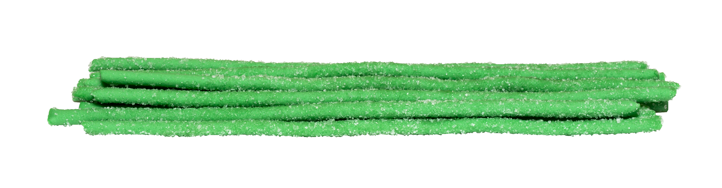
96 ct EASTER BUBBLE GUM STRAW SHIPPER
Item # 04220
Contains:
48 units Bubble Gum Straws Strawberry
48 units Bubble Gum Straws Green Apple
Unit Cost | $ 1.10
Case Cost | $ 105.60
Seasonal Order Deadline: October 7th 2026
ITEM | UNIT UPC
Strawberry | 7-93216-04120-1
Green Apple | 7-93216-04121-8
Case GTIN | 007-93216-04220-8
Case Dimensions | 16.42” L x 8.62” W x 22.68” H
Case Weight | 18.3 LBS
Case Cube | 1.86

