Slide 1
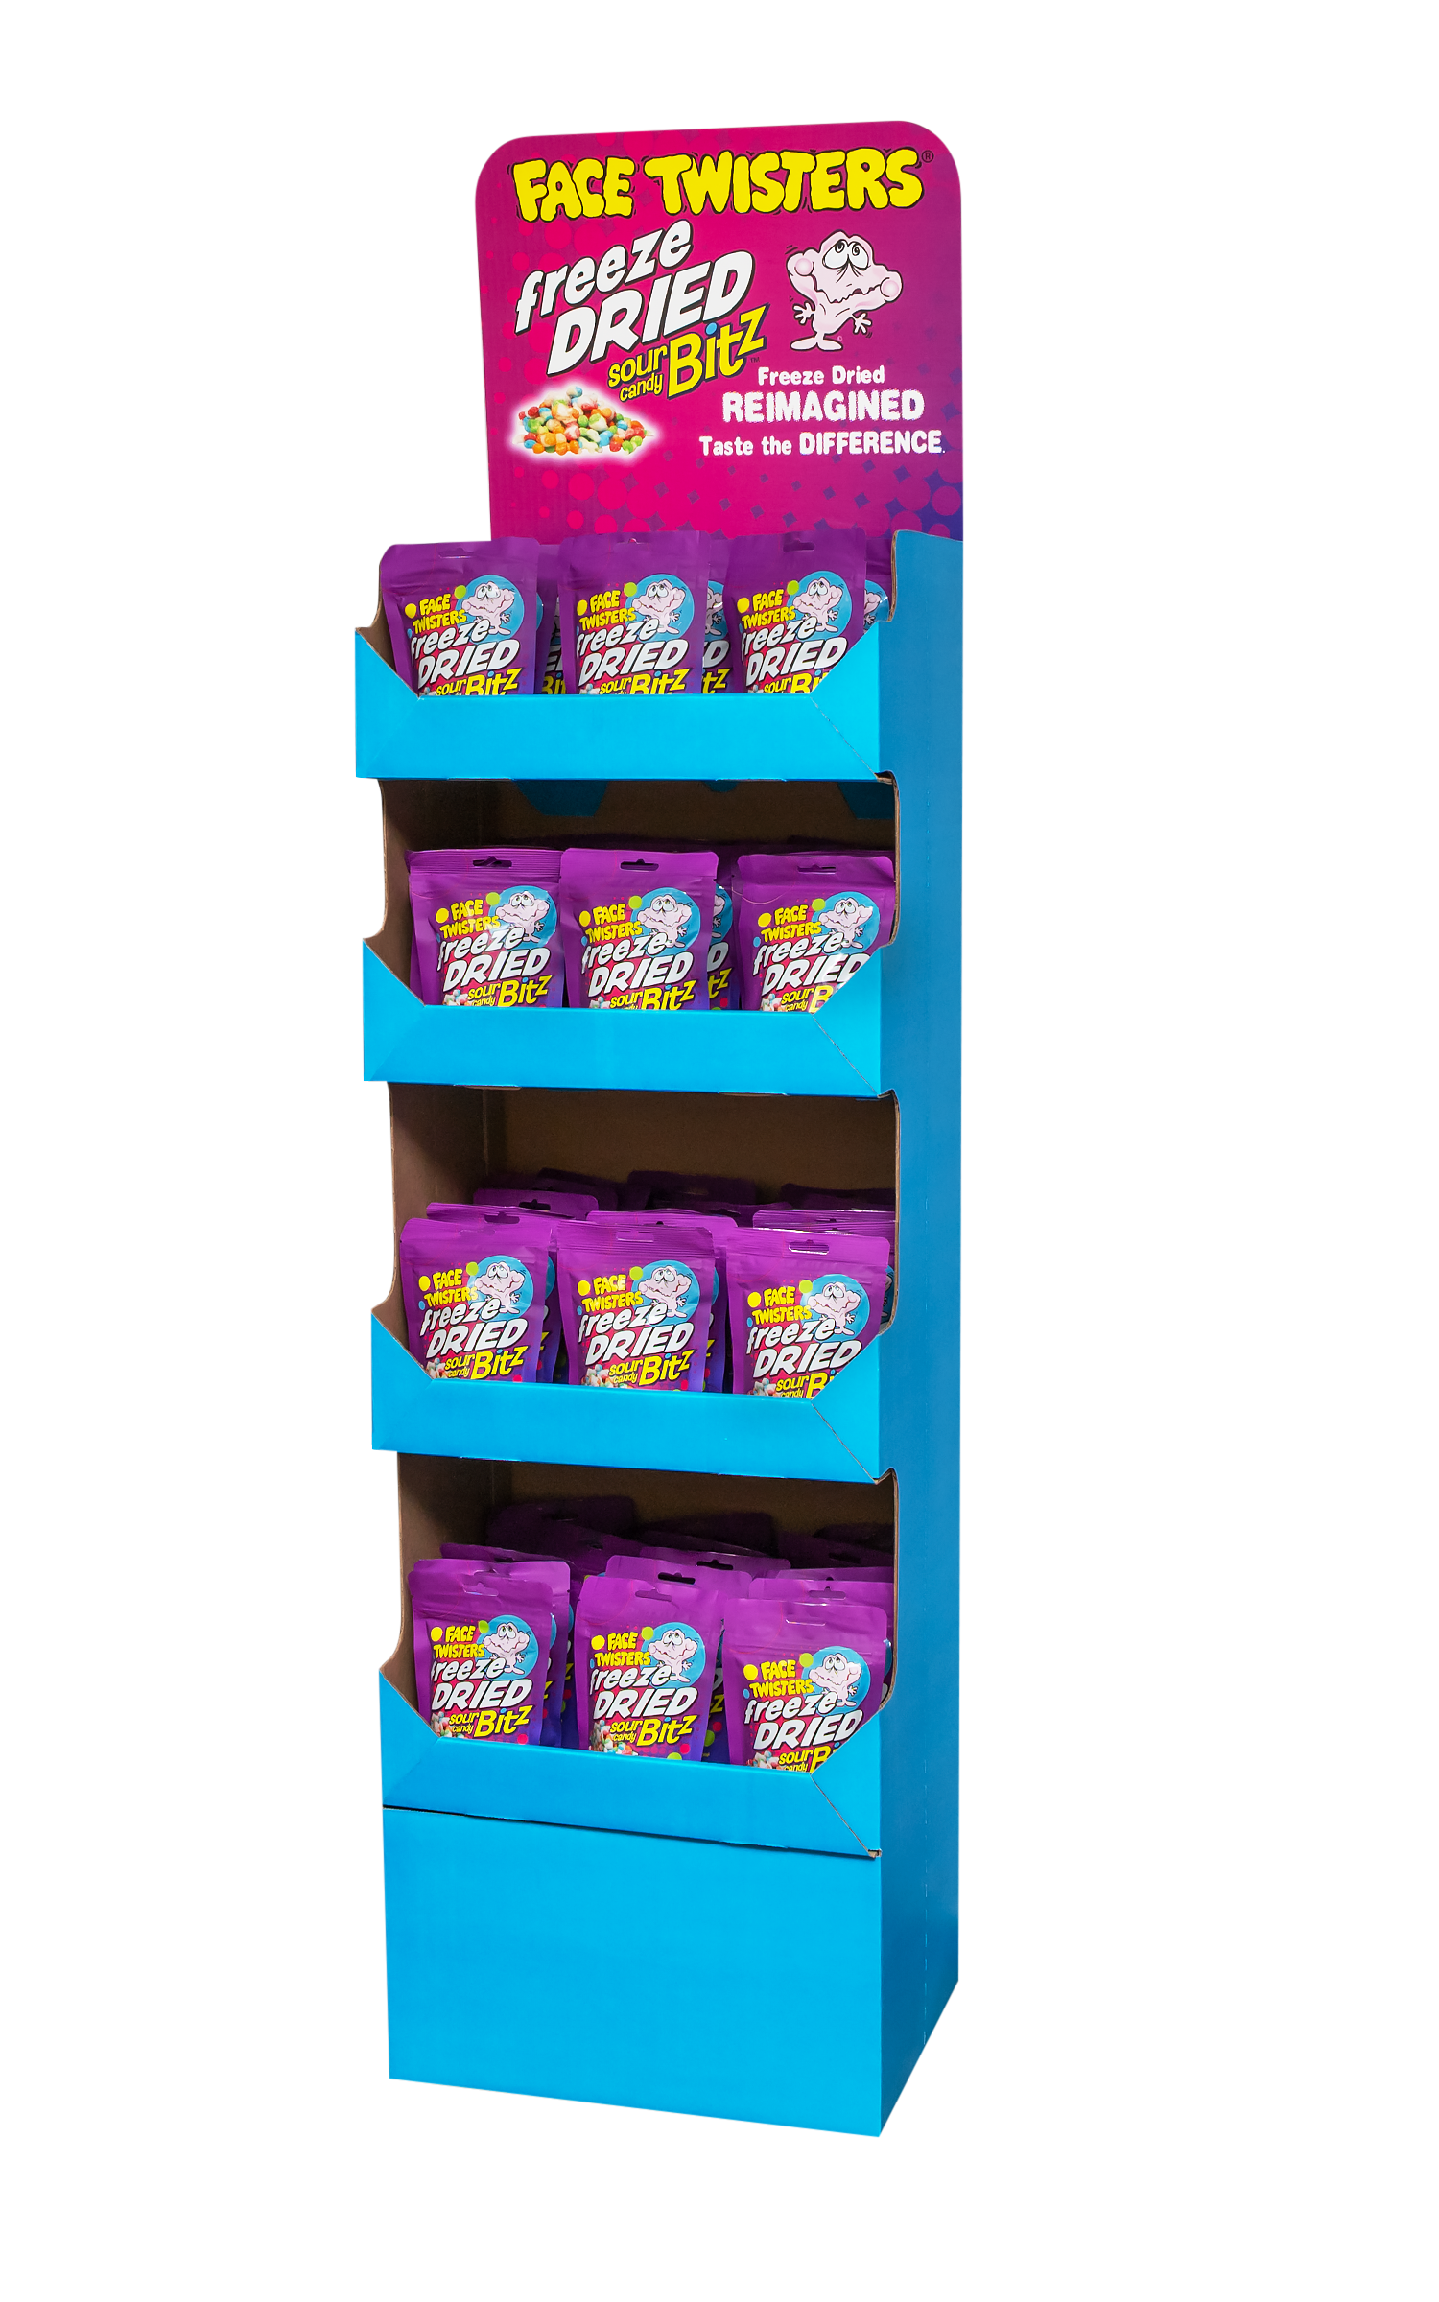
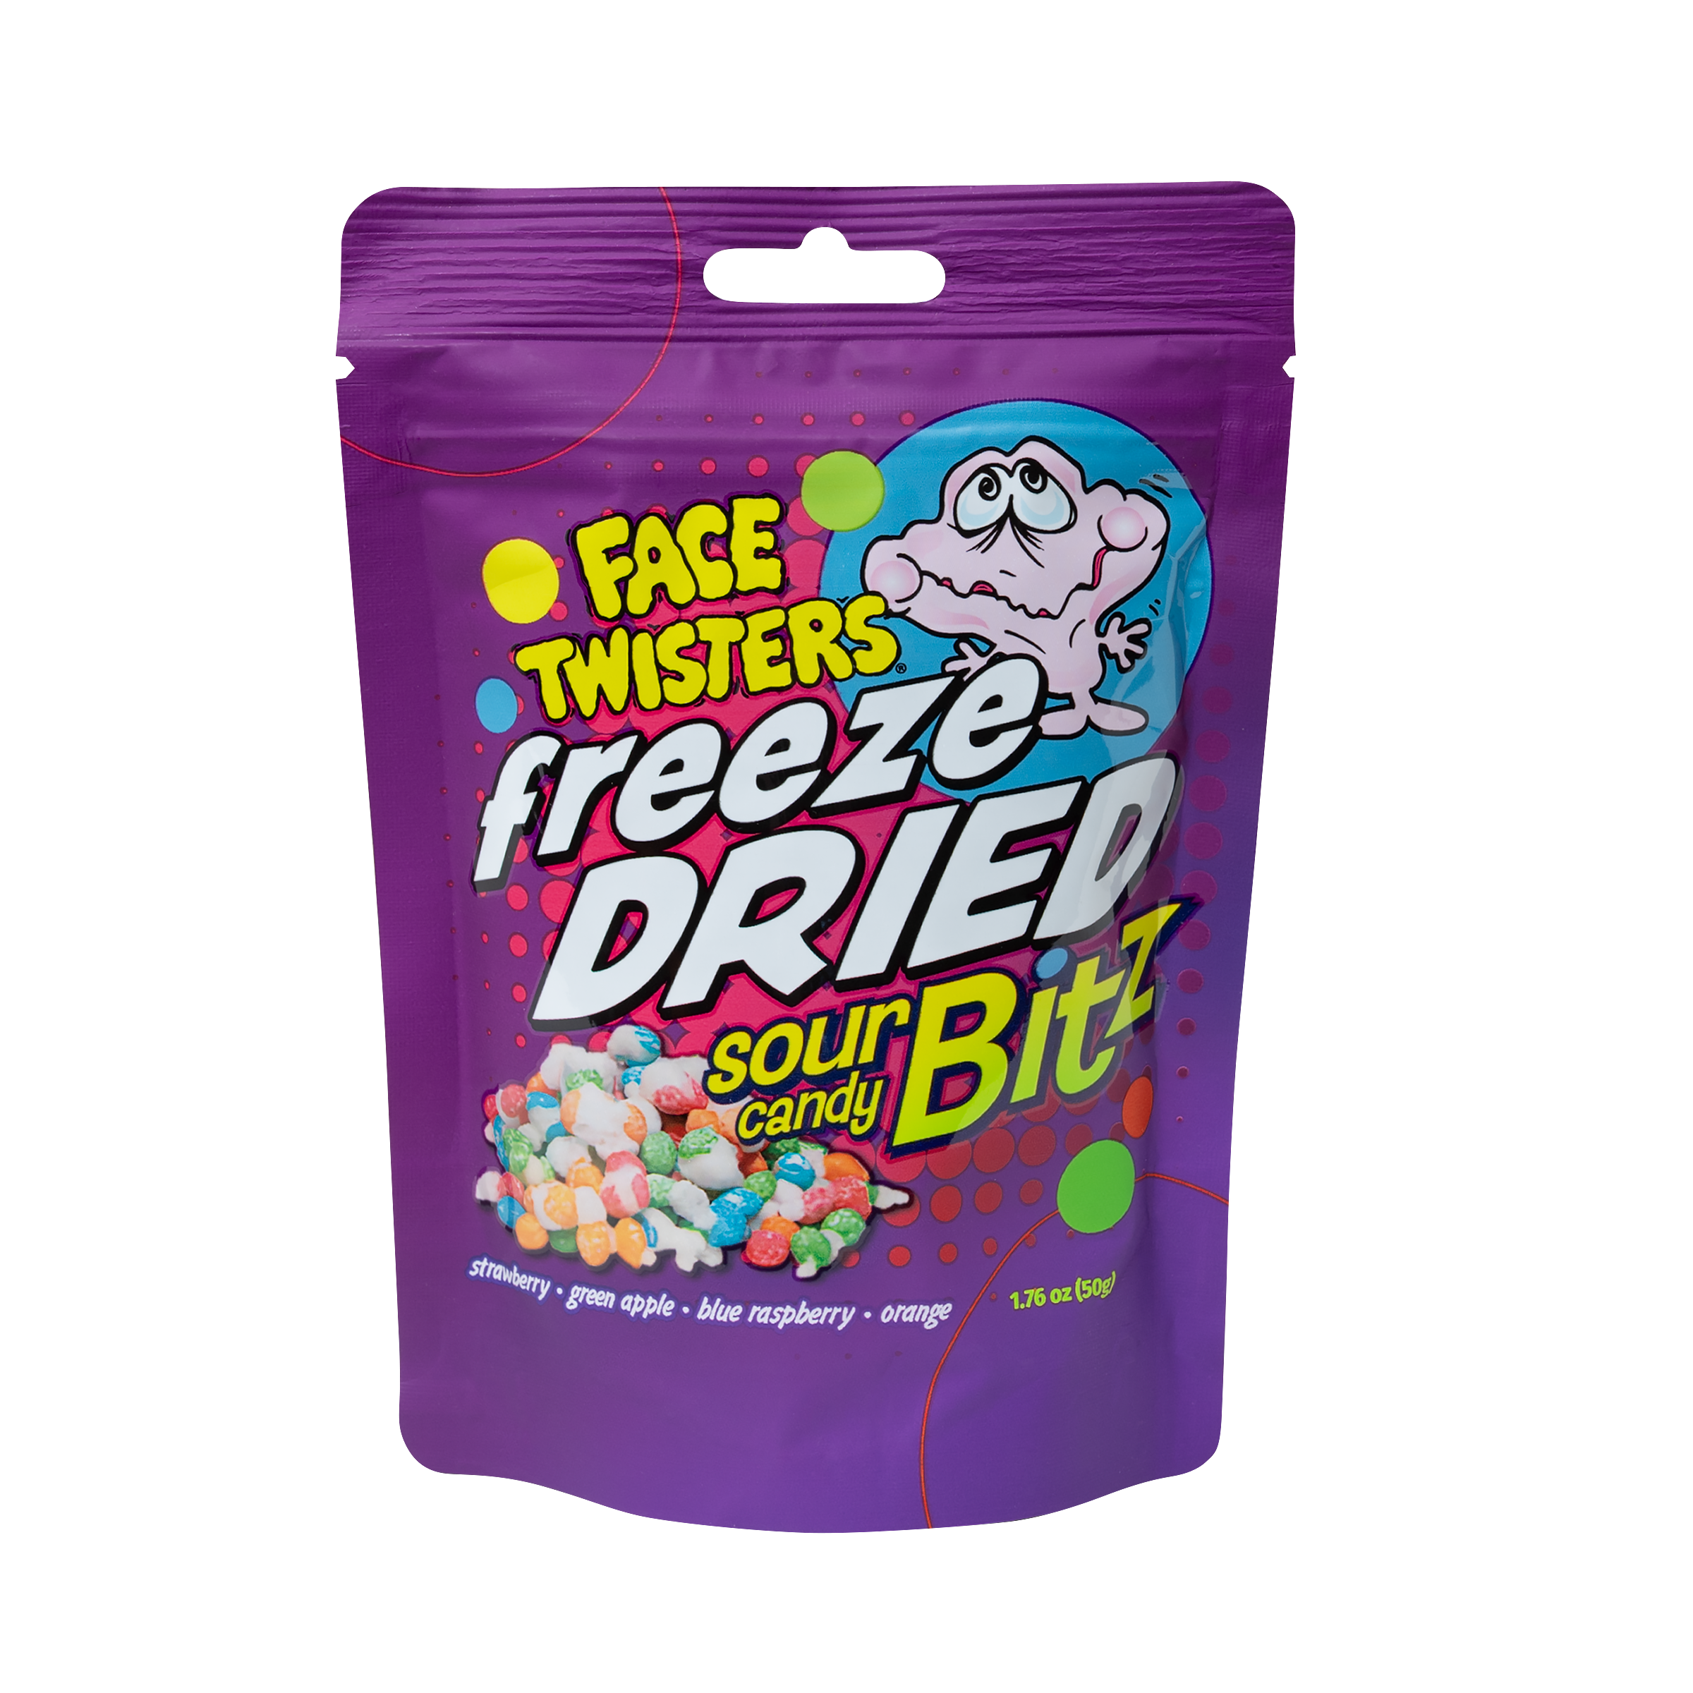
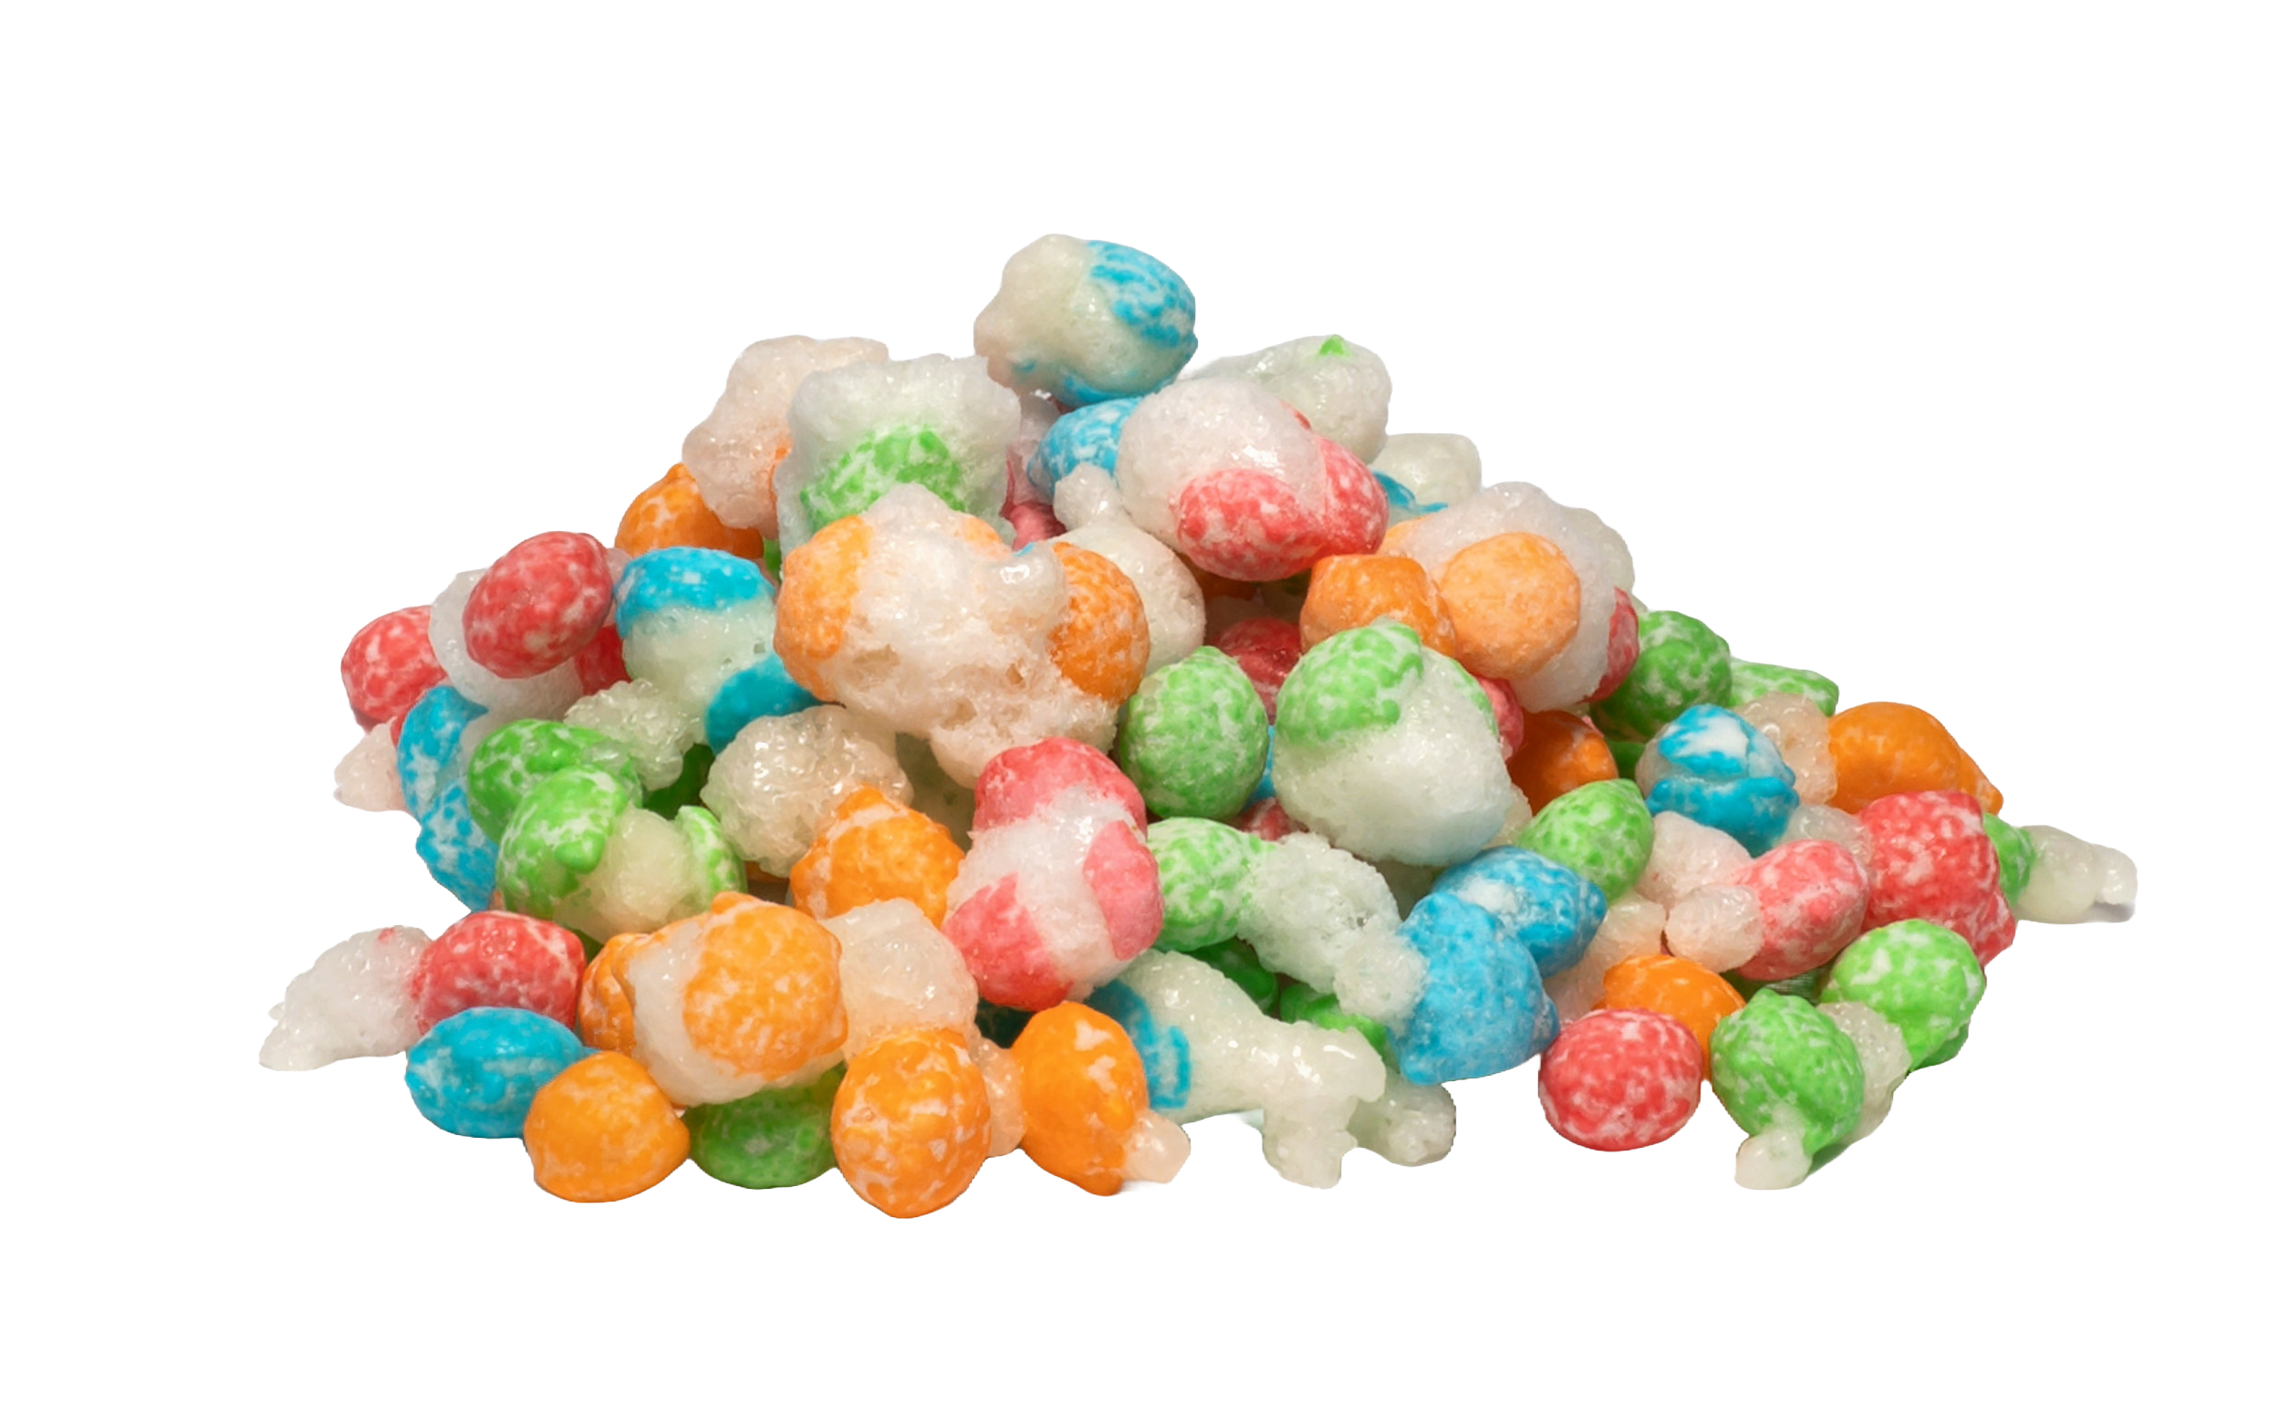
NEW!
60 ct FREEZE DRIED SOUR CANDY BITZ™ FLOOR SHIPPER
Item # 34010
1.76 oz (50g)
Freeze Dried Sour Candy Bitz™ in Strawberry + Green Apple + Blue Raspberry + Orange
Unit Cost | $ 2.19
Case Cost | $131.40
Freeze Dried Reimagined. Taste the Difference!
Case GTIN | 007-93216-34010-6
Unit UPC | 7-93216-31030-7
Case Dimensions | 47” L x 15.5” W x 9.5” H
Case Weight | 16.65 LBS
Case Cube | 4.00

