Slide 1
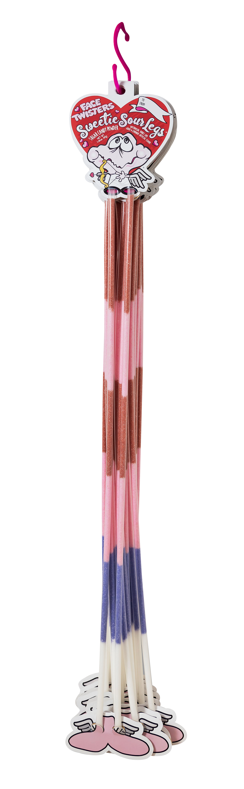
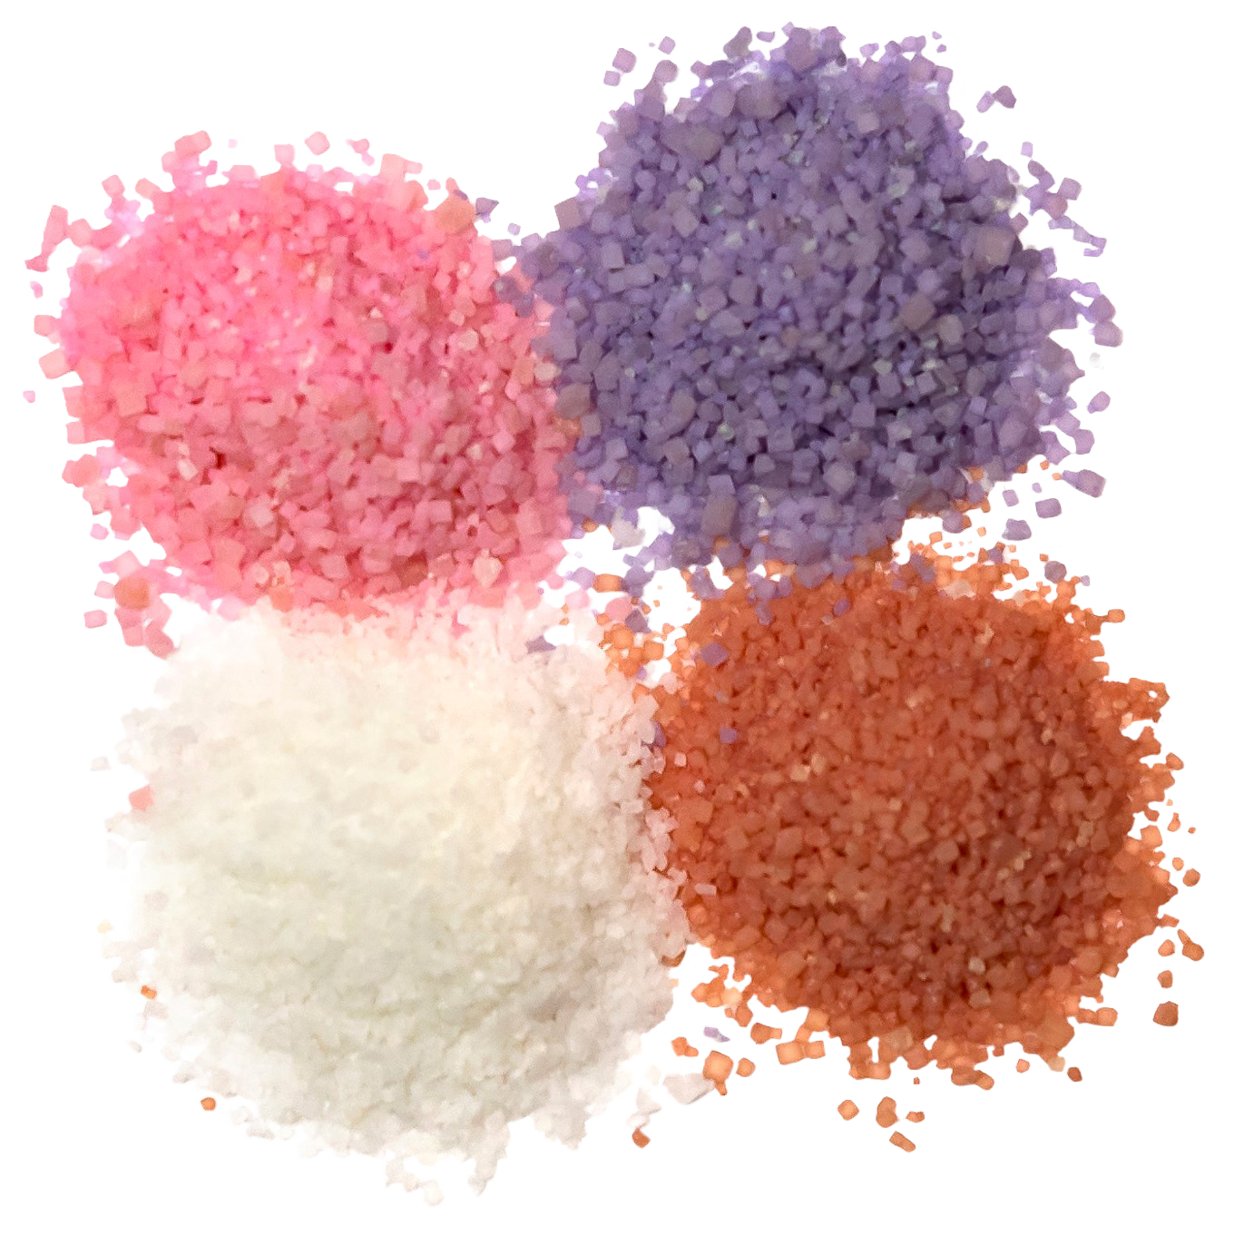
Over 7 million units sold
SWEETIE SOUR LEGS®
2/12 ct “S” Hooks
Fruit-Flavored Sour Powder Straws in 4 assorted flavors
Item # 07300
1.66 oz (44g)
Unit Cost | $ 1.10
Case Cost | $ 26.40
Seasonal Order Deadline August 10, 2025
ITEM | UNIT UPC
Sweetie Sour Legs® | 7-93216-07320-2
Case GTIN | 007-93216-07300-4
Case Dimensions | 35.24” L x 5.29: W x 3.44” H
Case Weight | 3.83 LBS
Case Cube | 0.37

