Slide 1
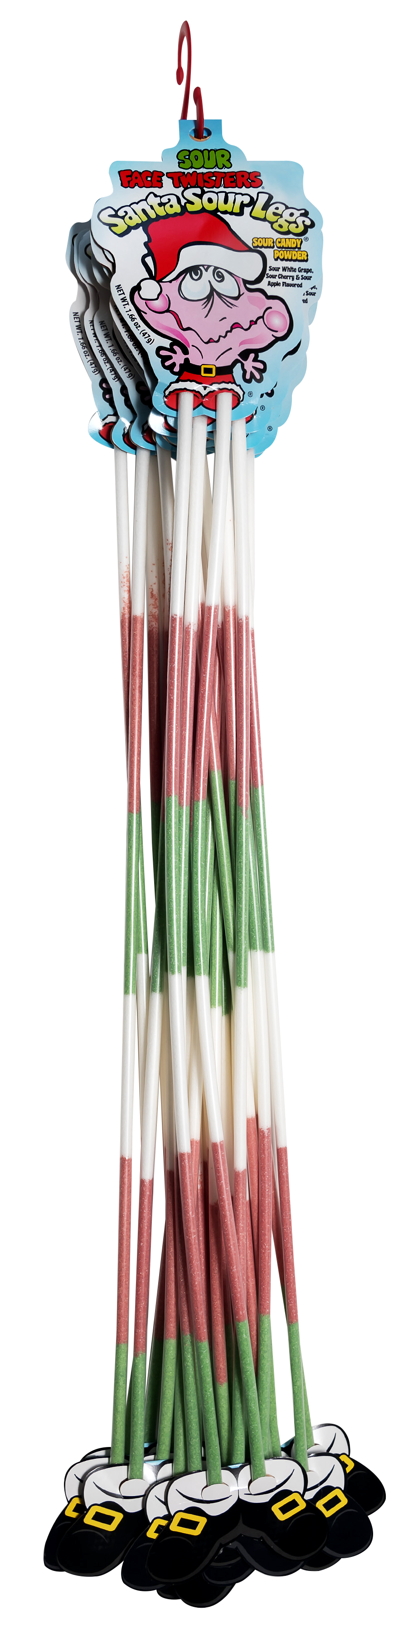
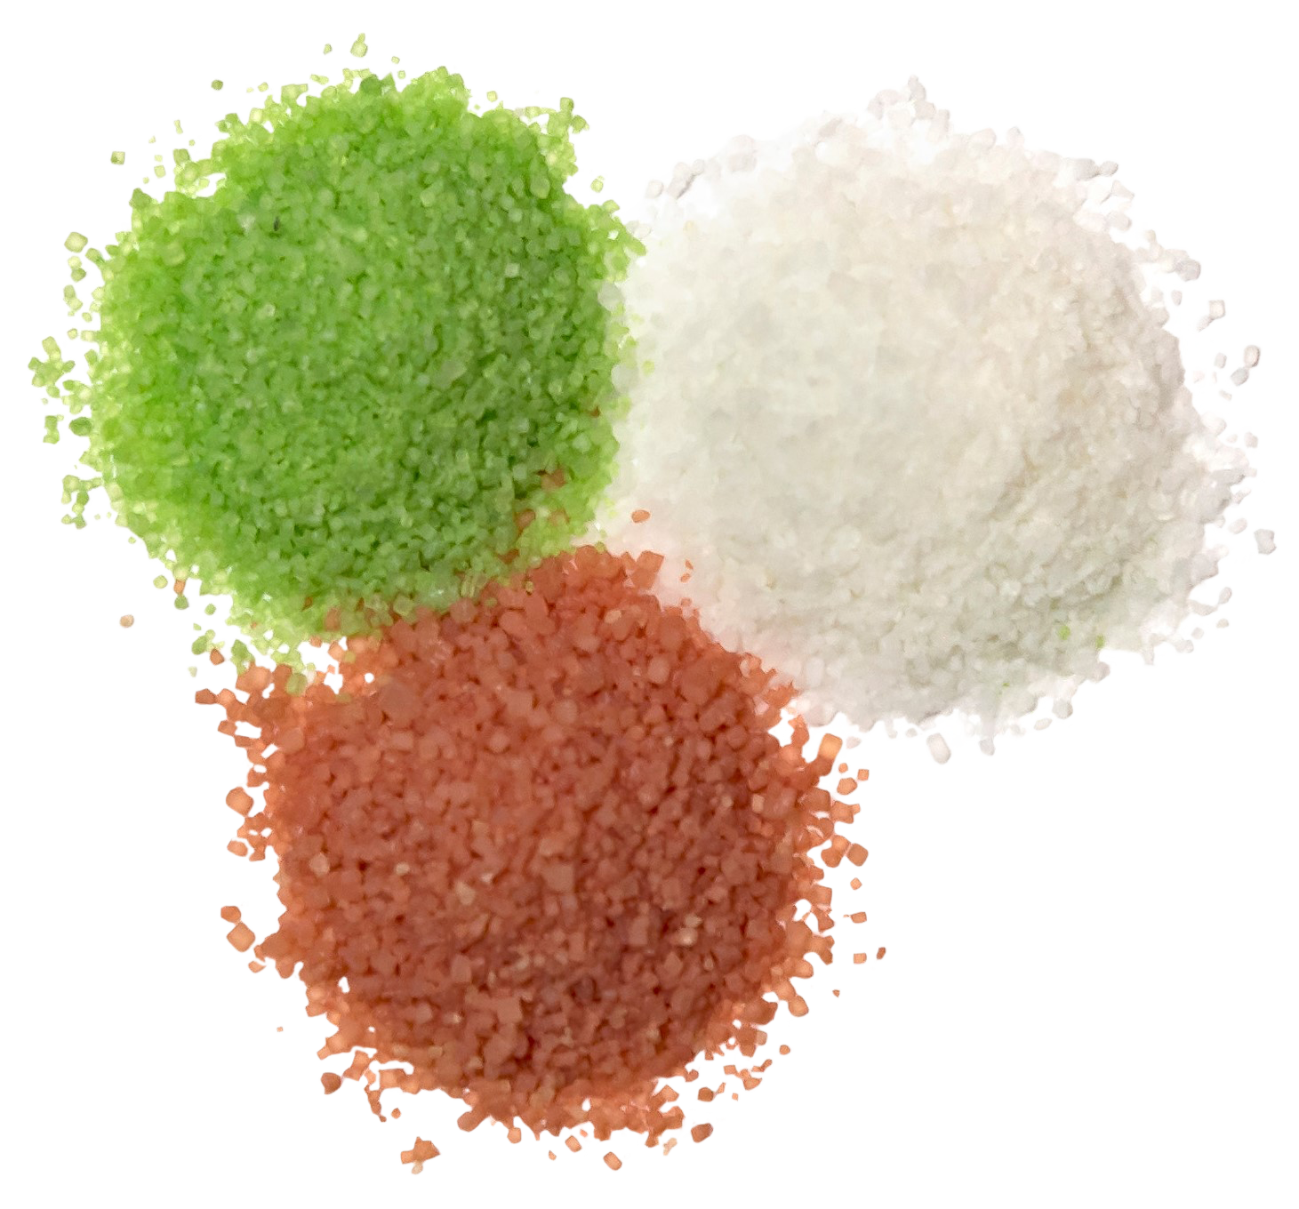
Over 7 million units sold
SANTA SOUR LEGS®
2/12 ct “S” Hooks
Fruit-Flavored Sour Powder Straws in Sour White Grape, Cherry and Green Apple
Item #07070
1.66 oz (44g)
Unit Cost | $ 1.10
Case Cost | $ 26.40
Seasonal Order Deadline: June 22, 2026
ITEM | UNIT UPC
Santa Sour Legs® | 7-93216-07090-4
Case GTIN | 007-93216-07070-6
Case Dimensions | 35.24” L x 5.29: W x 3.44” H
Case Weight | 3.83 LBS
Case Cube | 0.37

