Slide 1
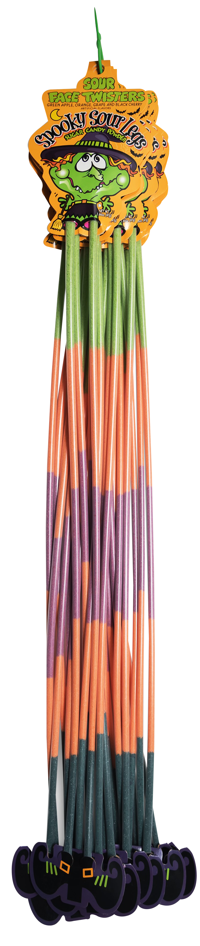
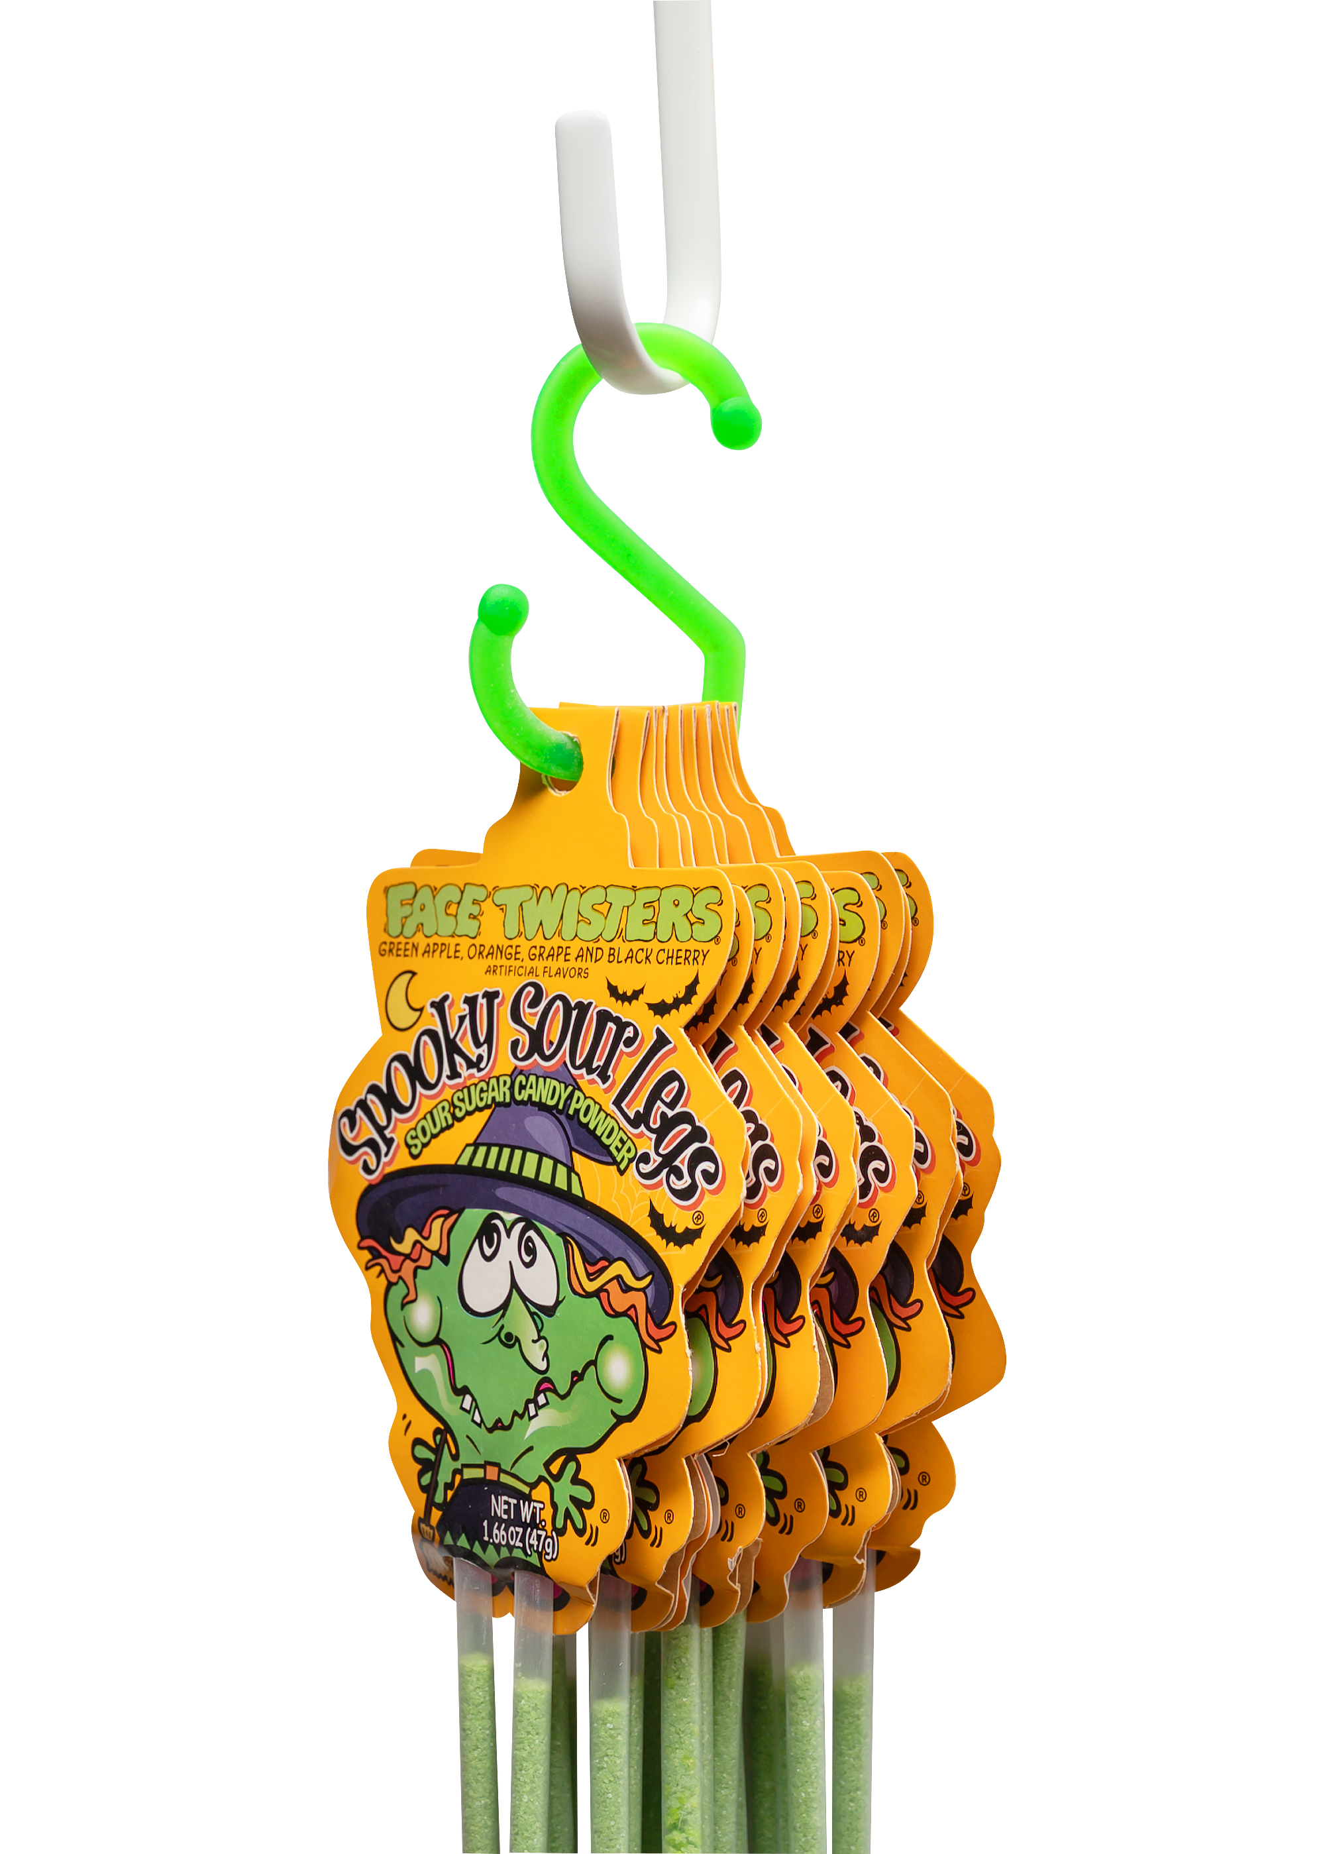
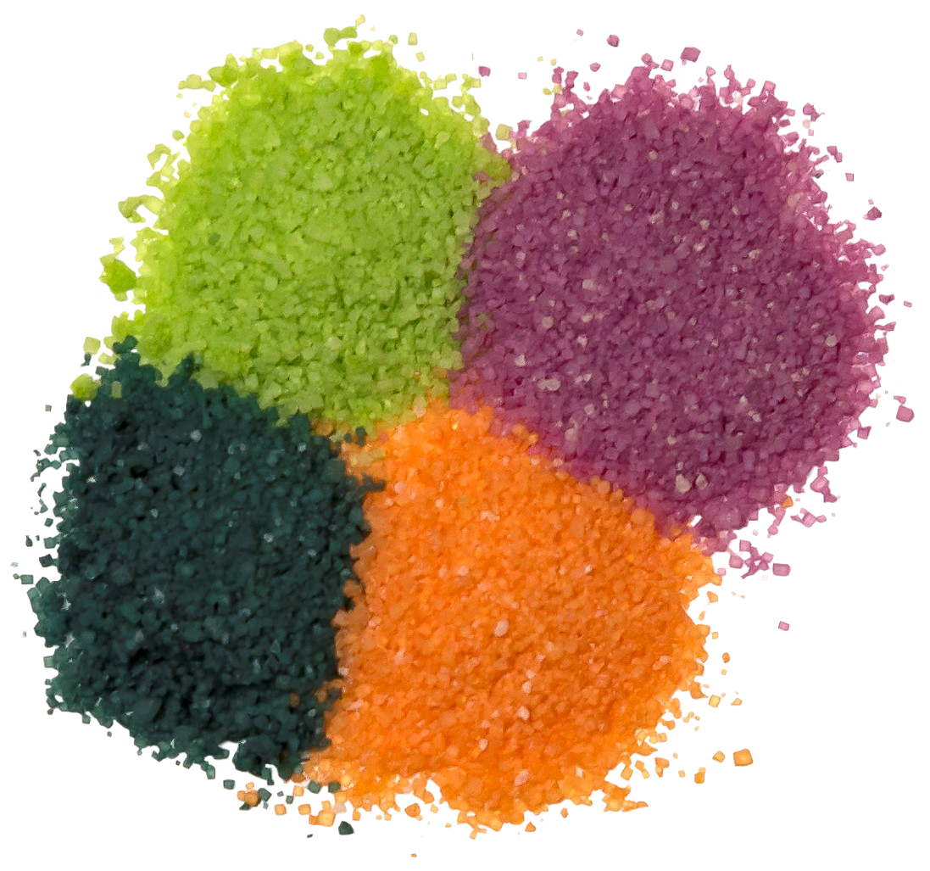
SPOOKY SOUR LEGS®
2/12 ct “S” Hooks
Over 7 million units sold
​Fruit-Flavored Sour Powder Straws in 4 Assorted Flavors
Item # 07200
1.66 oz (44g)
Unit Cost | $ 1.10
Case Cost | $ 26.40
Seasonal Order Deadline: April 23rd 2026
Case GTIN | 007-93216-07200-7
Case Dimensions | 35.24” L x 5.29" W x 3.44” H
Case Weight | 3.83 LBS
Case Cube | 0.37
ITEM | UNIT UPC
Spooky Sour Legs® | 7-93216-07220-5

