Slide 1
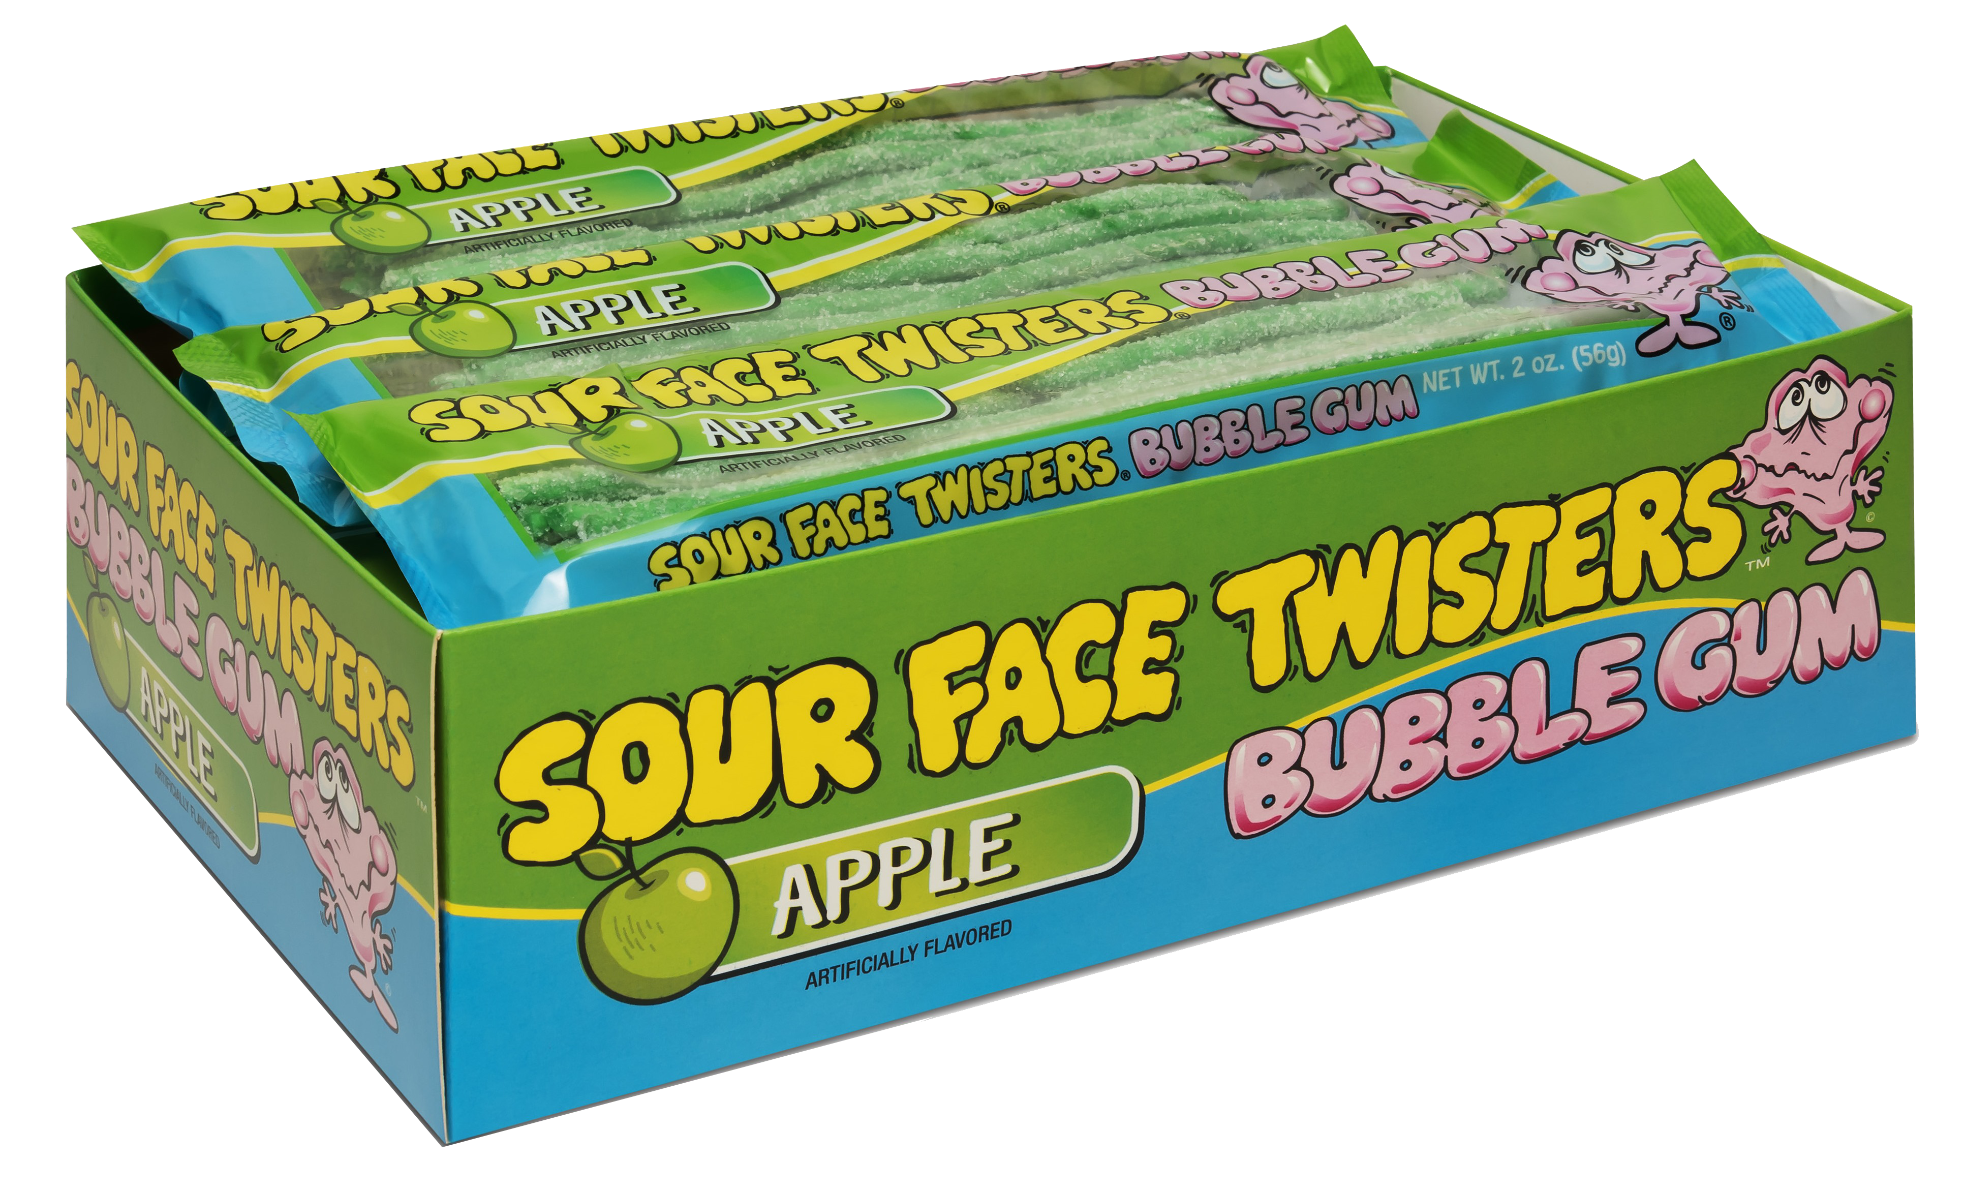
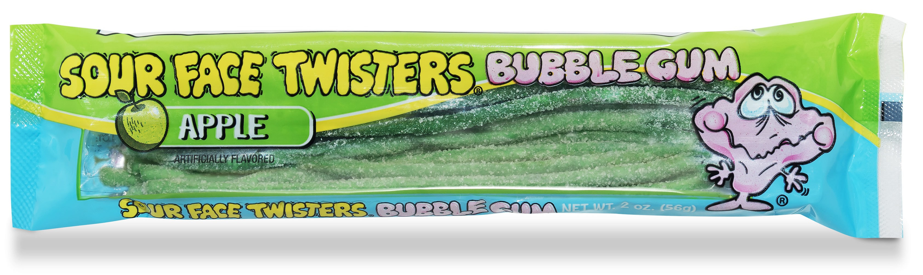
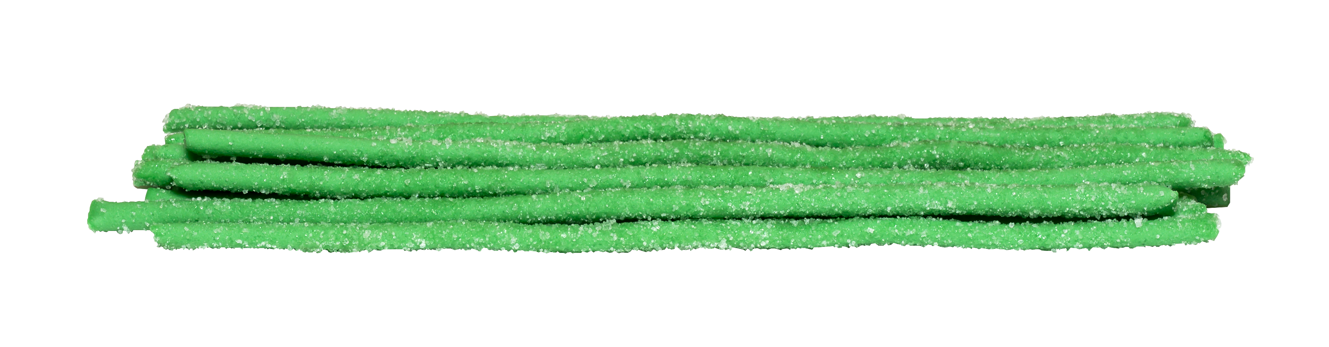
GREEN APPLE SOUR BUBBLE GUM STRAWS
Item # 04211
6/12 ct
Unit Cost | $ 1.10
Case Cost | $ 79.20
ITEM | UNIT UPC
Green Apple Bubble Gum Straws | 7-93216-04121-8
Case GTIN | 007-93216-04211-6
Case Dimensions | 12.6" L x 10.79" W x 9.69 H”
Case Weight | 11.3 LBS
Case Cube | 0.76

