Slide 1
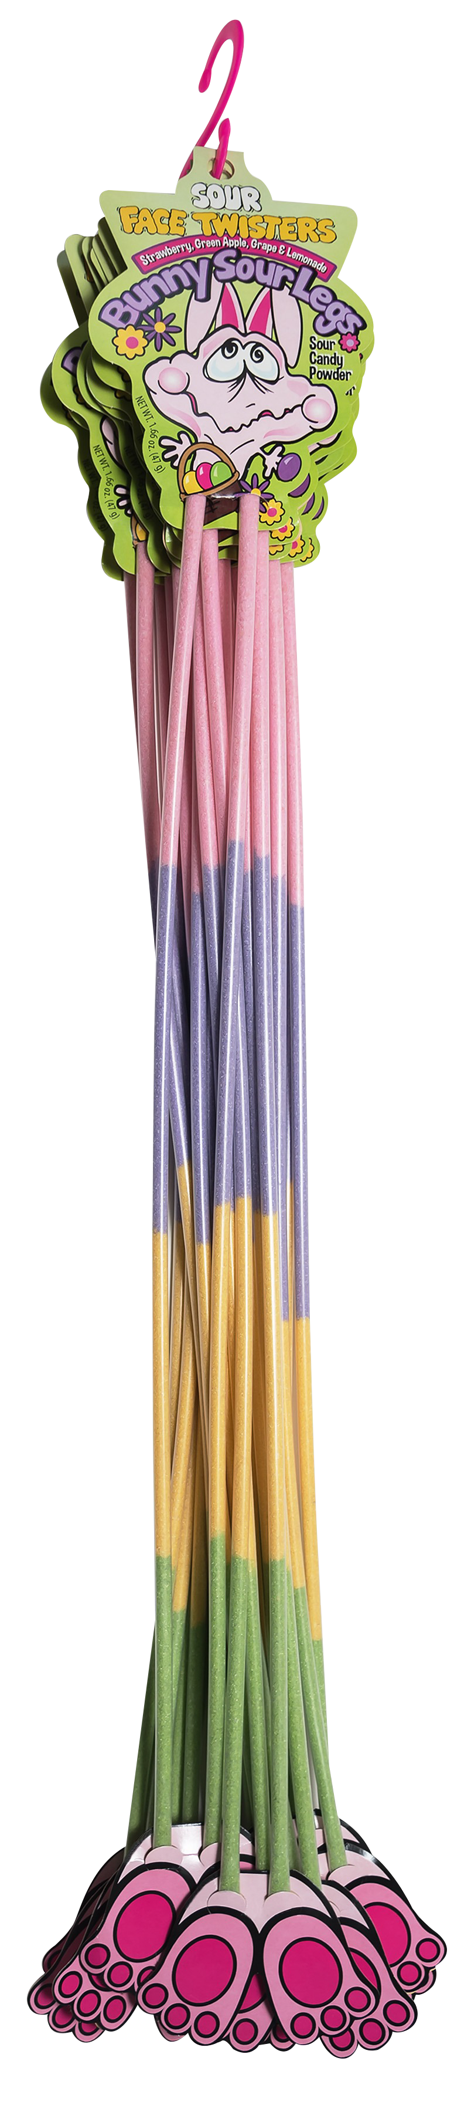
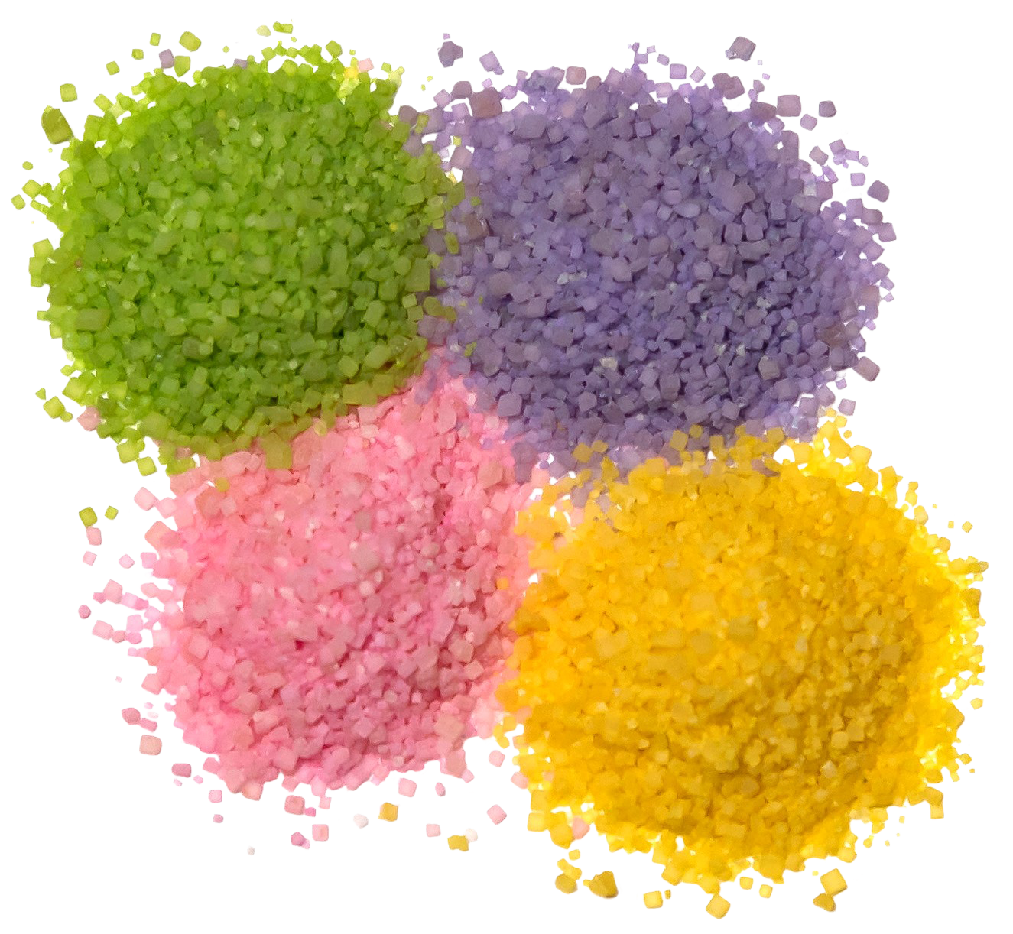
Over 7 million units sold
BUNNY SOUR LEGS® 2/12 ct “S” Hooks
Fruit-Flavored Sour Powder Straws in ​4 assorted flavors
ITEM # 07100
1.66 oz (44g)
Unit Cost | $ 1.10
Case Cost | $ 26.40
Seasonal Order Deadline: October 7th 2026
Case GTIN | 007-93216-07100-0
Case Dimensions | 35.24” L x 5.29" W x 3.44” H
Case Weight | 3.83 LBS
Case Cube | 0.37
ITEM | UNIT UPC
Bunny Sour Legs® | 7-93216-07120-8

