Slide 1
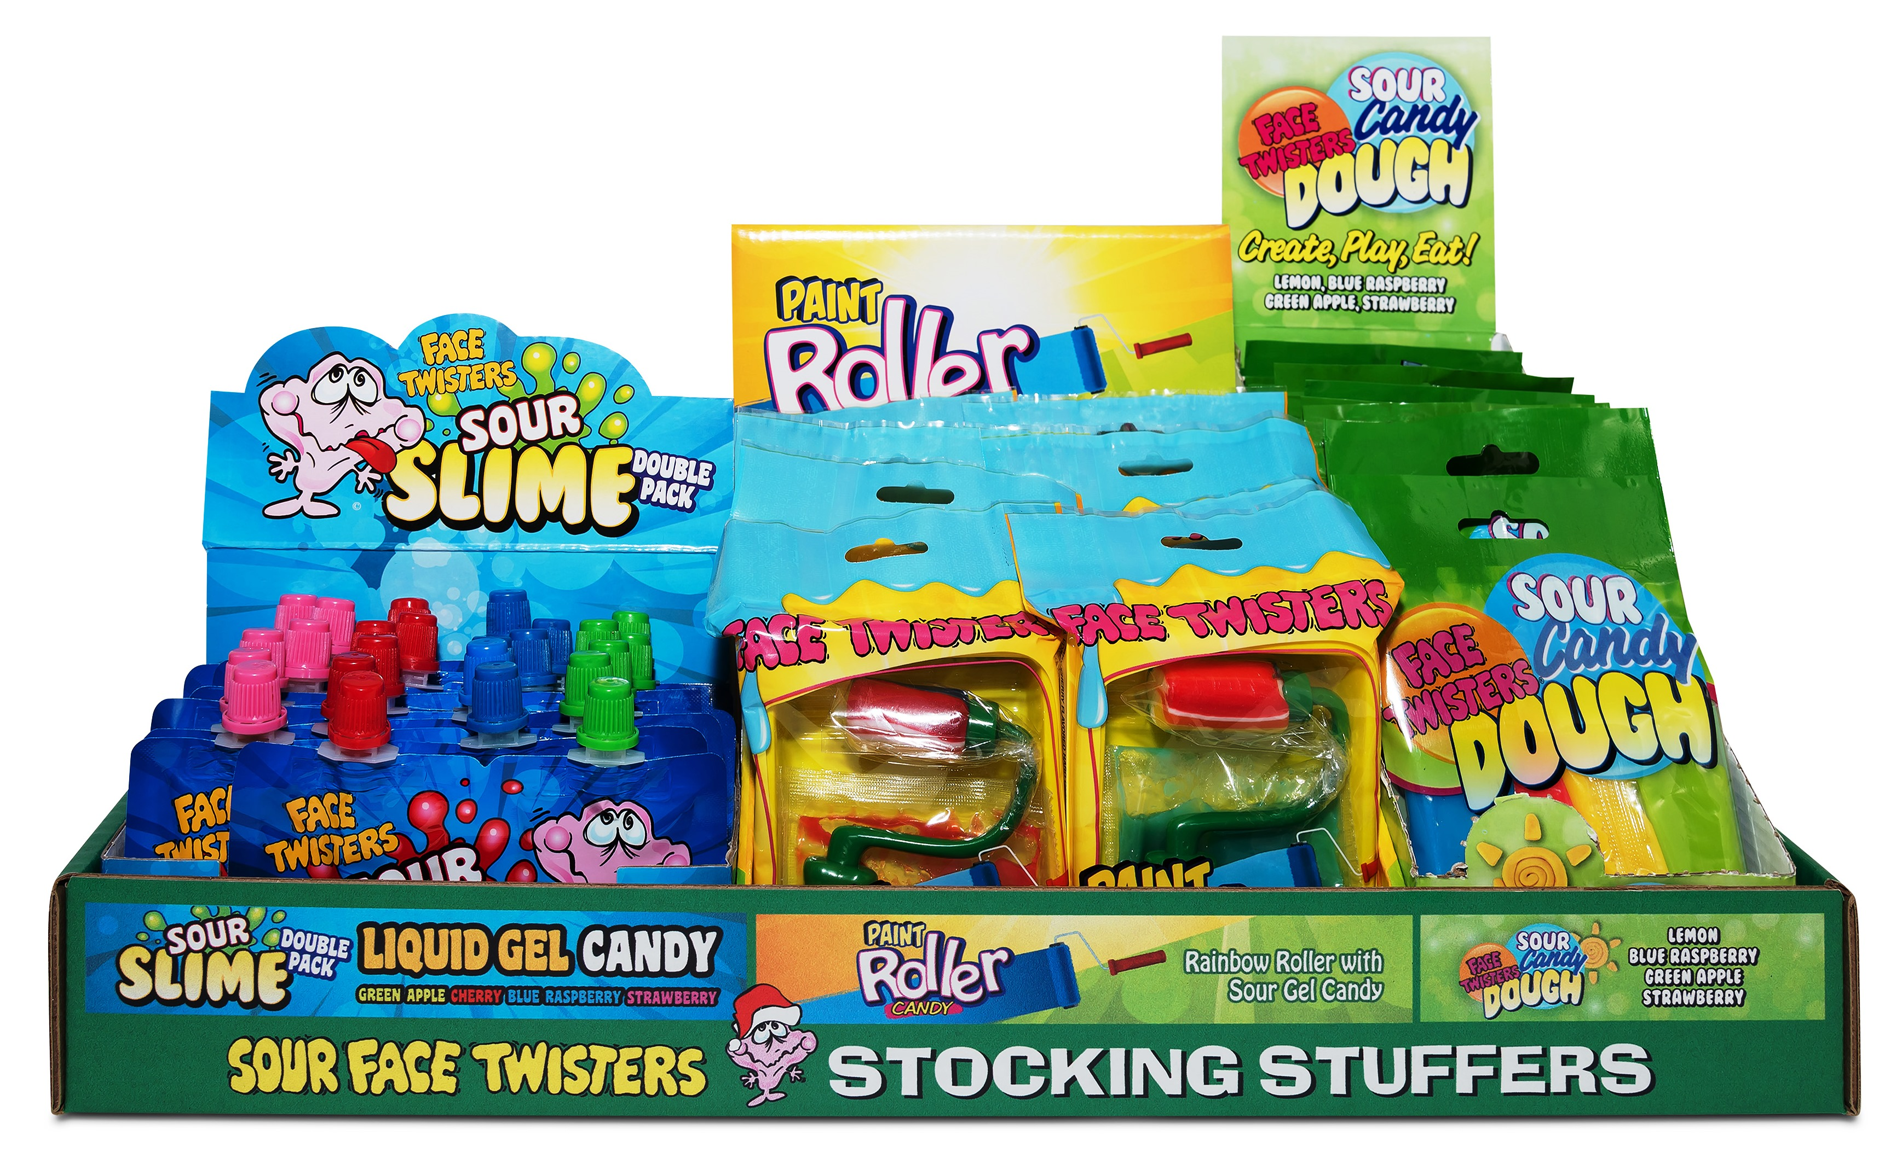
42 ct HOLIDAY NOVELTY SHELF DISPLAY DRC
Item # 13030
Contains:
12 units Paint Roller® Candy
18 units Sour Slime Double Pack
12 units Sour Candy Dough®
Unit Cost | $ 1.07
Case Cost | $ 44.94
Seasonal Order Deadline is June 22^{t,} 2026
ITEM | UNIT UPC
Paint Roller® Candy | 7-93216-12030-2
Sour Slime Double Pack Strawberry/Green Apple | 7-93216-10050-2
Sour Slime Double Pack Cherry/Blue Raspberry | 7-93216-10050-2
Sour Candy Dough® | 7-93216-11030-3
Case GTIN | 007-93216-13010-3
Case Dimensions | 19.34” L x 10.21” W x 7.35” H
Case Weight | 7.82 LBS
Case Cube | 0.84

