Slide 1
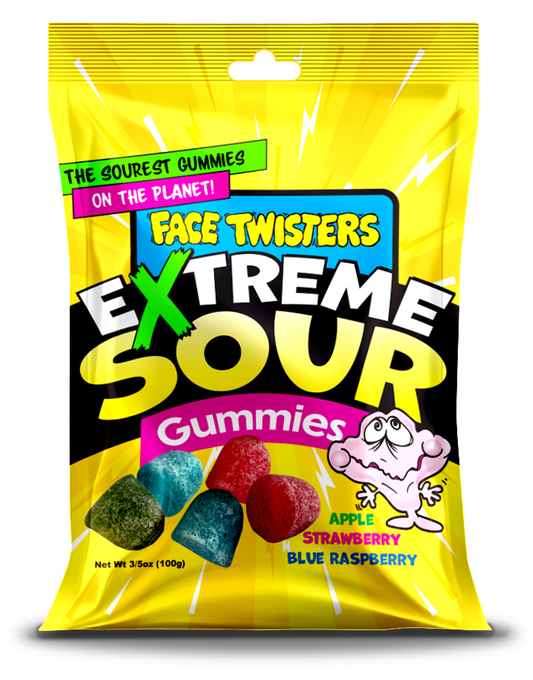
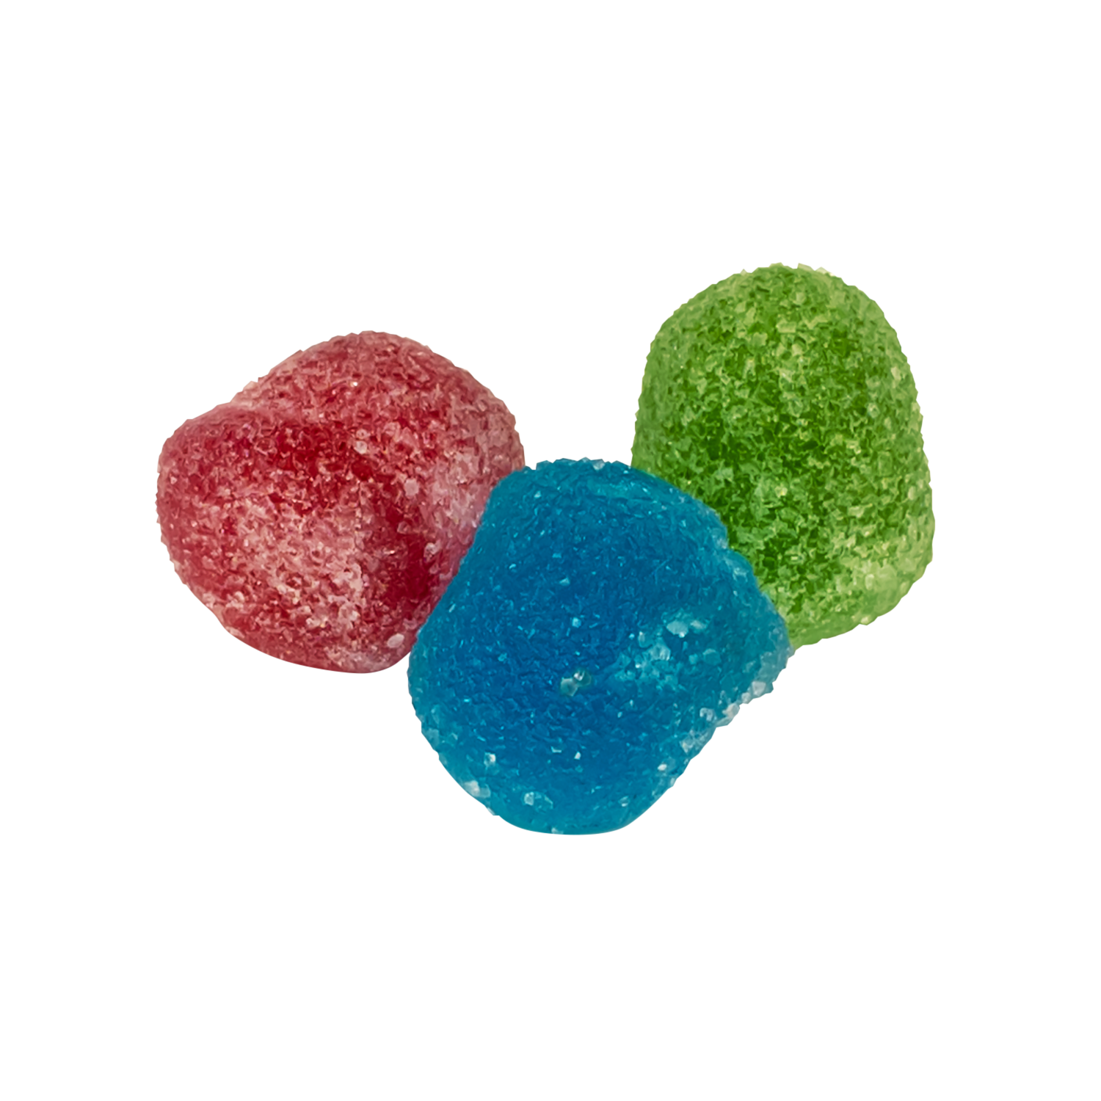
NEW!
EXTREME SOUR GUMMIMES
4 - 12 ct Case
AVAILABLE
MAR 2026
Super sour Blue Raspberry + Strawberry + Green Apple gummies
Item #21010
3.5 oz (100g)
Unit Cost | $ 1.00
Case Cost | $ 48.00
ITEM | UNIT UPC
Extreme Sour Gummies in Blue Raspberry, Strawberry & Green Apple | 7-93216-21030-0
Case GTIN | 007-93216-21010-2
Case Dimensions | 11.3” L x 10.9” W x 11.3” H
Case Weight | 12.12 lbs
Case Cube | 0.80

