Slide 1
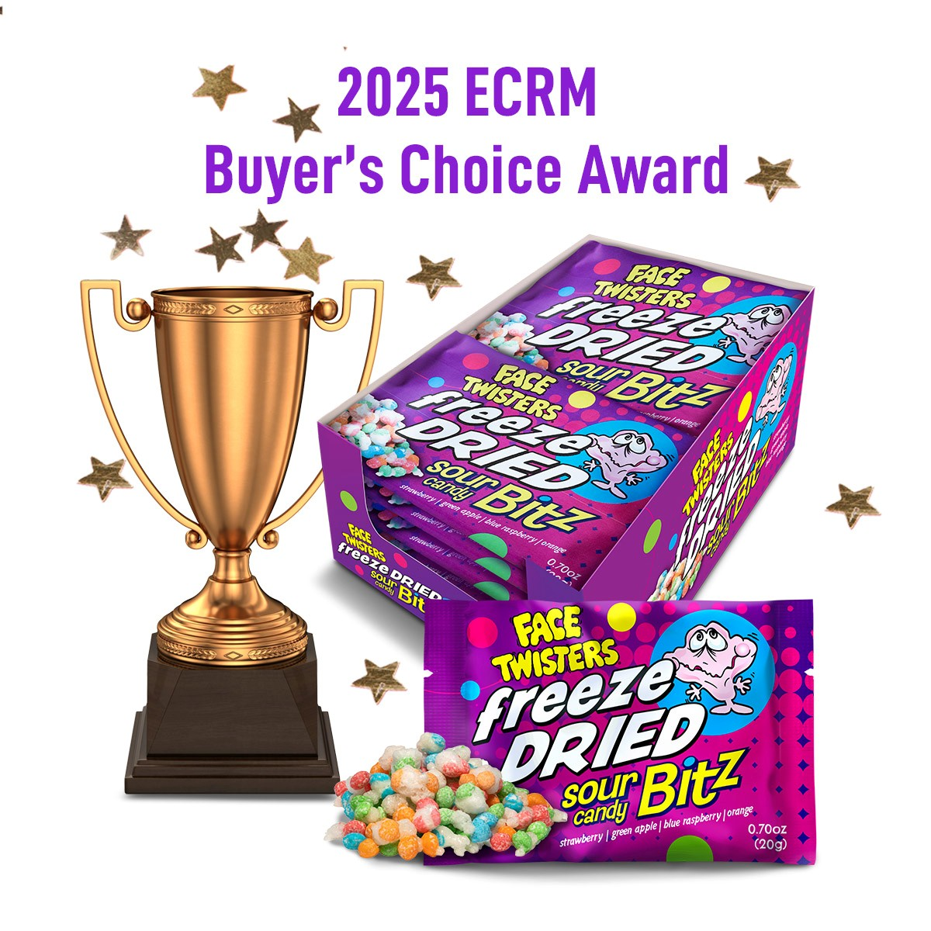
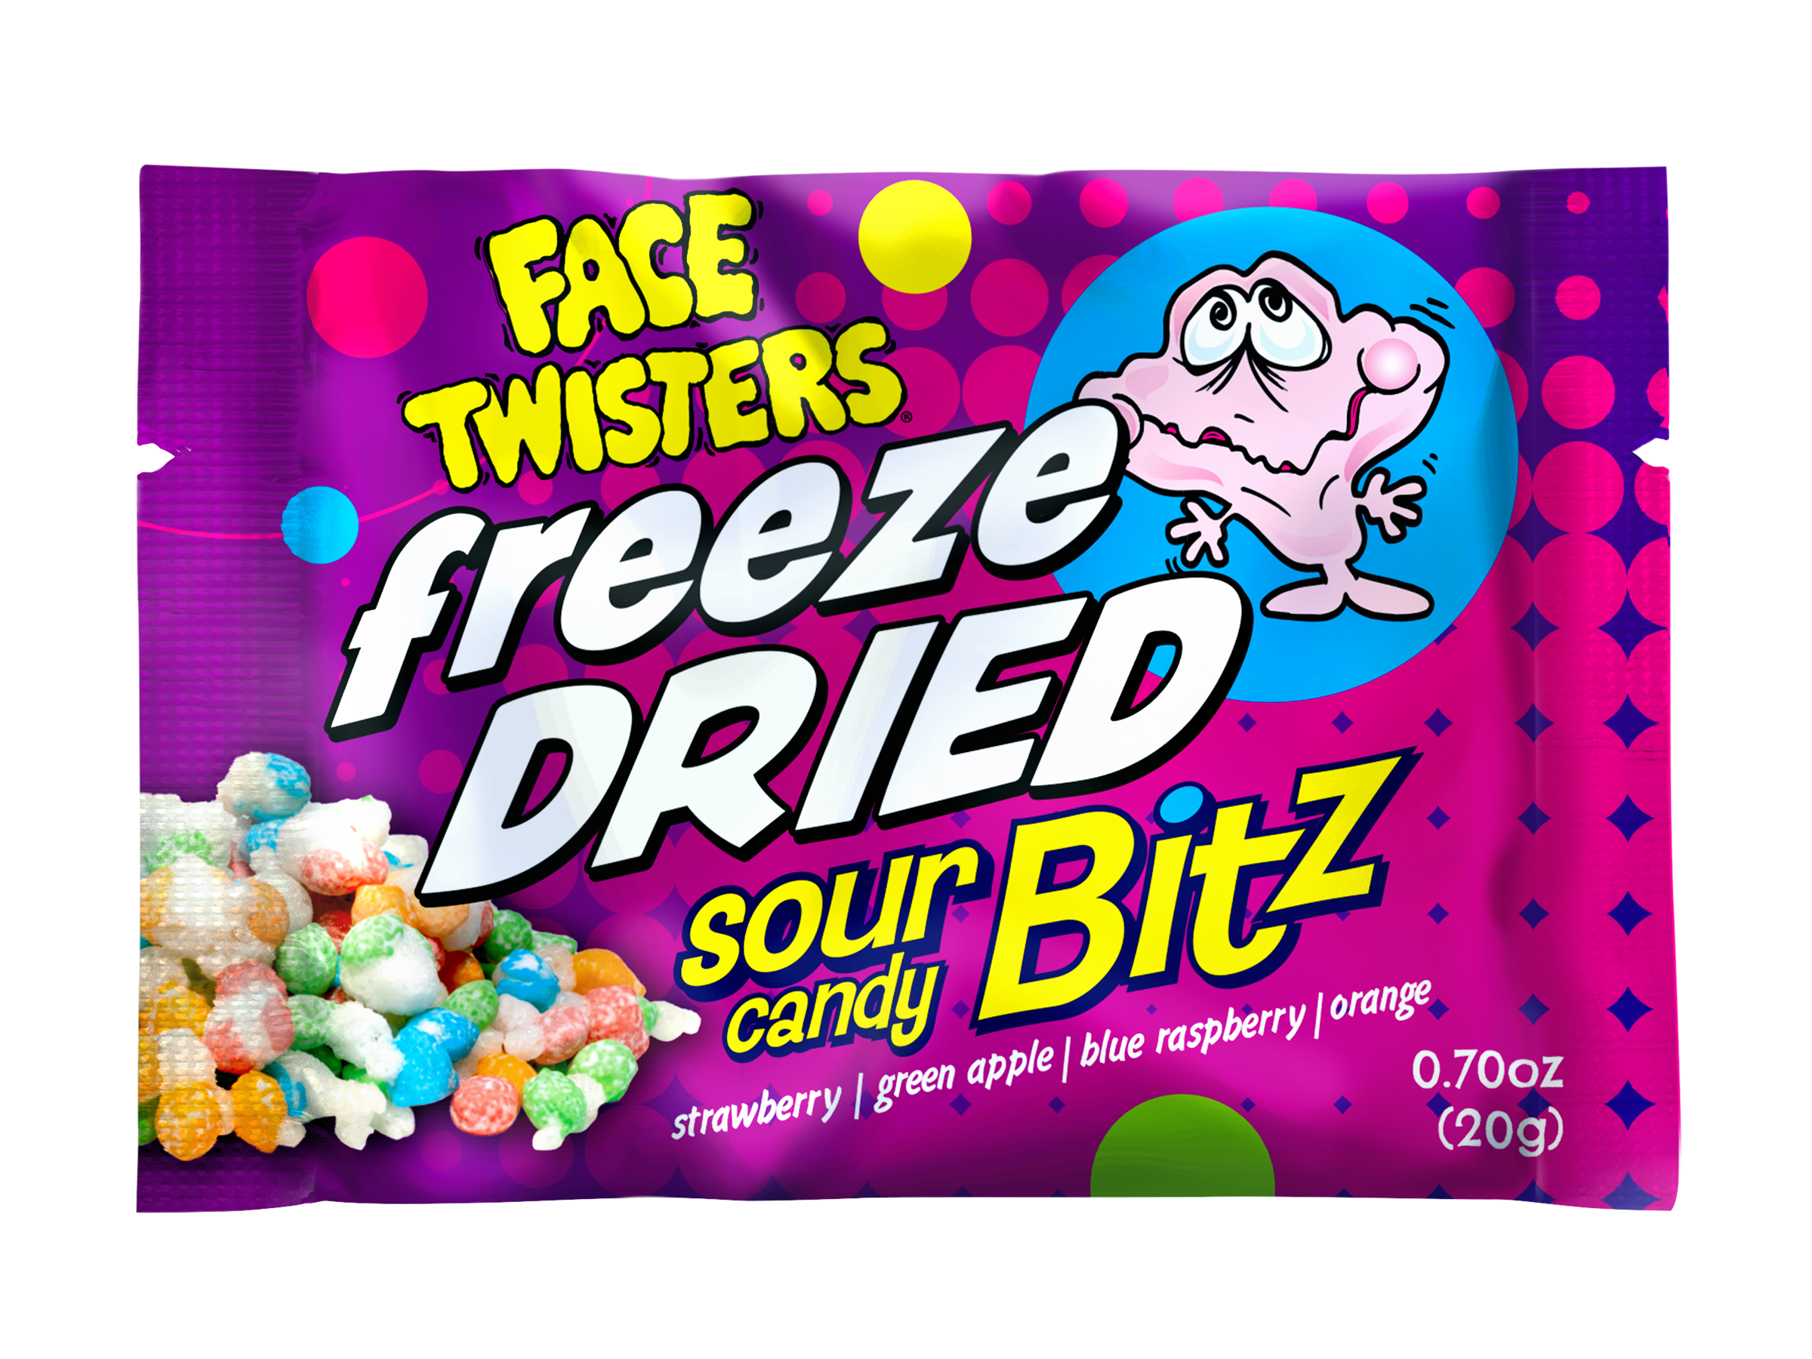
NEW!
FREEZE DRIED SOUR CANDY BITZ™ 4/12 ct Case
Freeze Dried Reimagined. Taste the Difference!
Item # 33010
0.70 oz (20g)
Freeze Dried Sour Candy Bitz™ in Strawberry + Green Apple + Blue Raspberry + Orange
Unit Cost | $ 0.90
Case Cost | $ 43.20
ITEM | UNIT UPC
Freeze Dried Sour Candy Bitz™ | 7-93216-33030-5
Case GTIN | 007-93216-33010-7
Case Dimensions | 11.65” L x 8.27” W x 8.35” H
Case Weight | 3.65 lbs
Case Cube | 0.465

