Slide 1
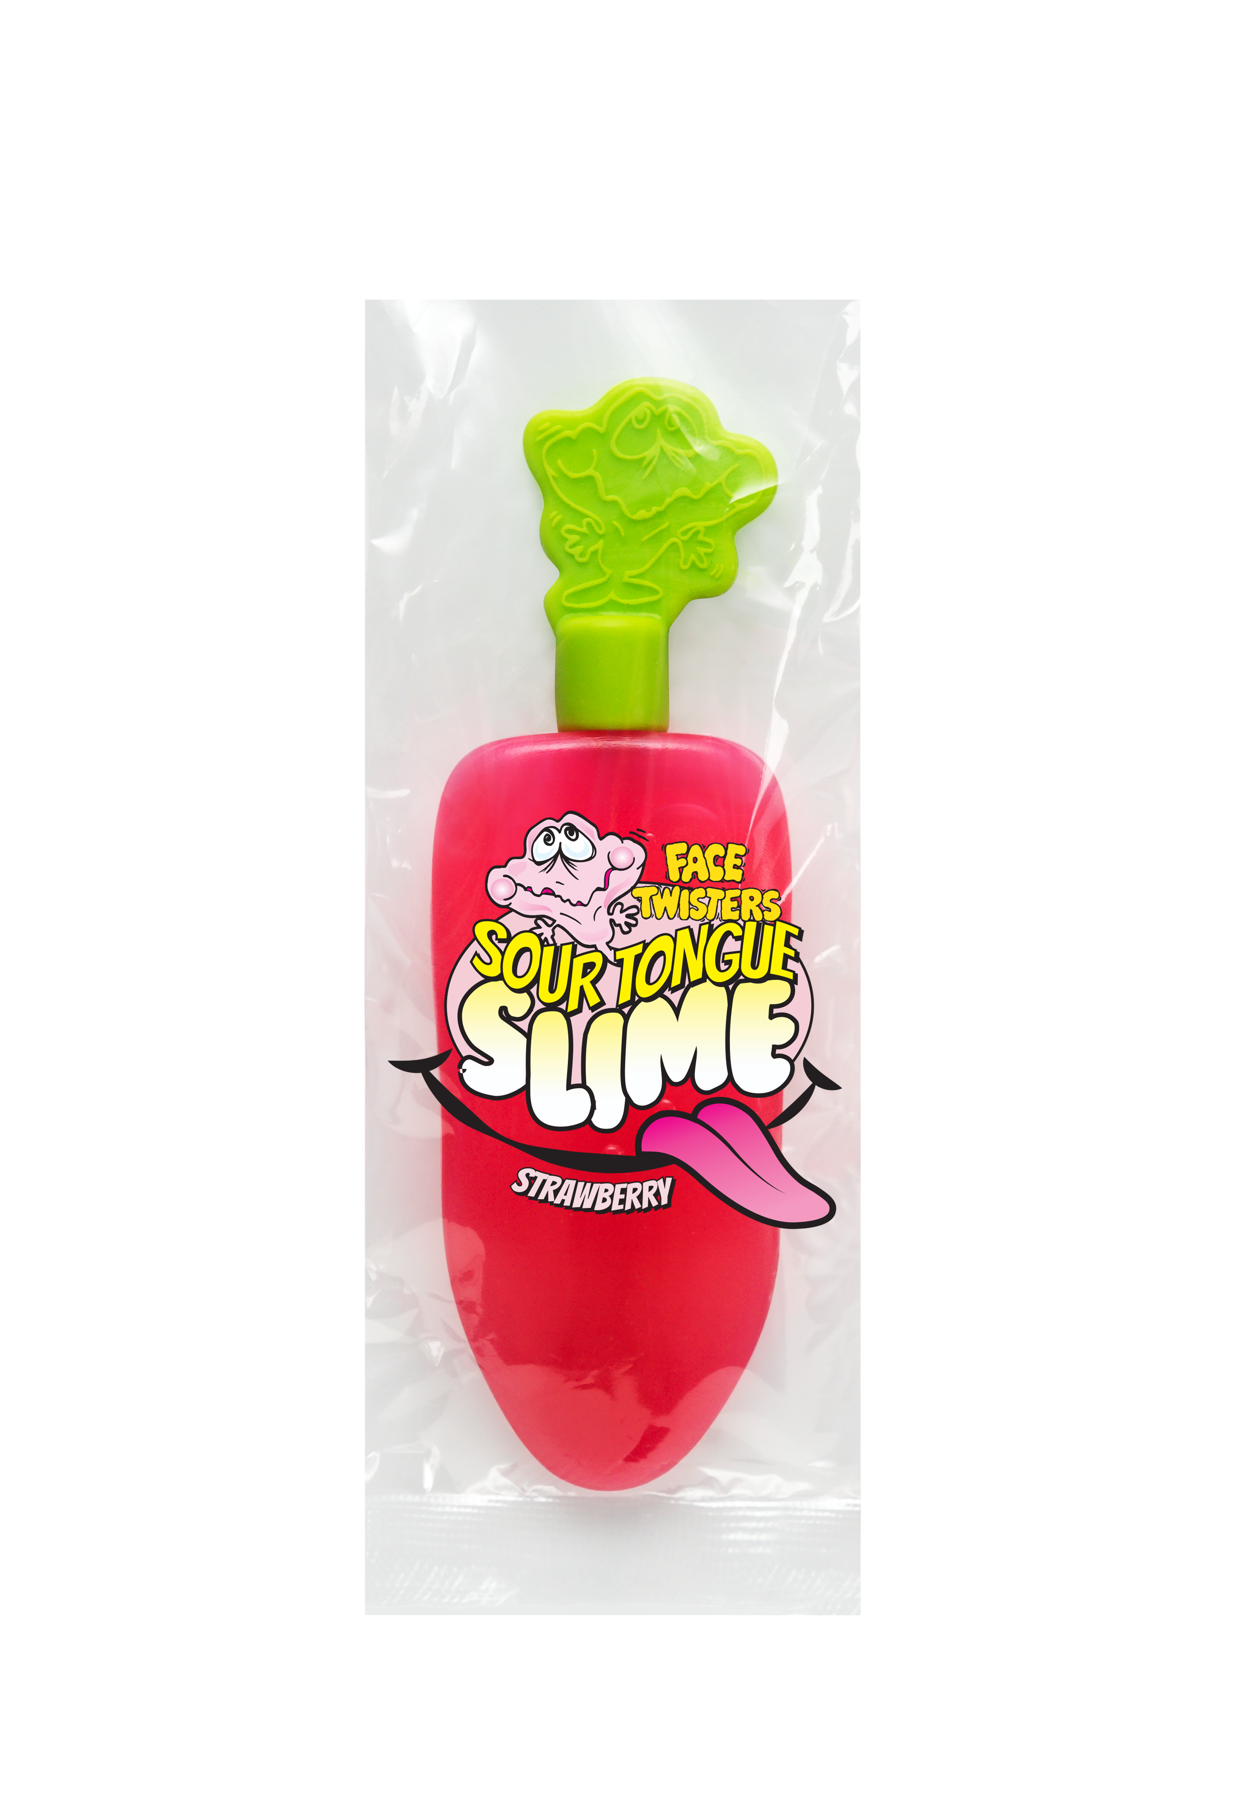
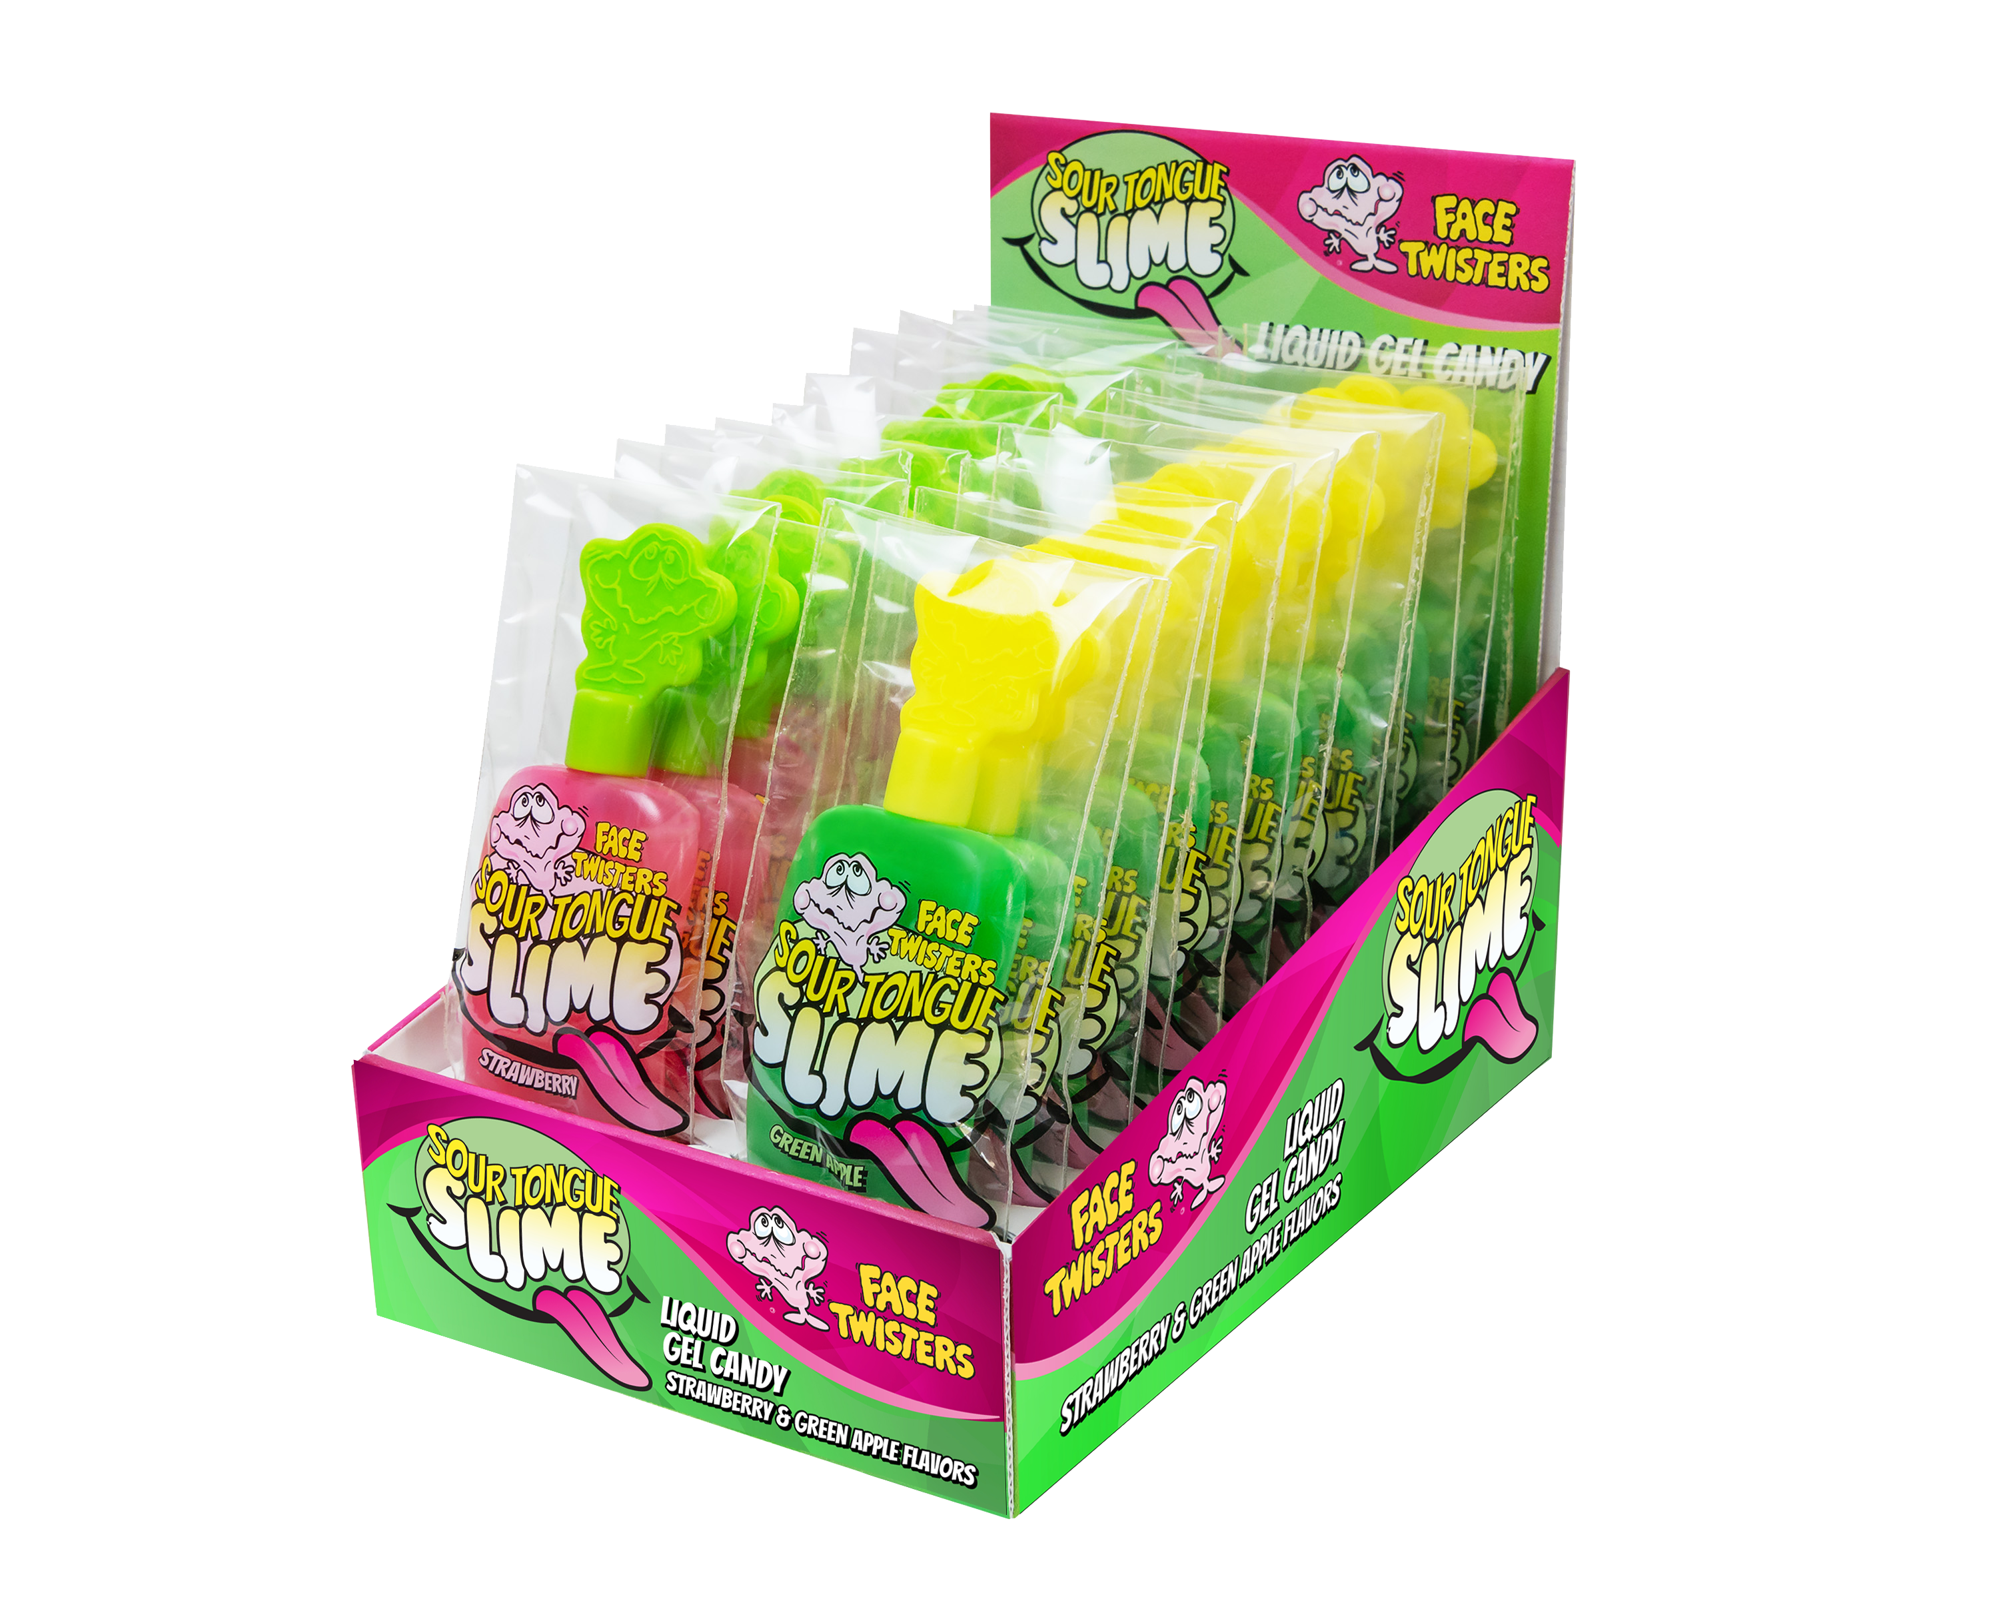
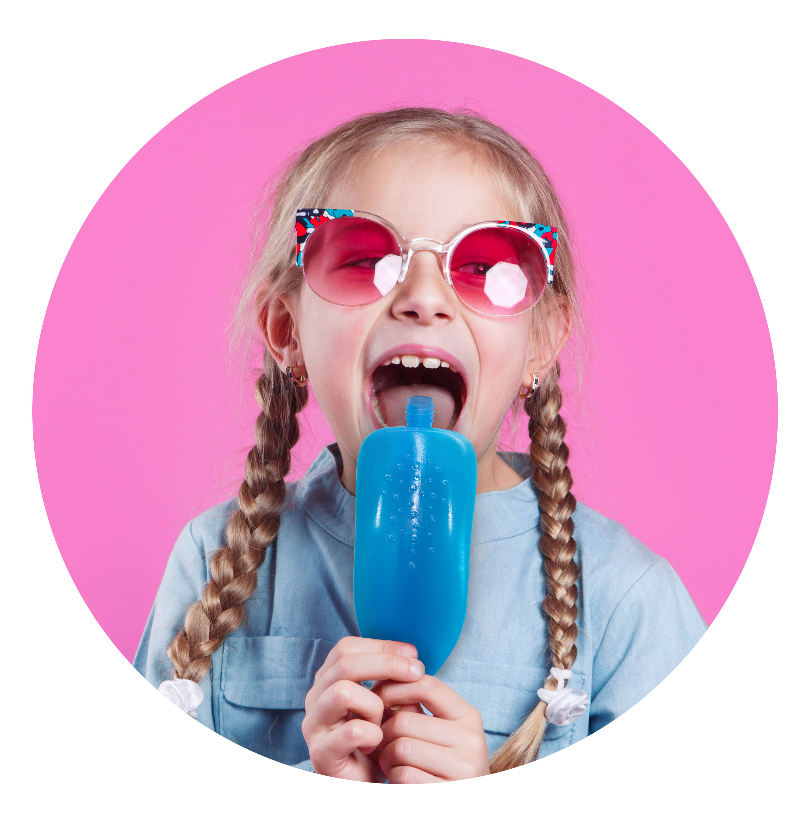
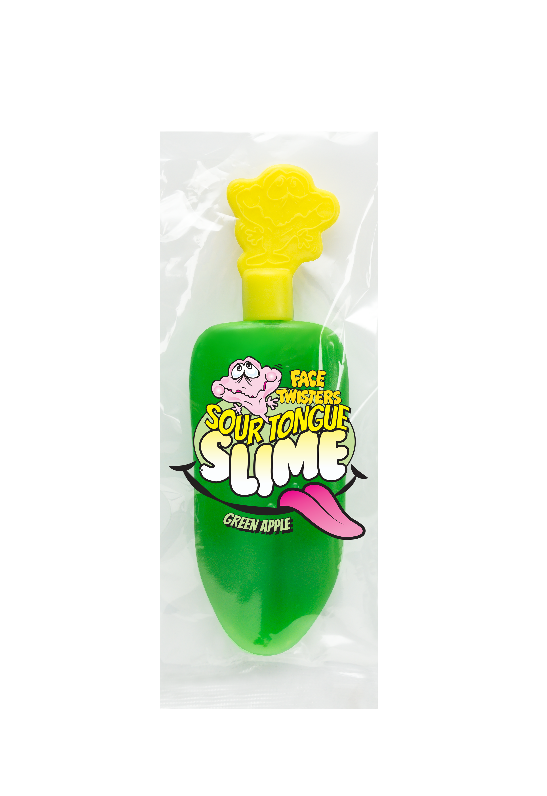
SOUR TONGUE SLIME™
STRAWBERRY & GREEN APPLE 6/24 ct Case
Item #: 15010
1.4 oz (40g)
Sour liquid gel candy in a squeezable tongue shaped dispenser. Available in a combo display of Strawberry + Green Apple flavors.
Unit Cost | $ 1.37
Case Cost | $ 197.28
ITEM | UNIT UPC
Strawberry Flavor Tongue Slime™ | 7-93216-15030-9
Green Apple Flavor Tongue Slime™ | 7-93216-15030-9
Case GTIN | 007-93216-15010-1
Case Dimensions | 17.67” L x 17.51” W x 6.88” H
Case Weight | 20.4 lbs
Case Cube | 1.23

