Slide 1
2026 HOLIDAY STOCKING STUFFERS

Slide 2

We are...
Is a full product line of everyday core & non-chocolate novelty sour candy
Offers unbeatable value versus our competitors
Is a 27-year-old brand​
Has a unique product assortment with eye catching designs
Is viral on social media ​
​

Slide 3
Category Growth
As of August 2025
Non-chocolate novelty candy grew 98% in dollar sales and 41% in unit sales versus 3 years ago
With a 20% increase in dollar sales versus 3 years ago non-chocolate chewy candy continues to dominate, accounting for nearly half of all non chocolate sales

Slide 4
Non-Chocolate Candy
As of August 2025
Outperformed chocolate and gum with strong contributions from chewy and novelty candy.
Gummies and chewy candy have the highest consumer engagement
The chewier, crunchier and more intensely flavored and colored the better
Texture Innovation is a growth driver. Any candy that is hyper-sensory/sour or tactile/crunchier is especially compelling
Source: Circana data for year ending Aug 10, 2025

Slide 5
Sour Candy
As of August 2025
Sour Candy sales grow year after year with a 7% growth versus a year ago
Sour Candy Subcategory is Outpacing the Broader Candy Sector.
Sour Candy may serve as a “grounding technique” by redirecting focus on the intense sour sensation rather than anxious thoughts.
Source: Circana data for year ending Aug 10, 2025
“Can Sour Candy Help with Anxiety and Panic Attacks”
June 21, 2024

Slide 6


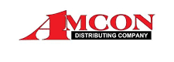


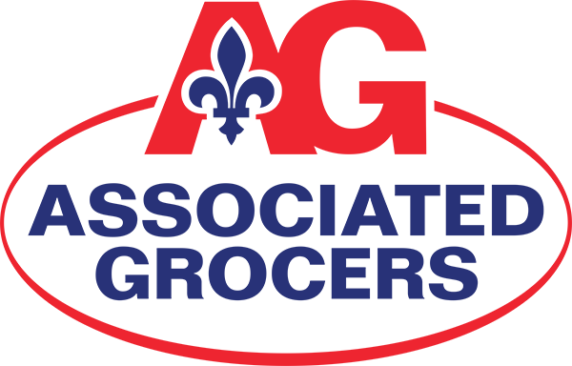




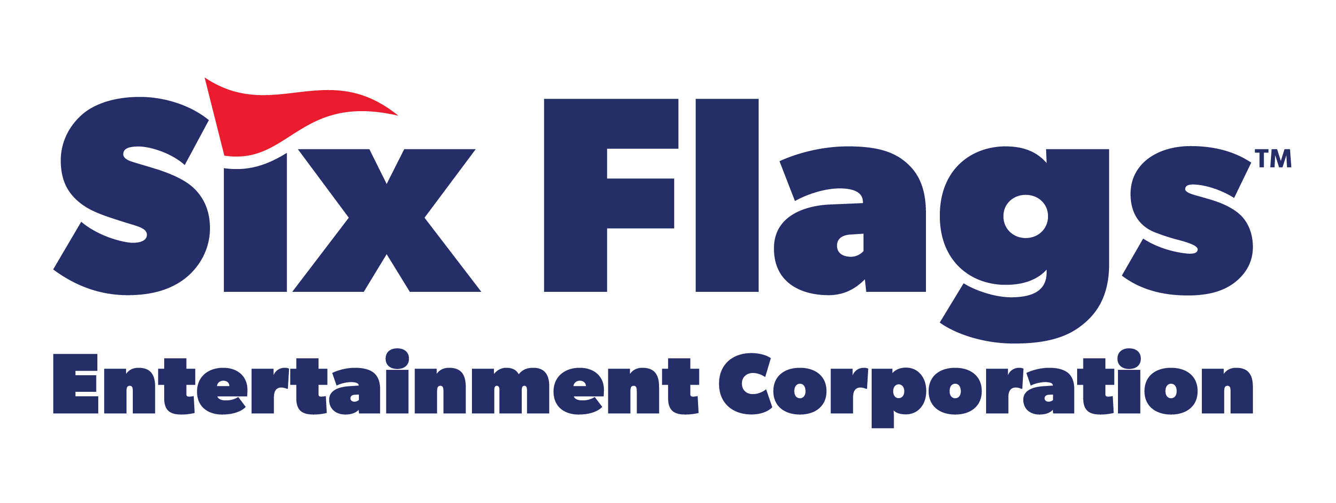




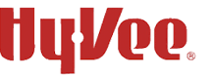






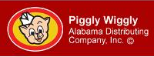


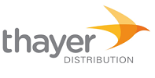
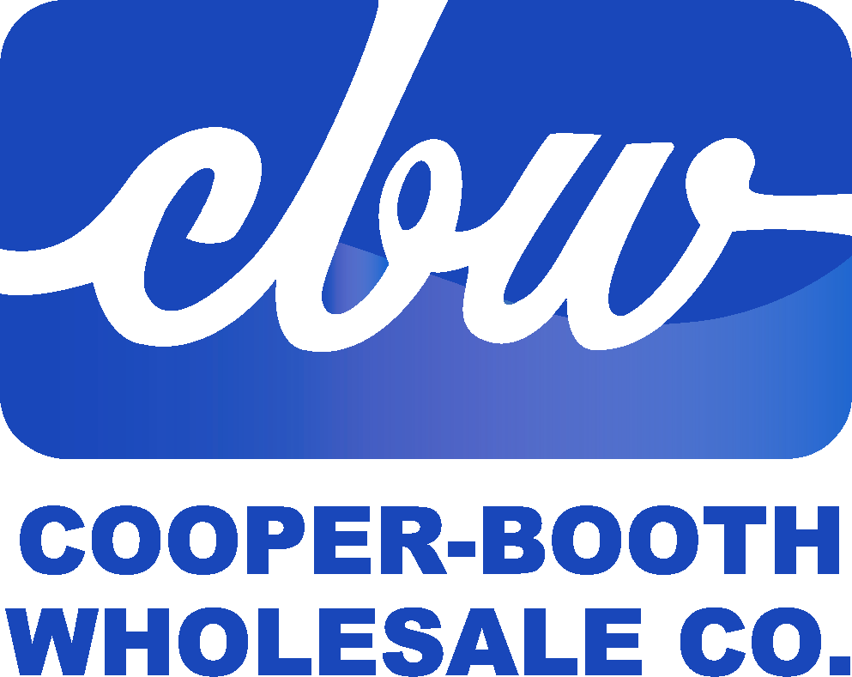

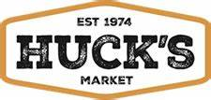

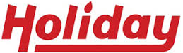


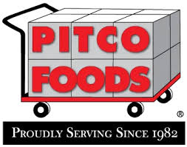



Slide 7
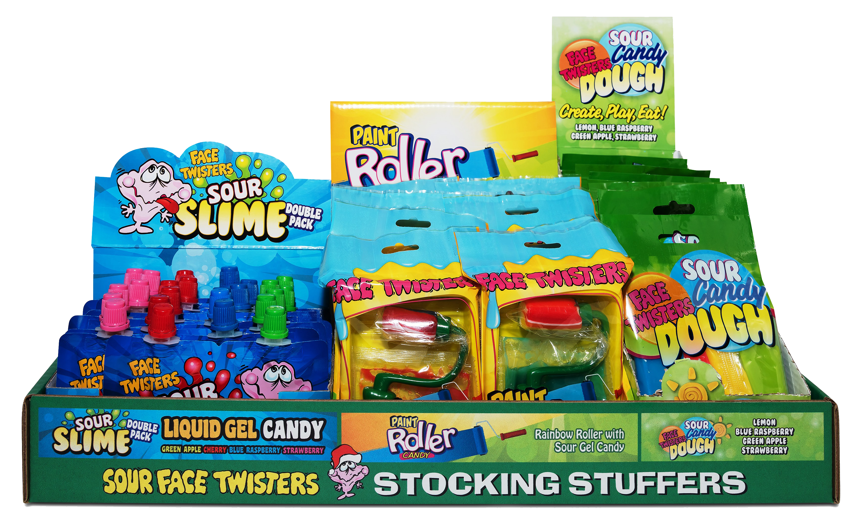
HOLIDAY NOVELTY SHELF TRAY
42 ct DRC
Item # 13030
Contains:
12 units Paint Roller® Candy
18 units Sour Slime Double Pack
12 units Sour Candy Dough®
Unit Cost | $ 1.07
Case Cost | $ 44.94

Slide 8

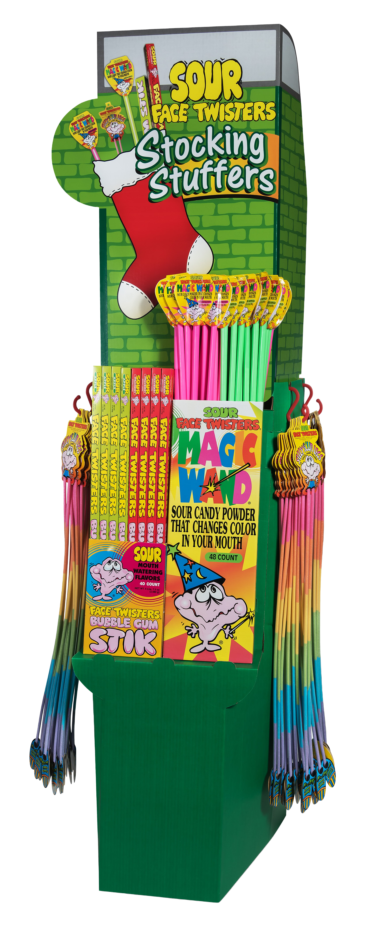
OVER 50,000 SOLD!
HOLIDAY SOUR CENTER
136 ct Floor Shipper
Contains:
20 units Big Stik® Strawberry
  20 units Big Stik® Green Apple
  24 units Magic Wand® Strawberry
  24 units Magic Wand® Green Apple
  48 units Silly Sour Legs®
Item # 09012
Unit Cost | $ 1.10
Case Cost | $ 149.60

Slide 9
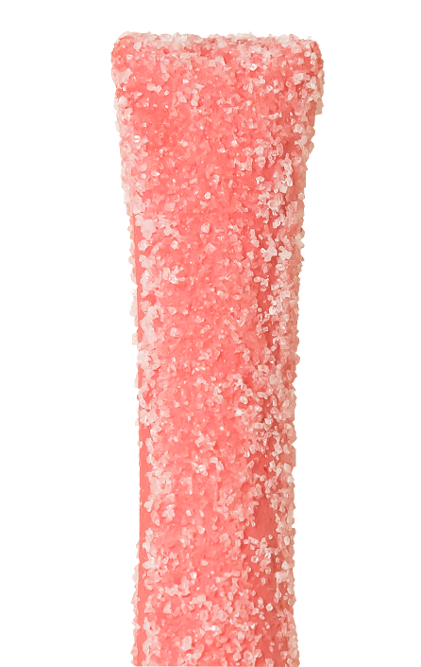
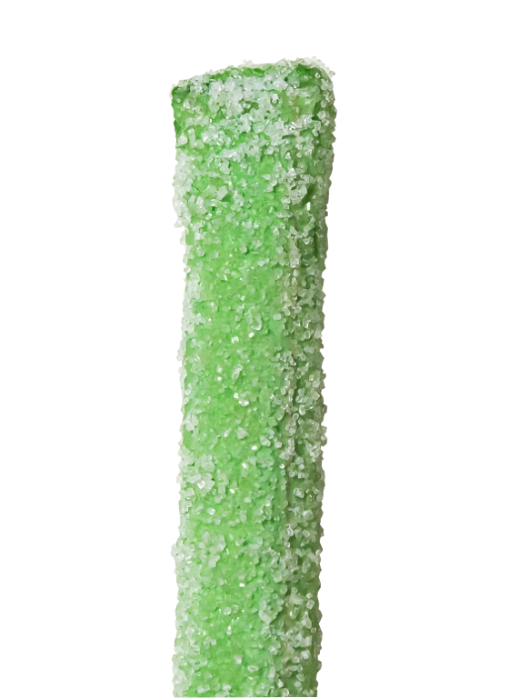
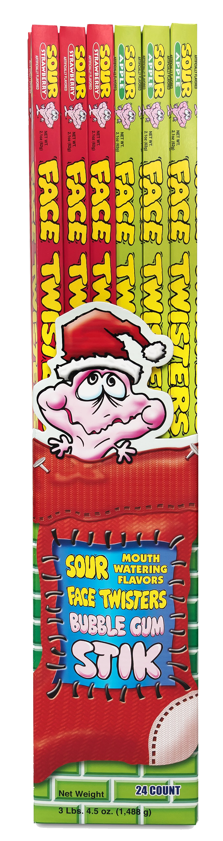
HOLIDAY BIG STIK™ SIDEKICK
2 / 24 ct Case
Item # 06012
  Contains:
  12 units Big Stik™ Strawberry Sour Bubble Gum
  12 units Big Stik™ Green Apple Sour Bubble Gum
Unit Cost | $ 1.10
Case Cost | $ 52.80

Slide 10
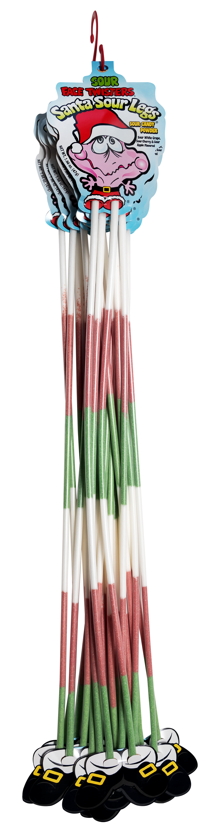
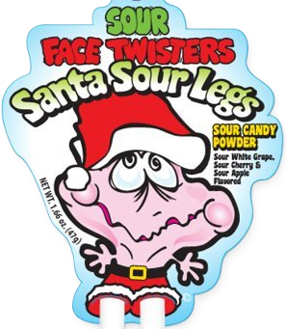
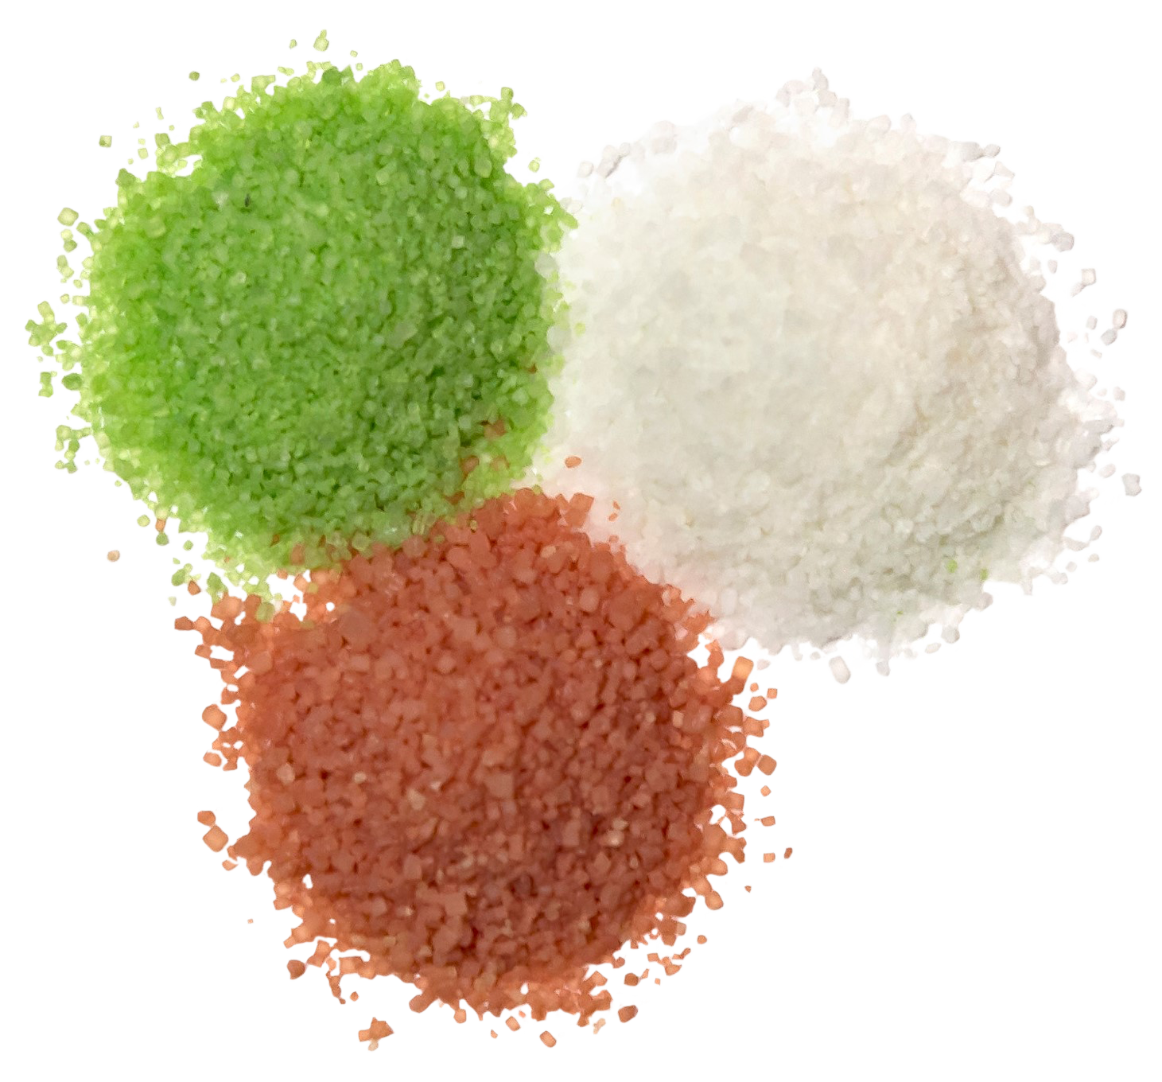
SANTA SOUR LEGS®
2-12 ct Case
Over 7 million units sold
Fruit-Flavored Sour Powder Straws in 3 assorted flavors of Sour White Grape, Sour Cherry and Sour Green Apple.
Item #07070
1.66 oz (44g)
Unit Cost | $ 1.10
Case Cost | $ 26.40

Slide 11
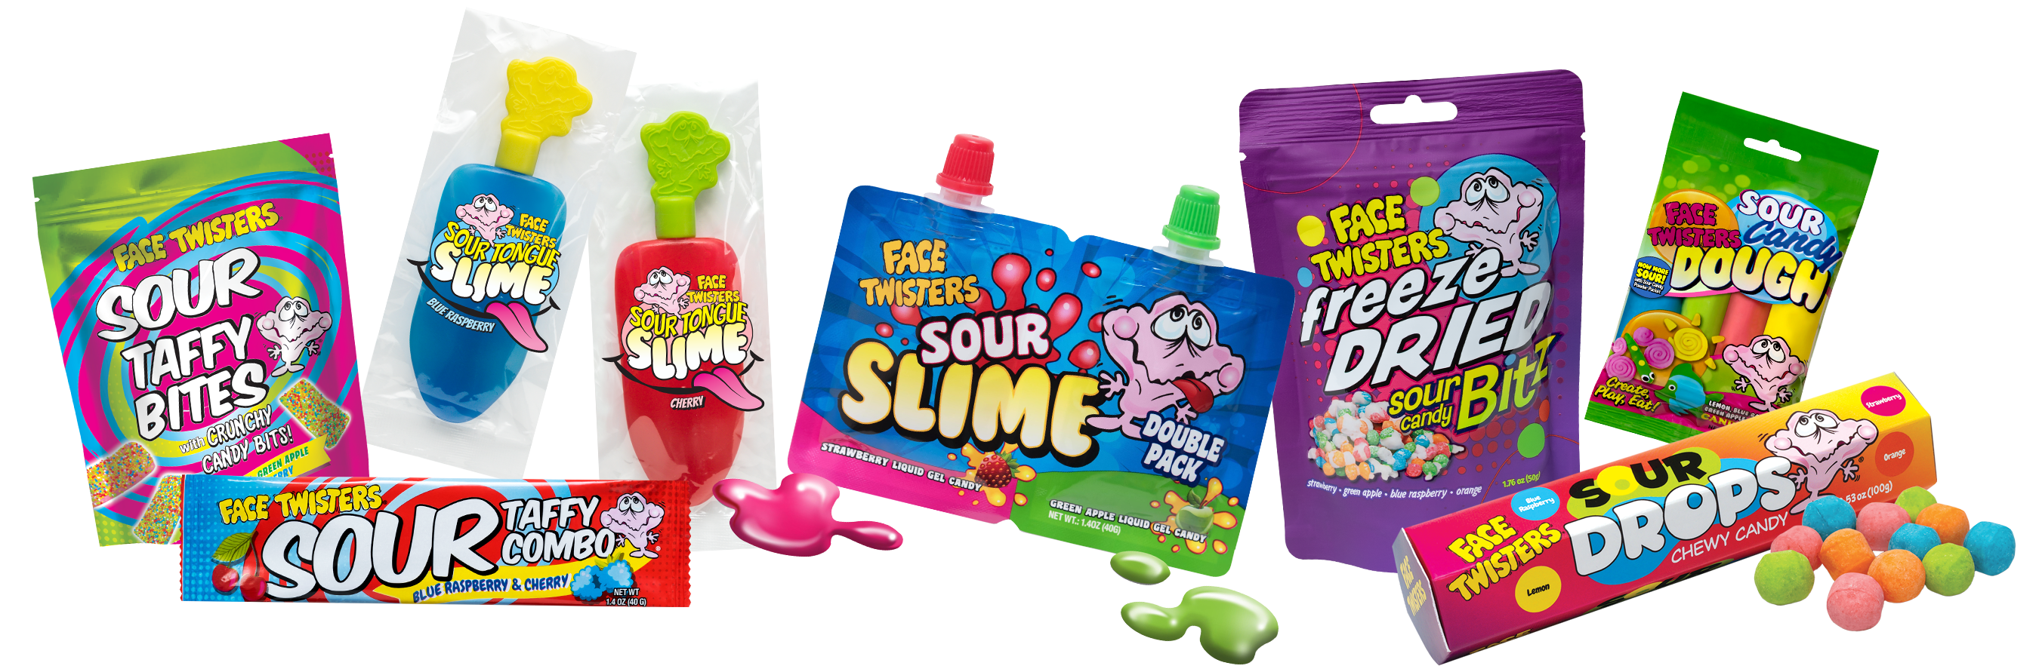
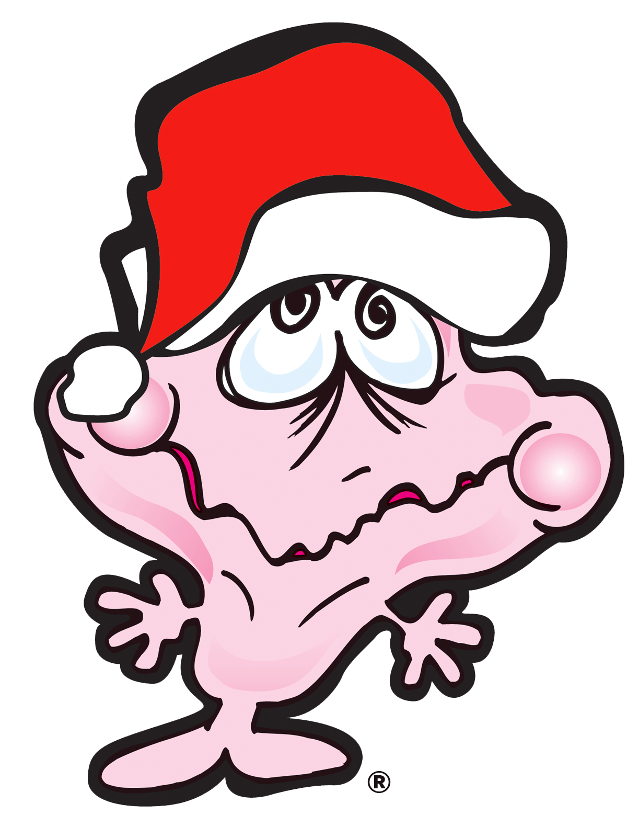
Payment terms are 2%/10 days, net 30 (with approved credit).
Lead time is 5 working days from receipt of order.
Order email: lisa@schusterproducts.com
SEASONAL ORDER MUST BE RECEIVED NO LATER THAN JUNE 22, 2026
FIRST AVAILABLE SHIP DATE: SEPTEMBER 14, 2026

