Slide 1
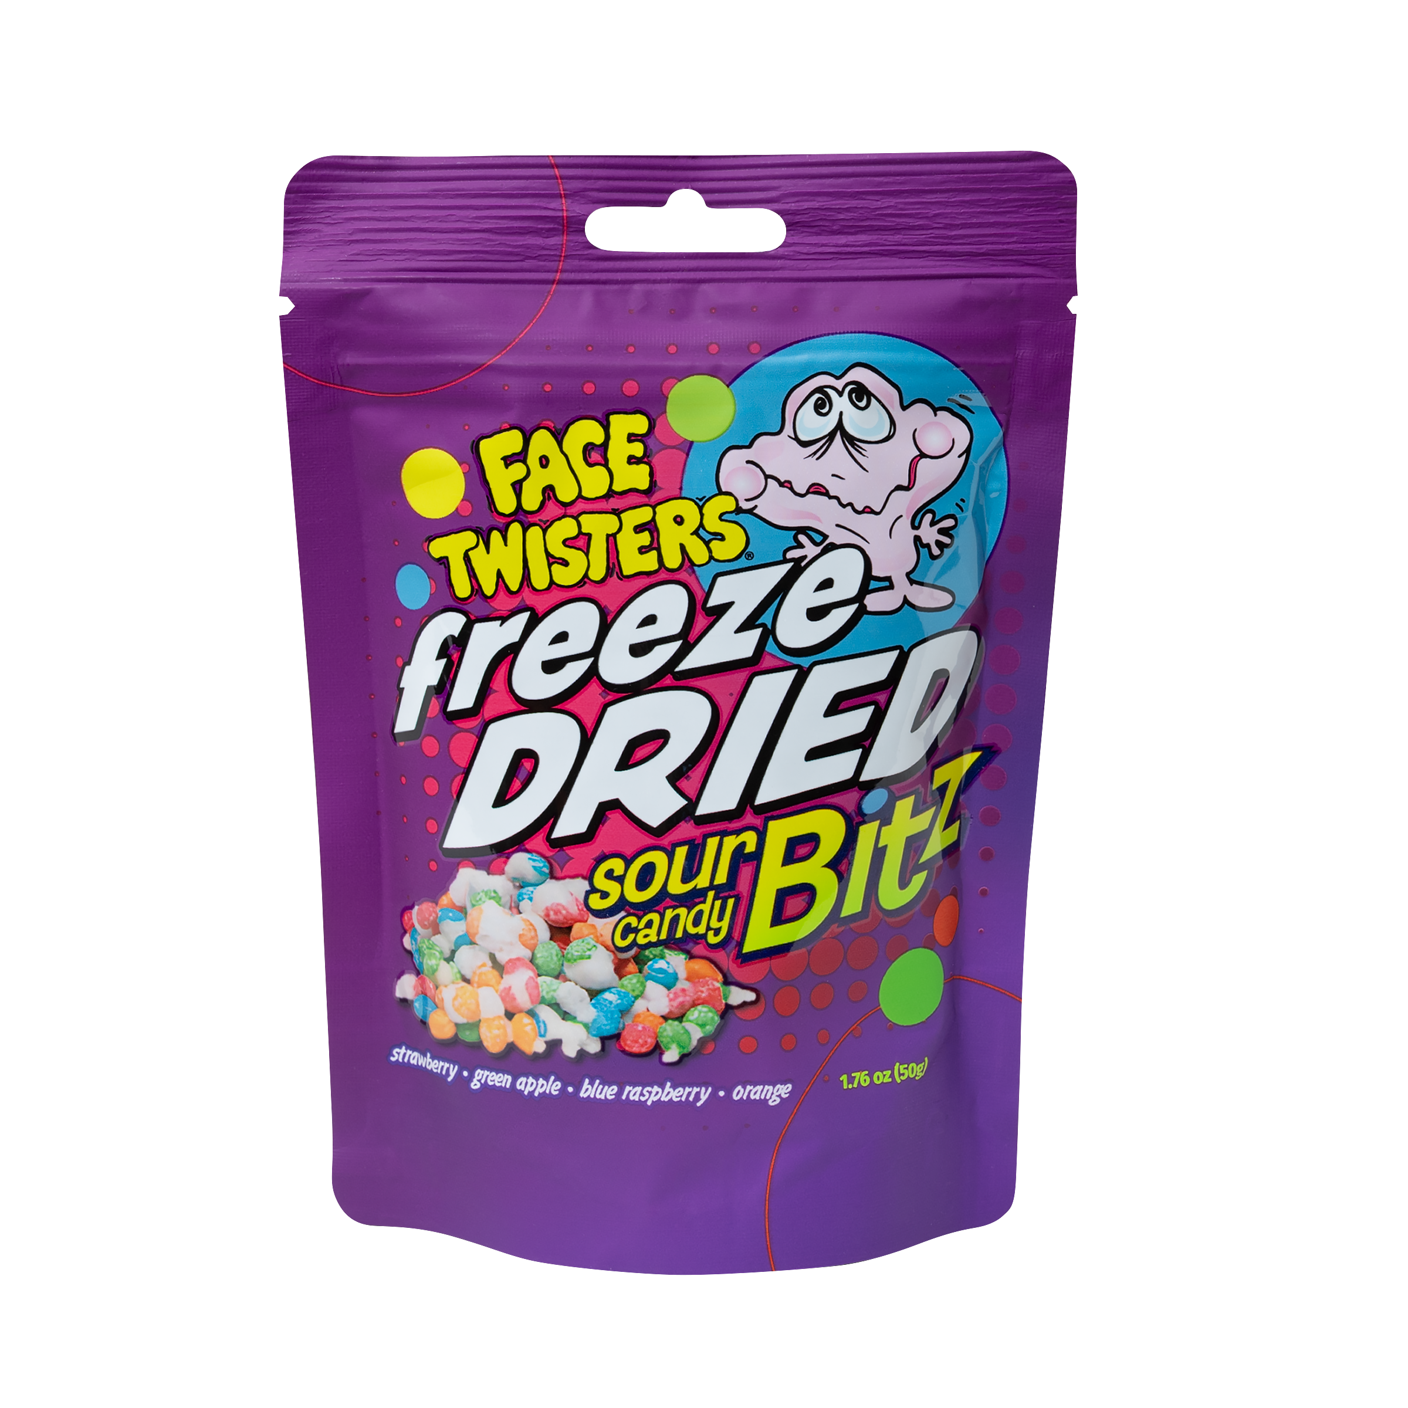

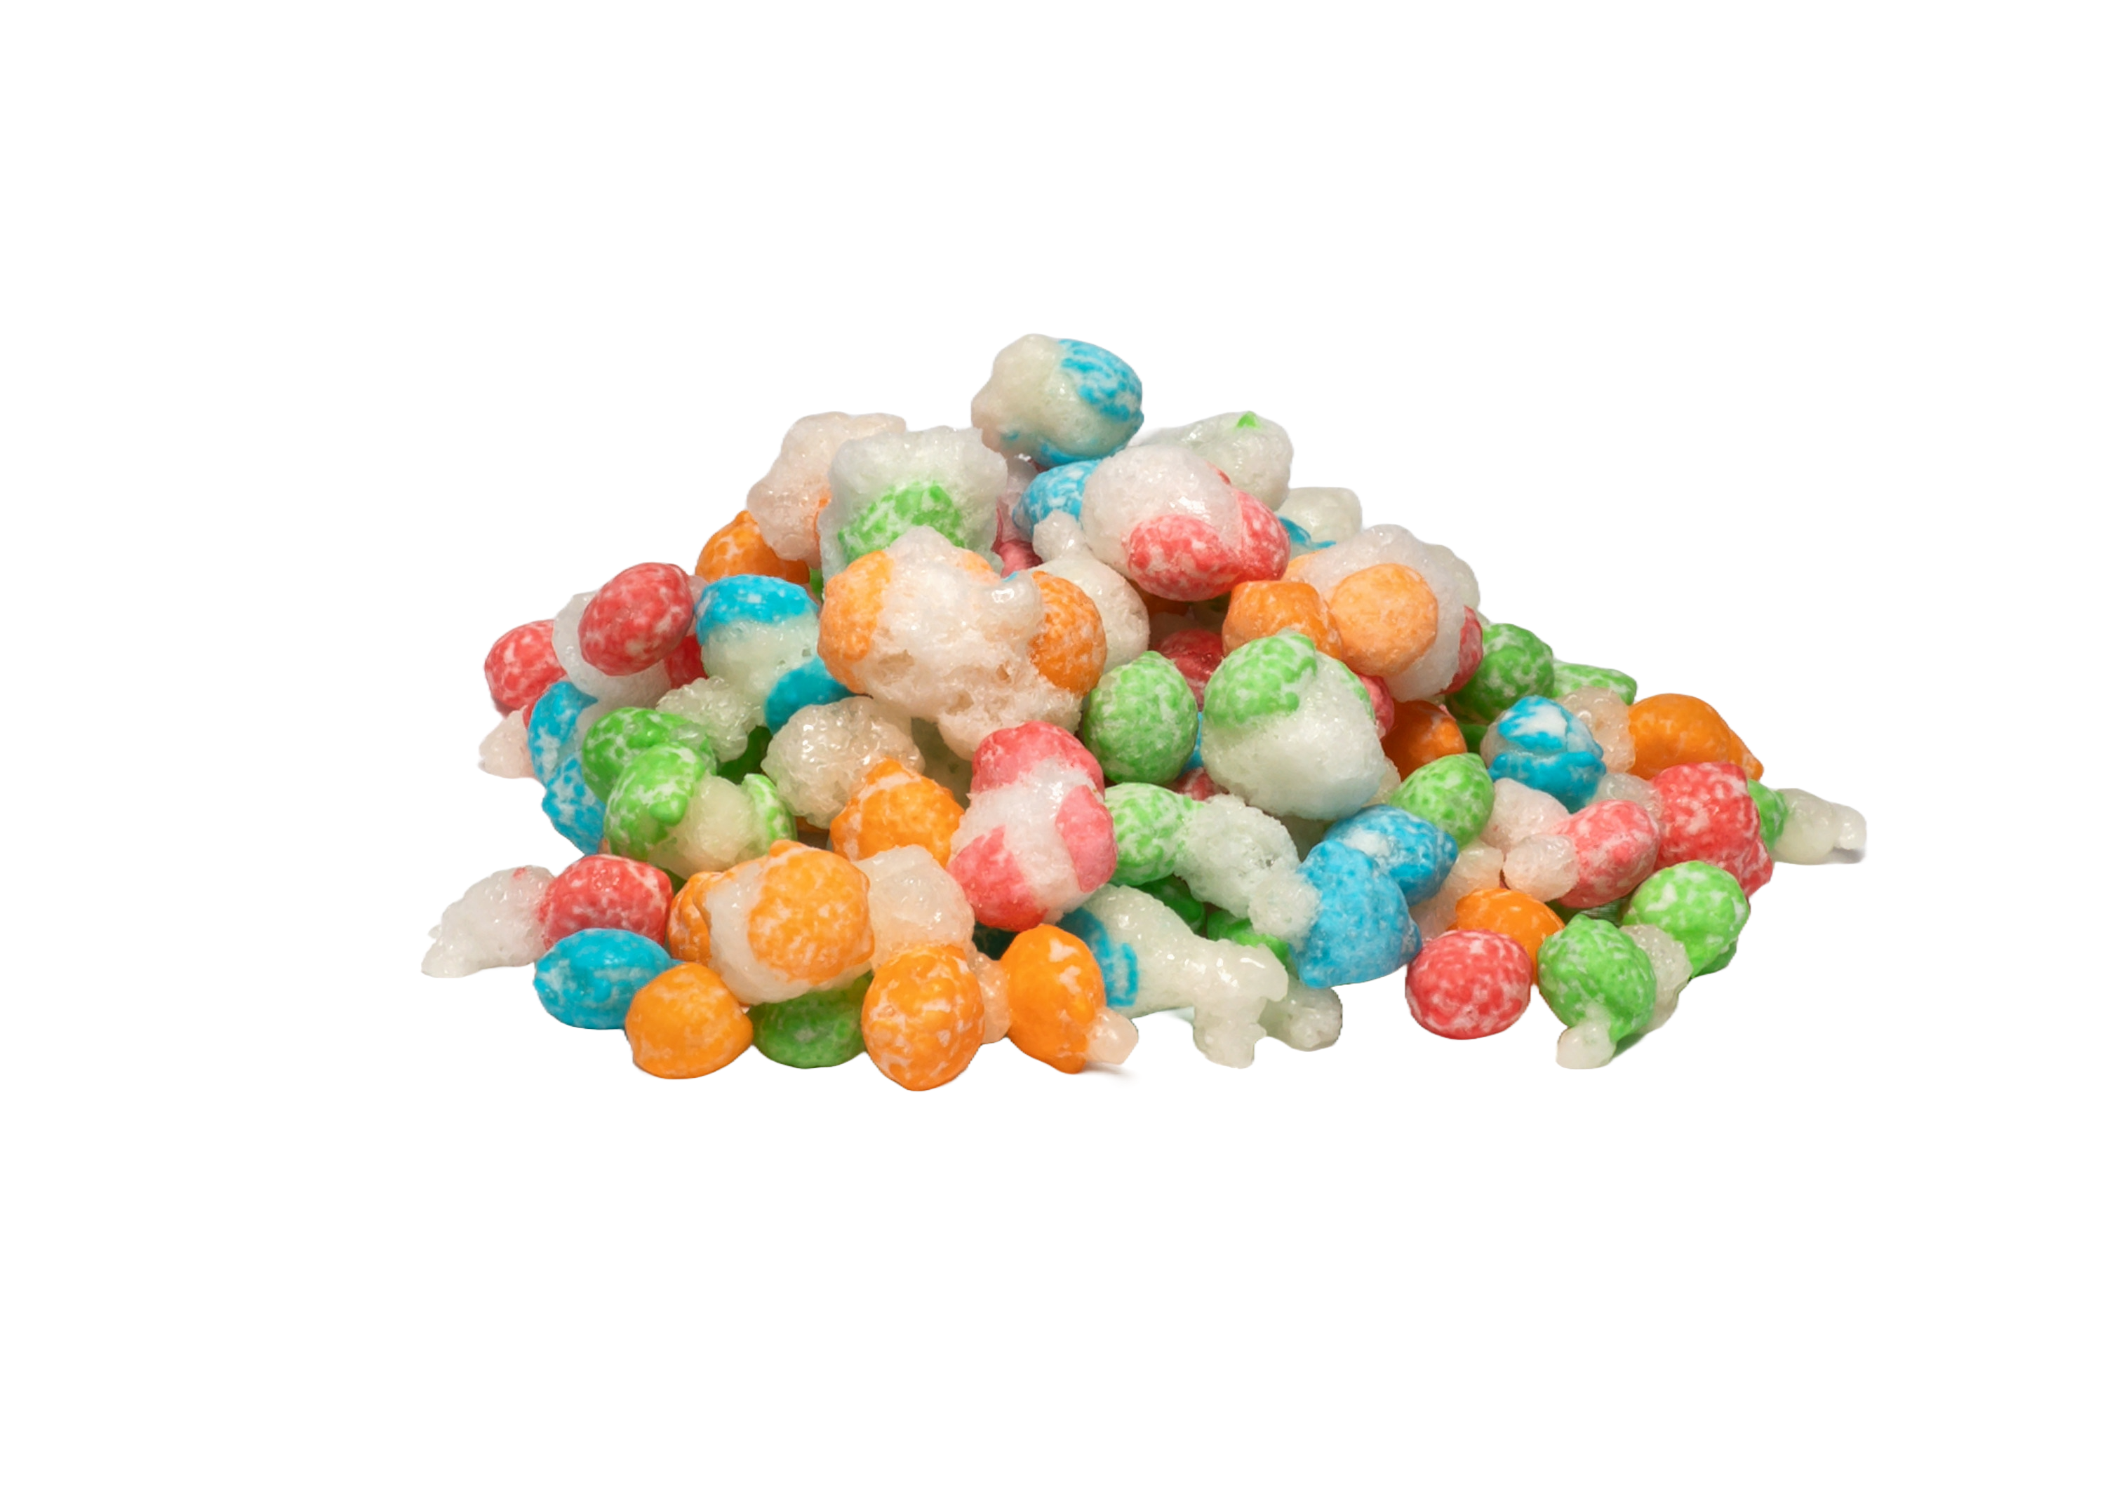
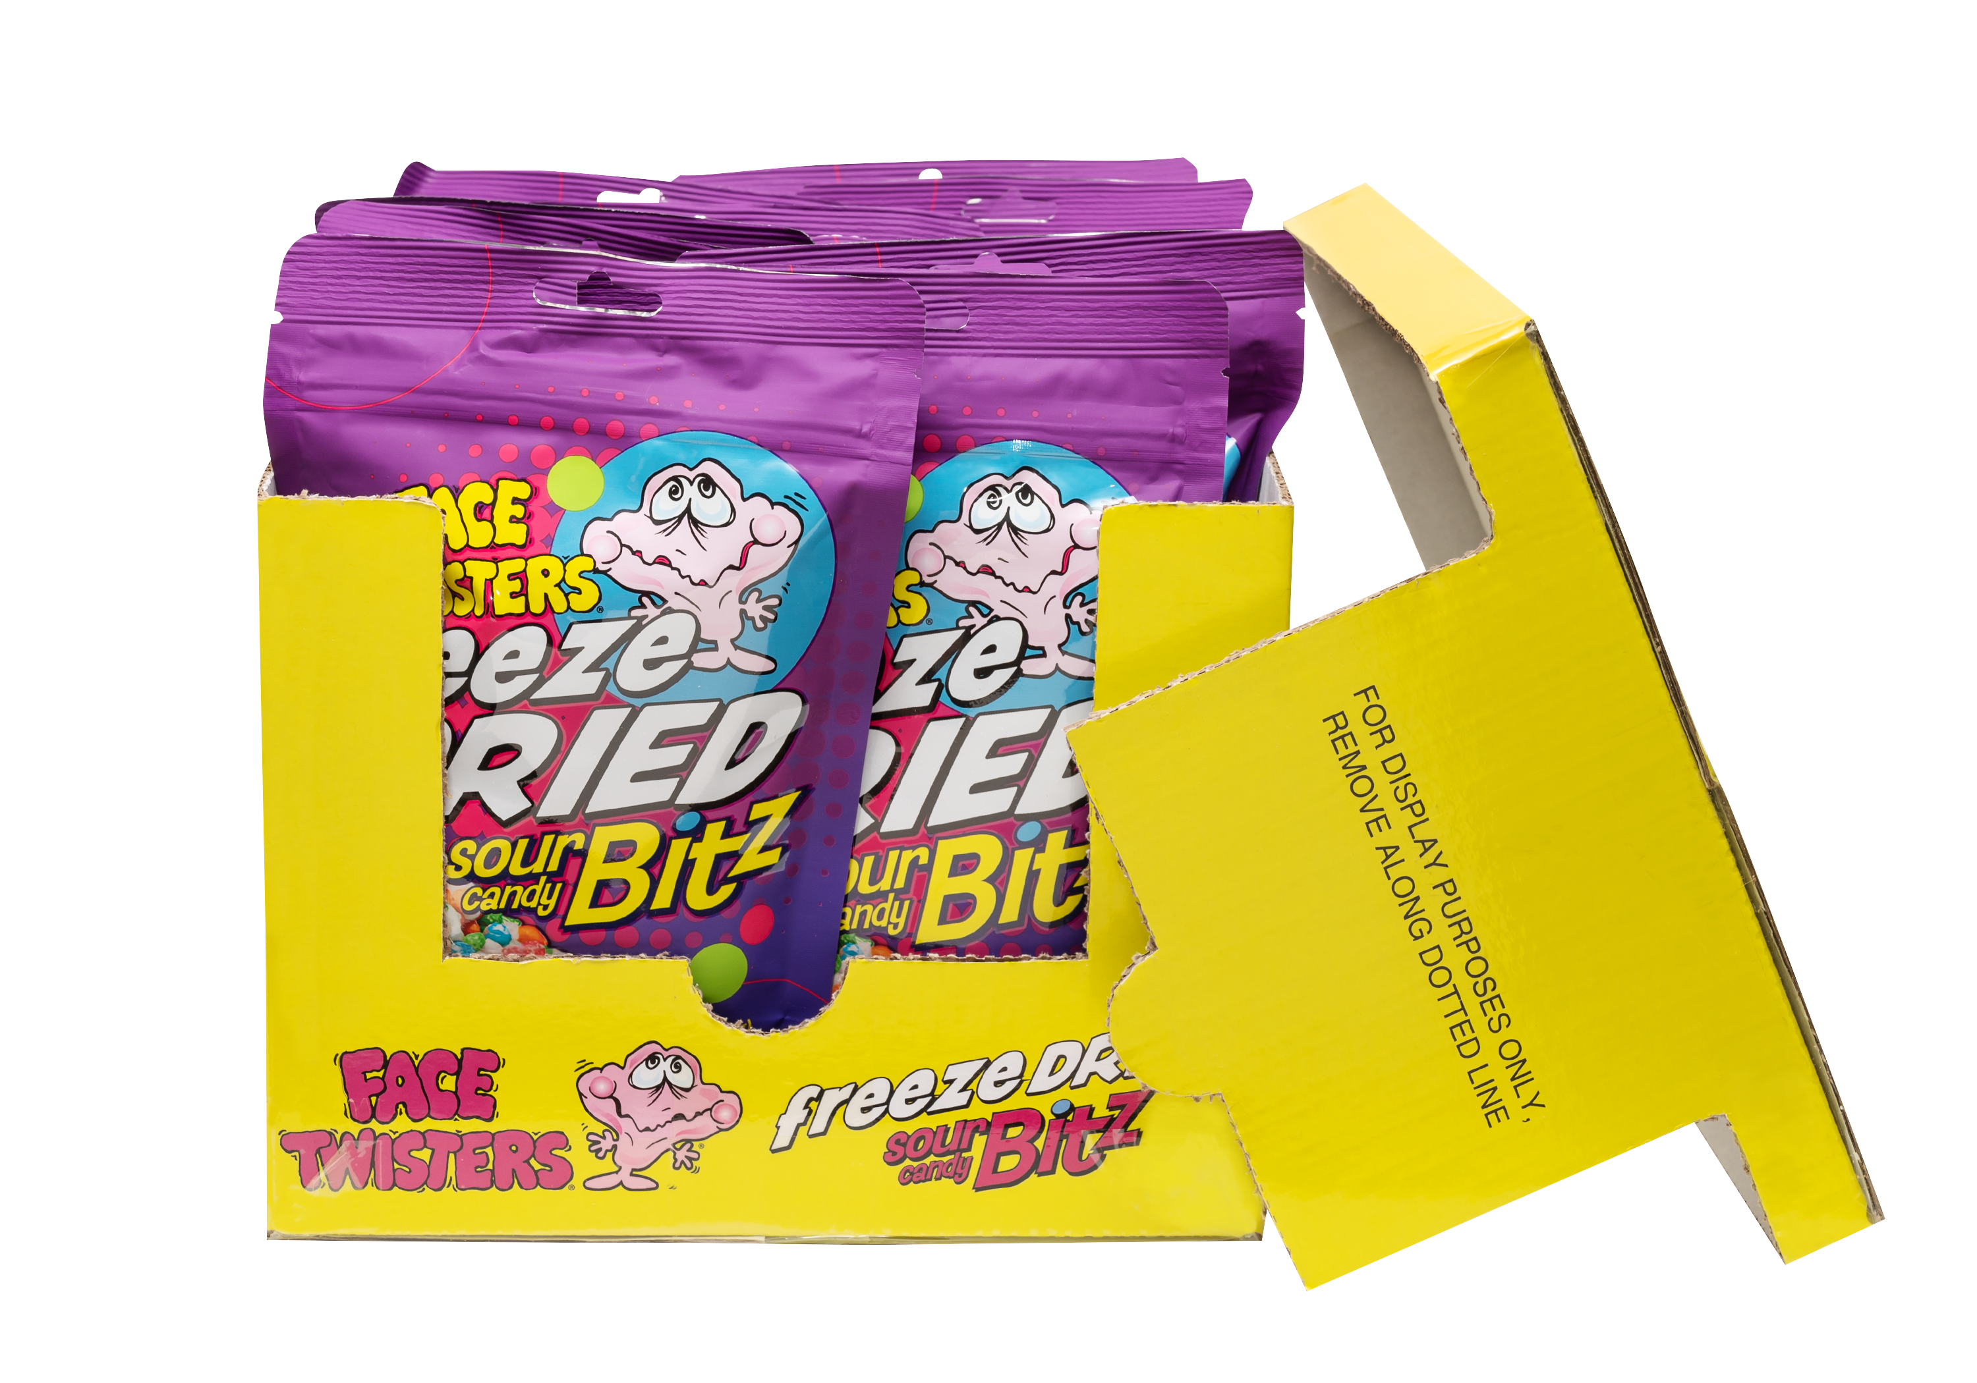
NEW!
FREEZE DRIED SOUR CANDY BITZ™ 12 ct DRC
Freeze Dried Reimagined. Taste the Difference!
Freeze Dried Sour Candy Bitz™ in Strawberry + Green Apple + Blue Raspberry + Orange
Item 31010
1.76 oz (50g)
Unit Cost | $ 2.19
Case Cost | $ 26.28
ITEM | UNIT UPC
Freeze Dried Sour Candy Bitz™ | 7-93216-31010-9
12 ct Display
Ready Case
Case GTIN | 007-93216-31010-9
Case Dimensions | 8.11” W x 10.24” D x 6.06” H
Case Weight | 2.15 lbs
Case Cube | 0.29

