Slide 1
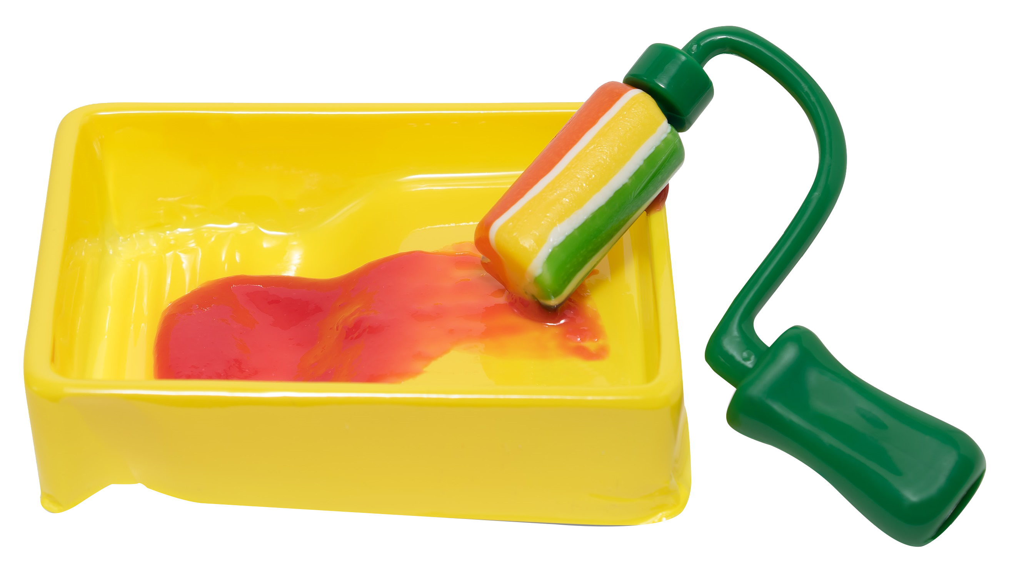
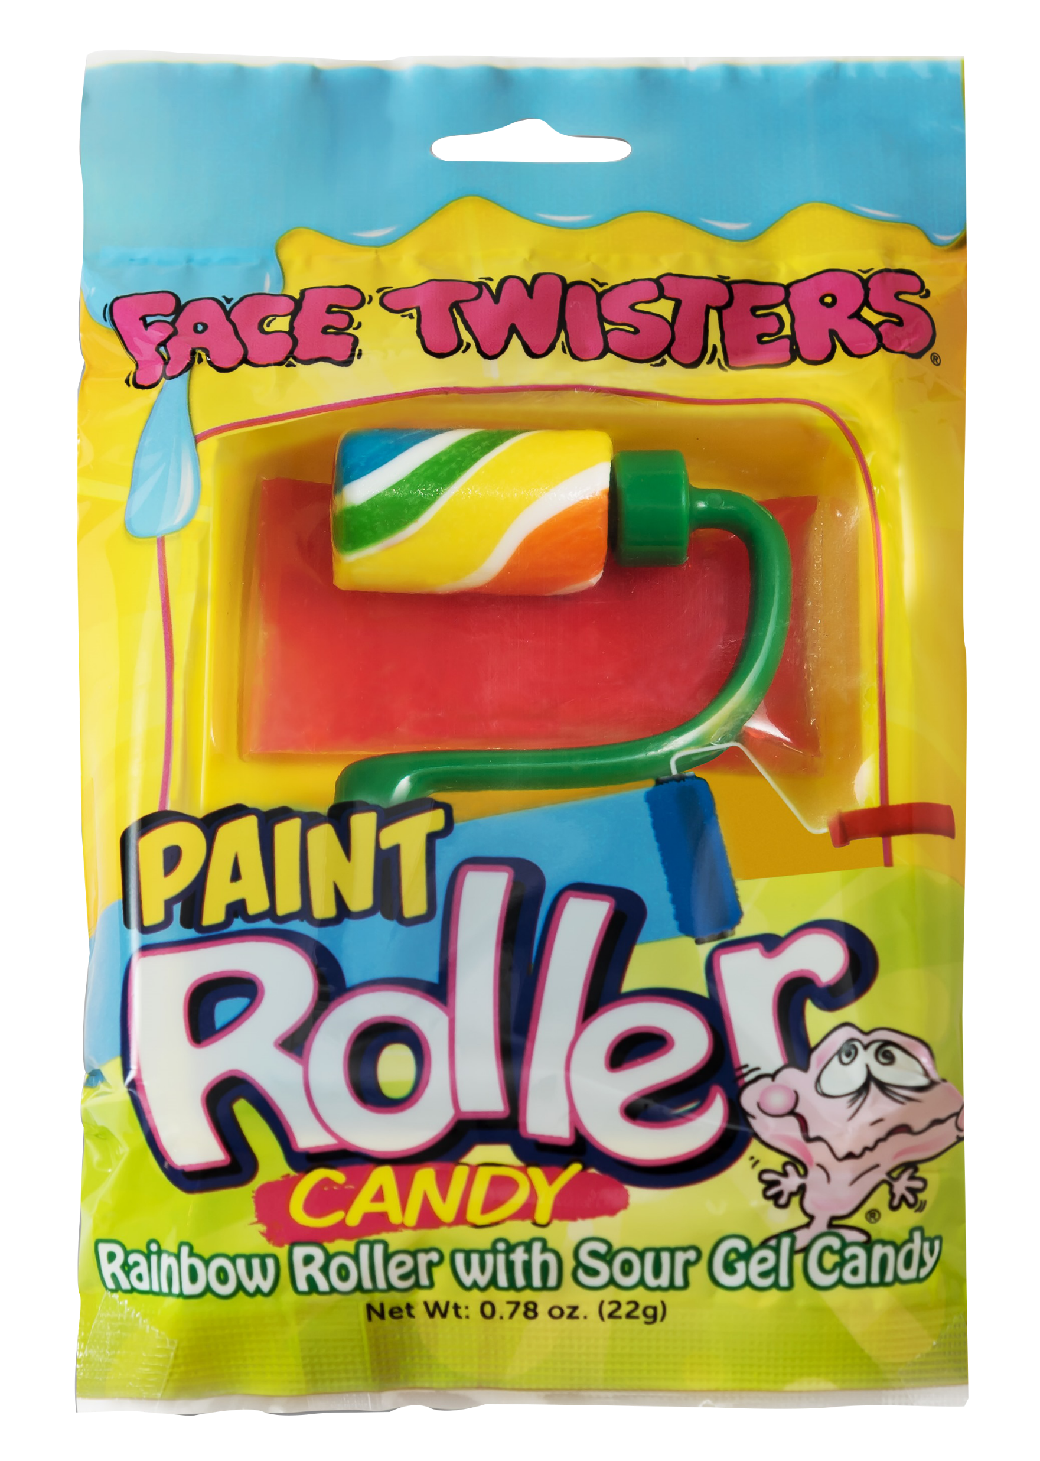
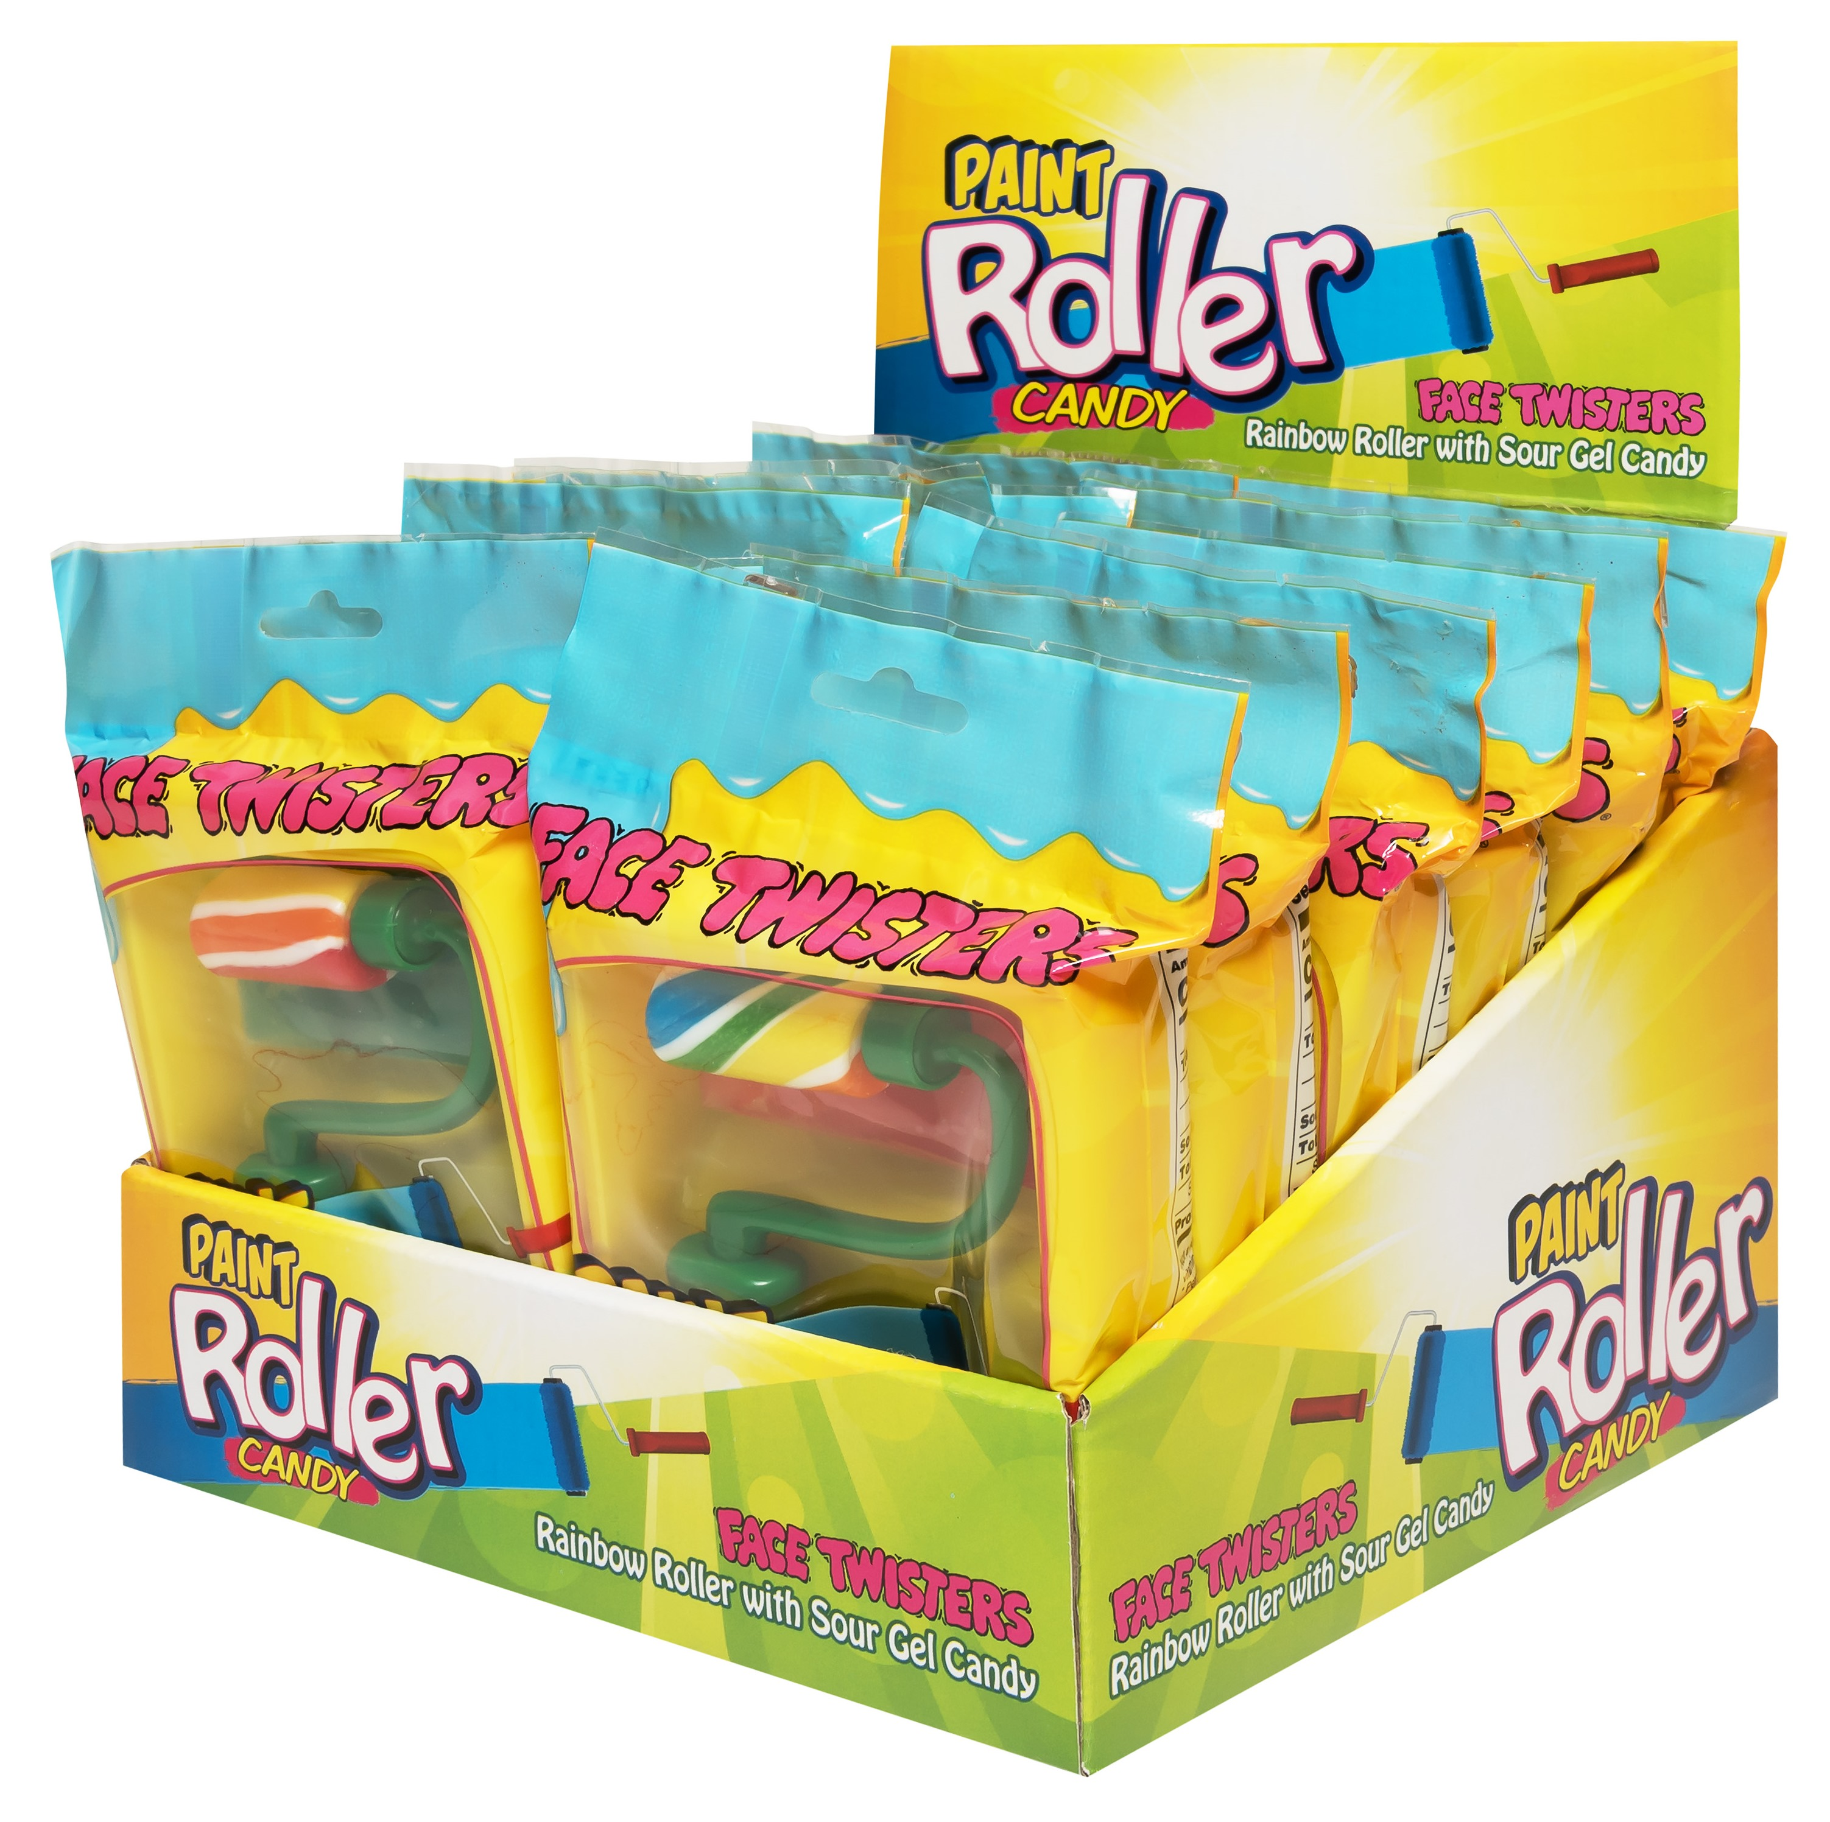
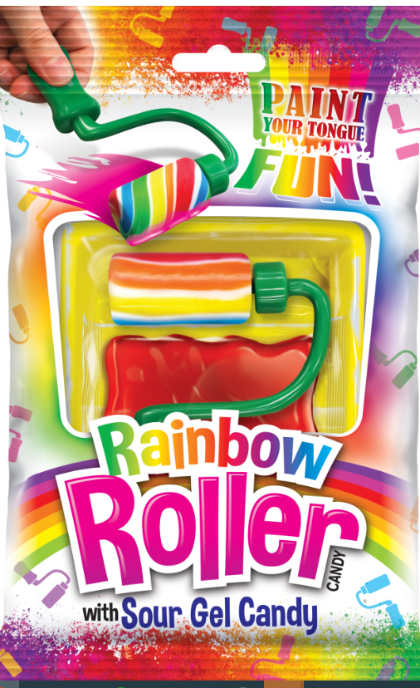
THE “ORIGINAL” PAINT ROLLER® CANDY 8/12 ct Case
Rainbow Hard Candy Twisted on a Paint Roller That Can Be Dipped or Rolled into Sour Gel Candy.
Item # 12010
0.78 oz (22g)
Unit Cost | $ 1.07
Case Cost | $ 102.72
ITEM | UNIT UPC
Paint Roller® Candy | 7-93216-12030-2
Case GTIN | 007-93216-12010-4
Case Dimensions | 15.04” L x 15.51 W x 10.63” H
Case Weight | 11.35 lbs
Case Cube | 1.44
NOTE: NOT TO BE CONFUSED WITH THE FOREIGN CANDY COMPANY’S RAINBOW ROLLER CANDY WHICH SELLS FOR $ 1.49 PER UNIT OR 40% MORE.

