Slide 1
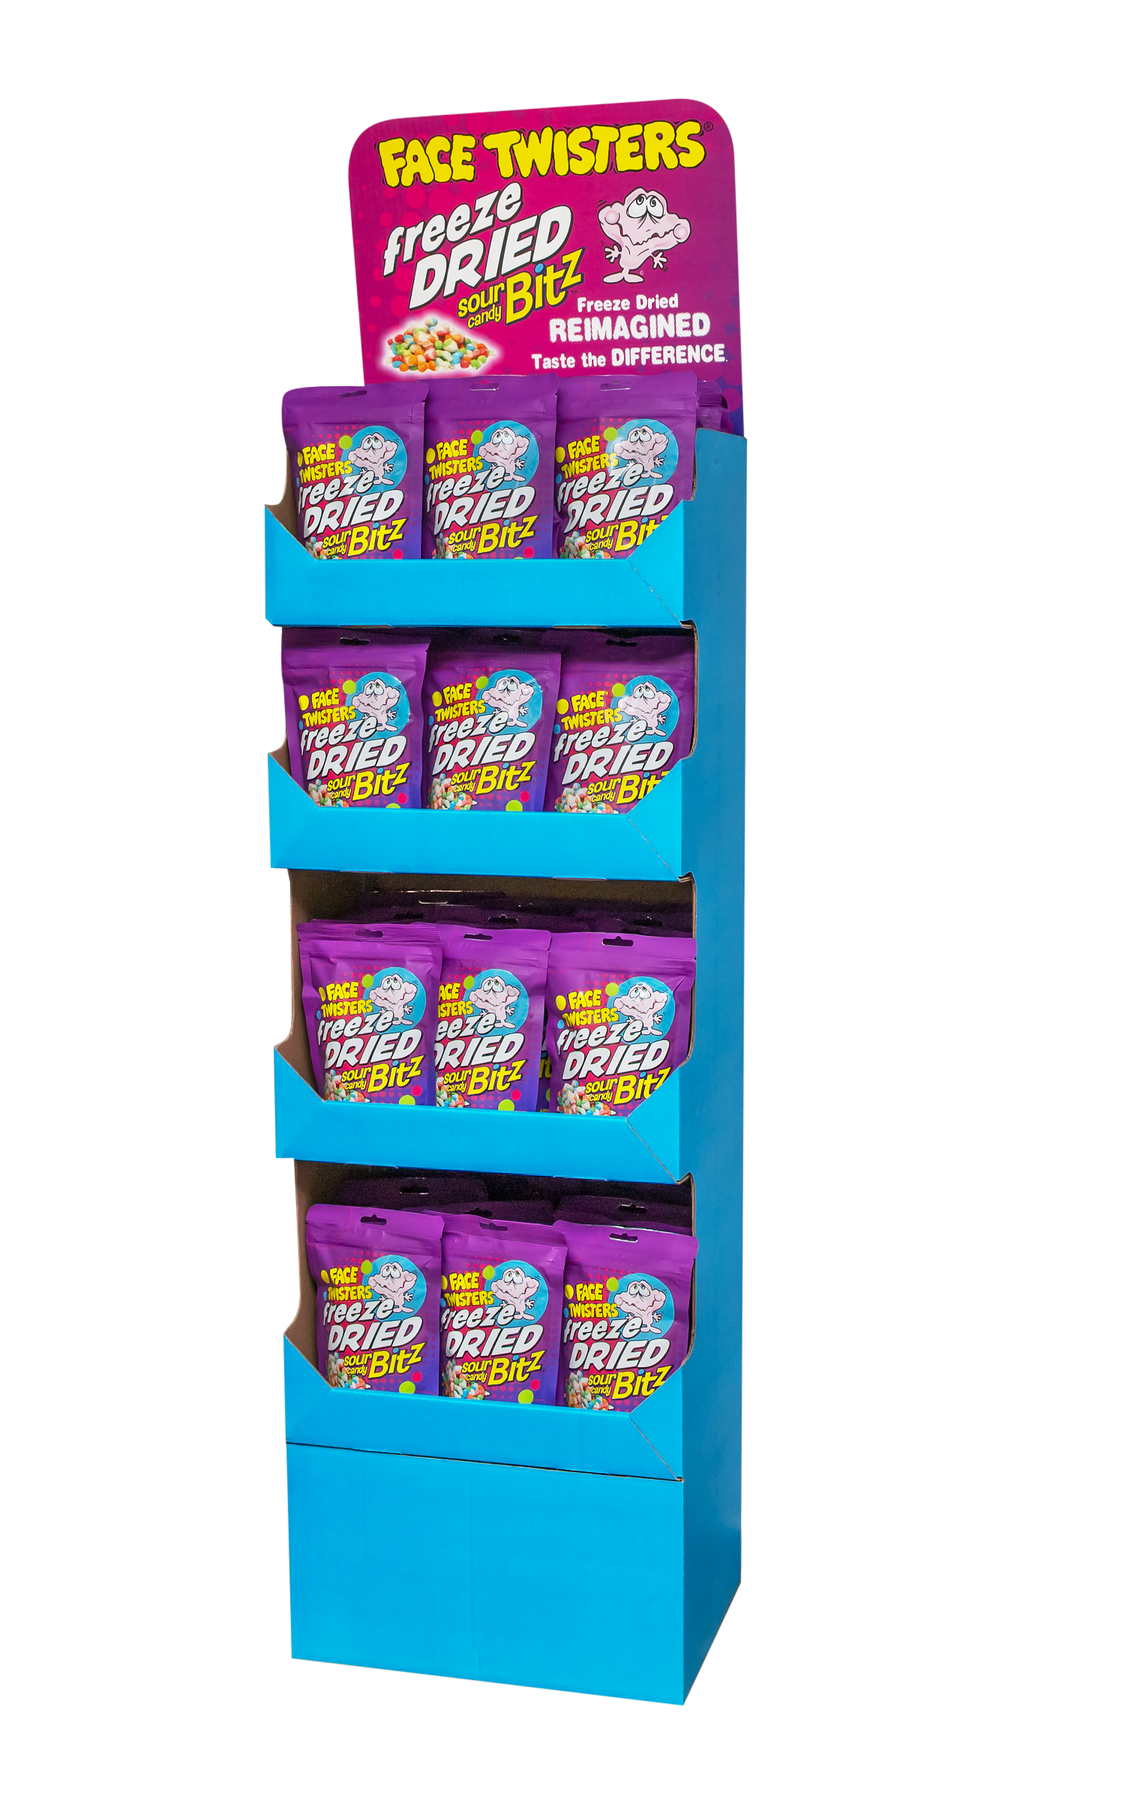
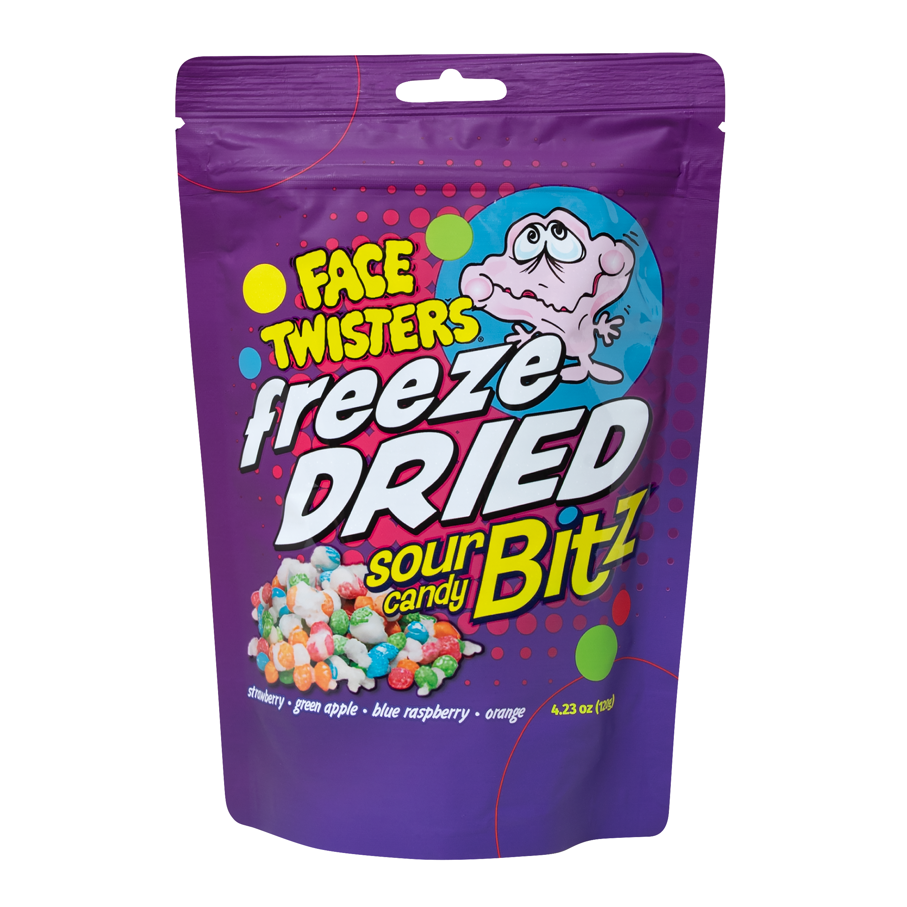
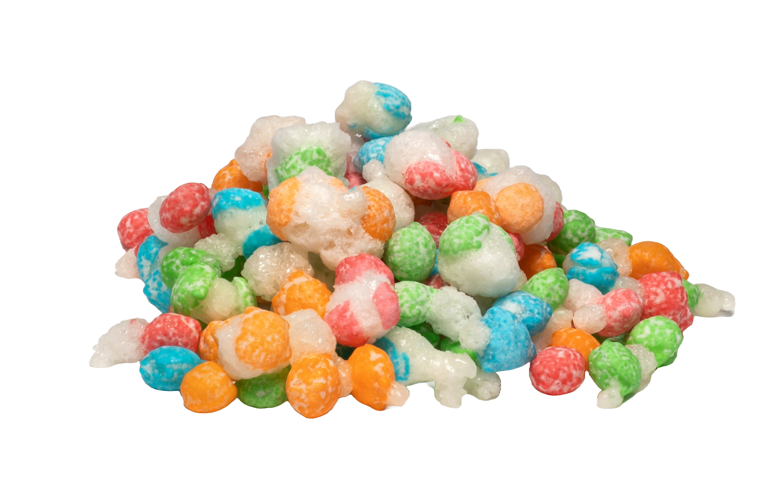
NEW!
48 ct FREEZE DRIED SOUR CANDY BITZ™ FLOOR SHIPPER
Freeze Dried Sour Candy Bitz™ in Strawberry + Green Apple + Blue Raspberry + Orange
Item # 35010
4.23 oz (120g)
Unit Cost | $ 4.00
Case Cost | $ 192.00
Freeze Dried Reimagined. Taste the Difference!
Case GTIN | 007-93216-34010-6
Unit UPC | 7-93216-31030-7
Case Dimensions | 47” L x 15.5” W x 9.5” H
Case Weight | 23.3 LBS
Case Cube | 4.00

