Slide 1
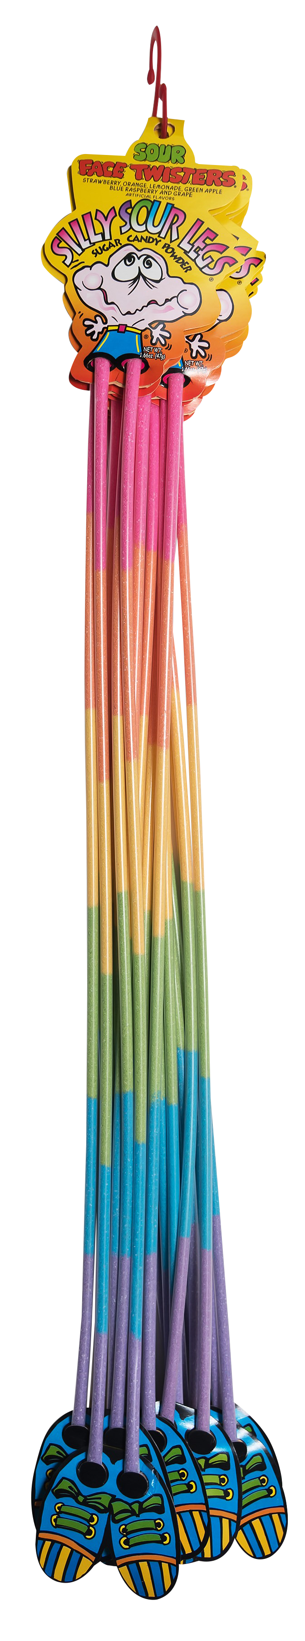
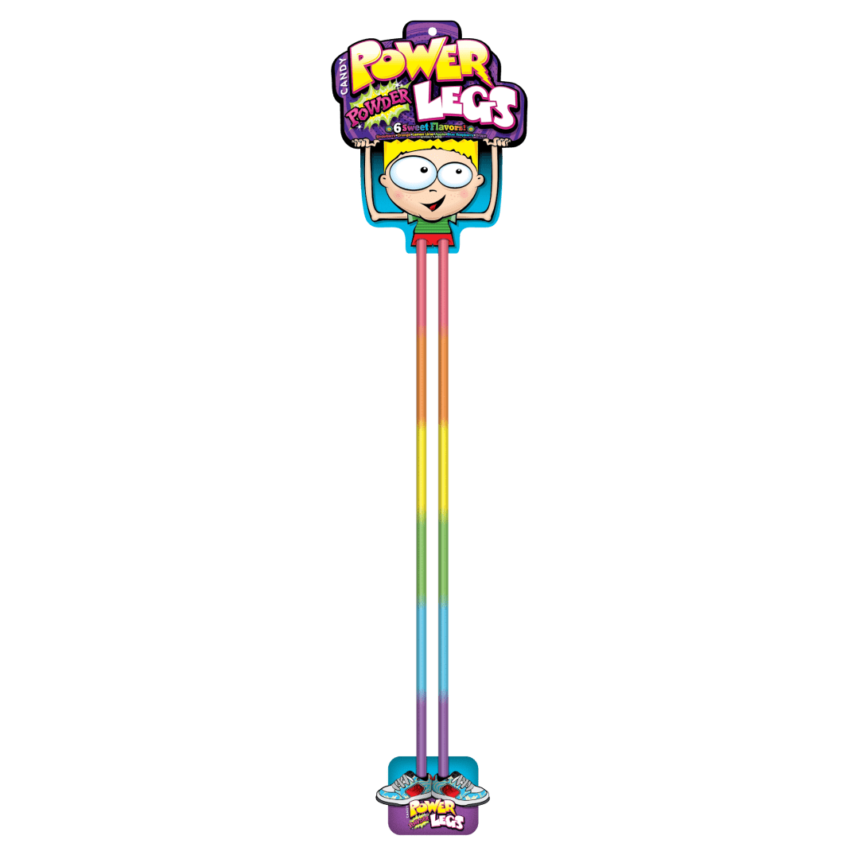
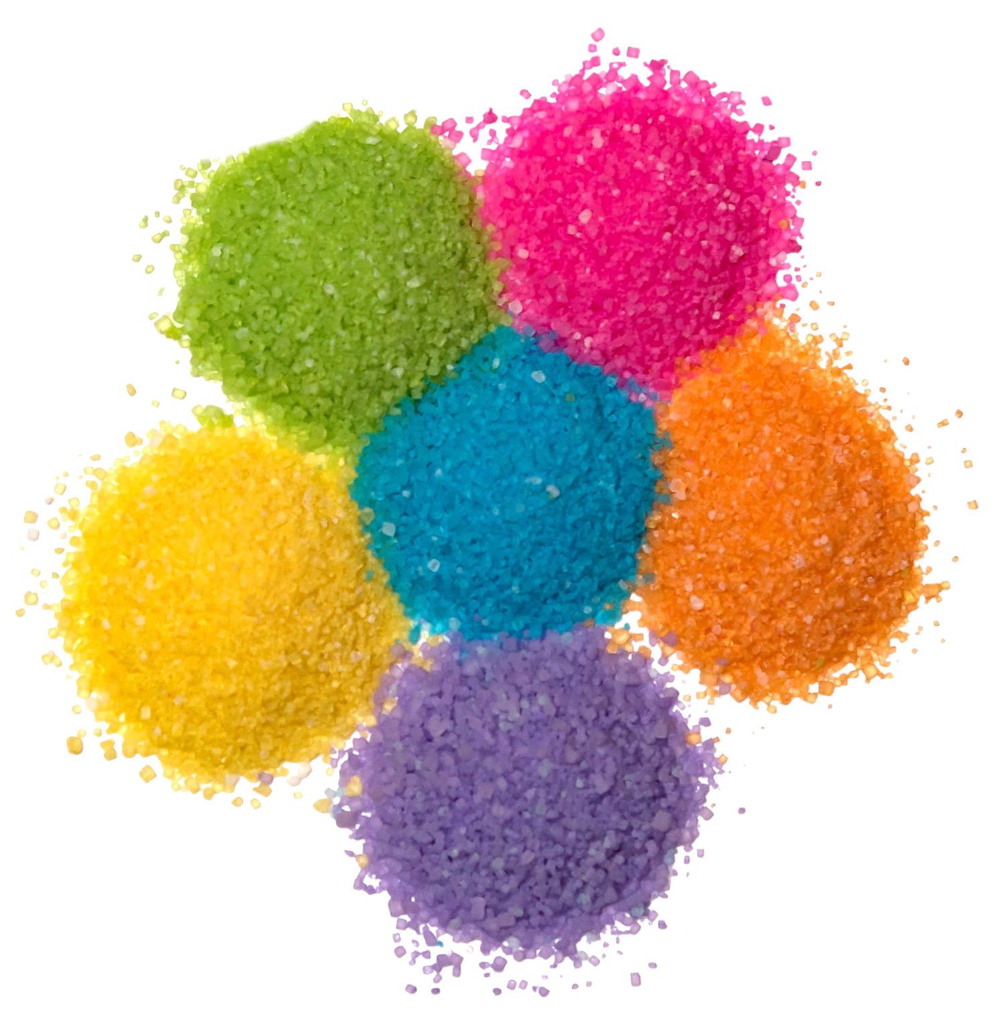
Over 7 million units sold
THE “ORIGINAL” SILLY SOUR LEGS®
2 – 12 “S” Hooks
Fruit-Flavored Sour Powder Straws in Strawberry + Orange + Lemonade + Green Apple + Blue Raspberry + Grape.
Unit Cost | $ 1.10
Case Cost | $ 26.40
Item # 07010
1.66 oz (44g)
NOTE: NOT TO BE CONFUSED WITH THE FOREIGN CANDY COMPANY’S POWER POWDER LEGS WHICH SELL FOR $1.99 PER UNIT OR 81% MORE
Case GTIN | 007-93216-07010-2
Case Dimensions | 35.24” L x 5.29: W x 3.44” H
Case Weight | 3.83 LBS
Case Cube | 0.37
ITEM | UNIT UPC
Silly Sour Legs® | 7-93216-07030-1

