Slide 1
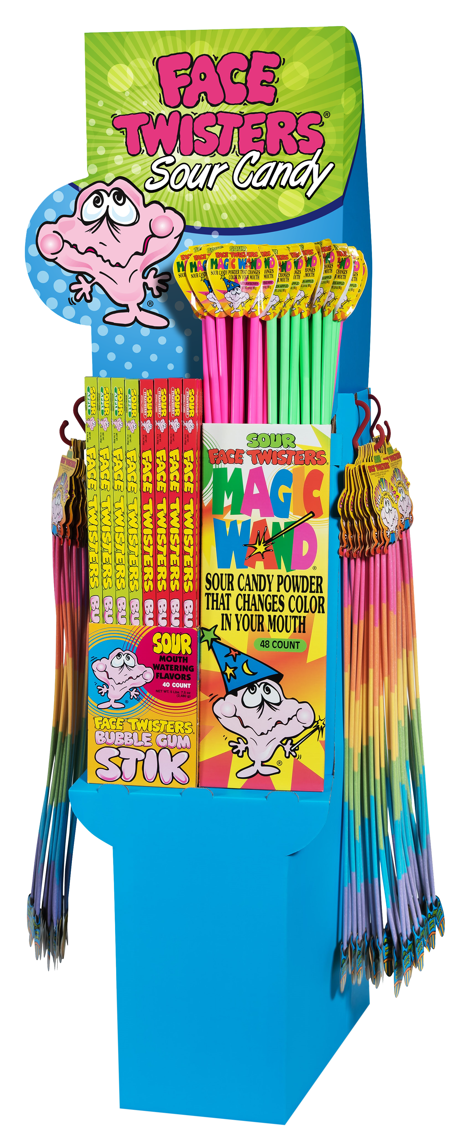
OVER 50,000 SOLD!
136 CT SOUR CENTER ASSORTMENT “A”
Item # 09010
Contains:
20 units Big Stik® Strawberry
  20 units Big Stik® Green Apple
  24 units Magic Wand® Strawberry
  24 units Magic Wand® Green Apple
  48 units Silly Sour Legs®
Unit Cost | $ 1.10
Case Cost | $ 149.60
ITEM | UNIT UPC
Big Stik® Strawberry | 7-93216-06030-1
Big Stik® Green Apple | 7-93216-06031-8
Silly Sour Legs® | 7-93216-07030-0
Magic Wand® Strawberry | 7-93216-08031-6
Magic Wand® Green Apple | 7-93216-08030-9
Case GTIN | 007-93216-09010-0
Case Dimensions | 35.93” L x 25.21” W x 6.16” H
Case Weight | 28.5 LBS
Case Cube | 3.23

