Slide 1
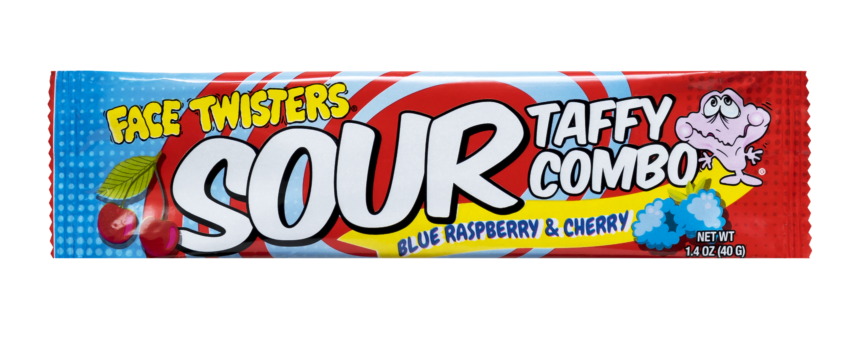
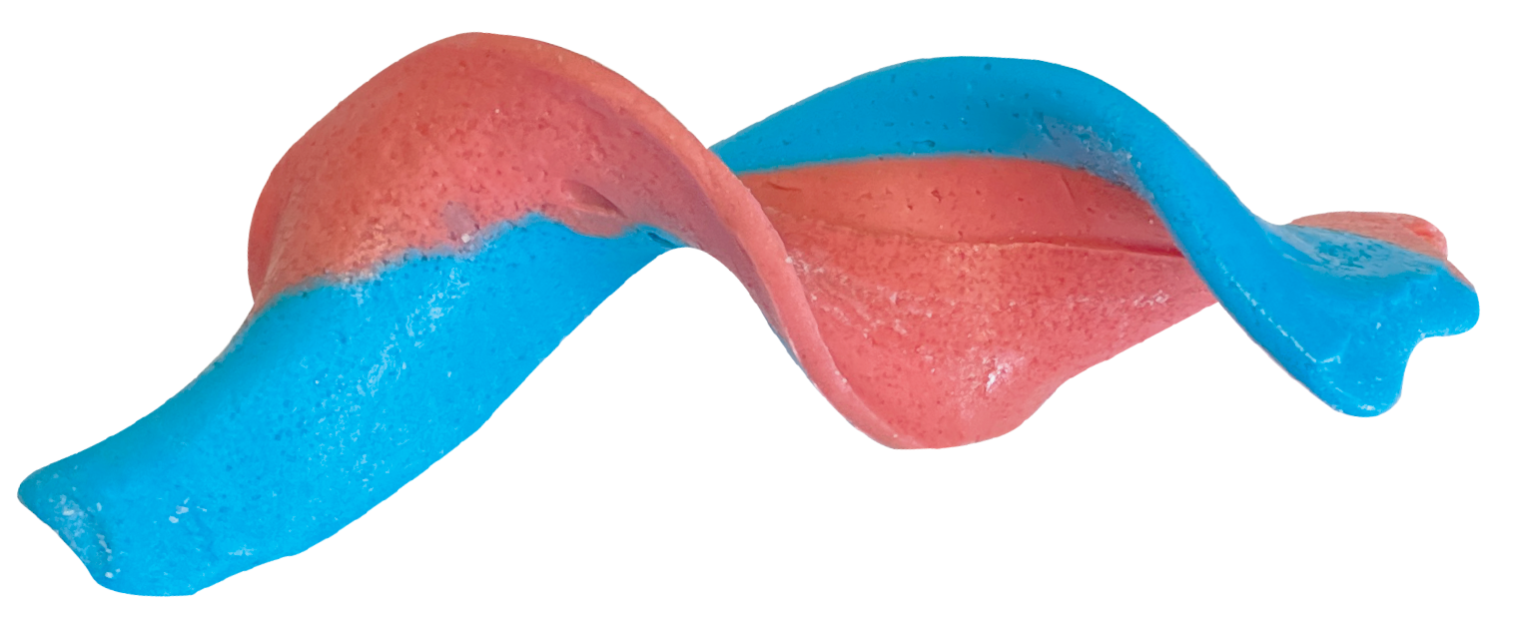
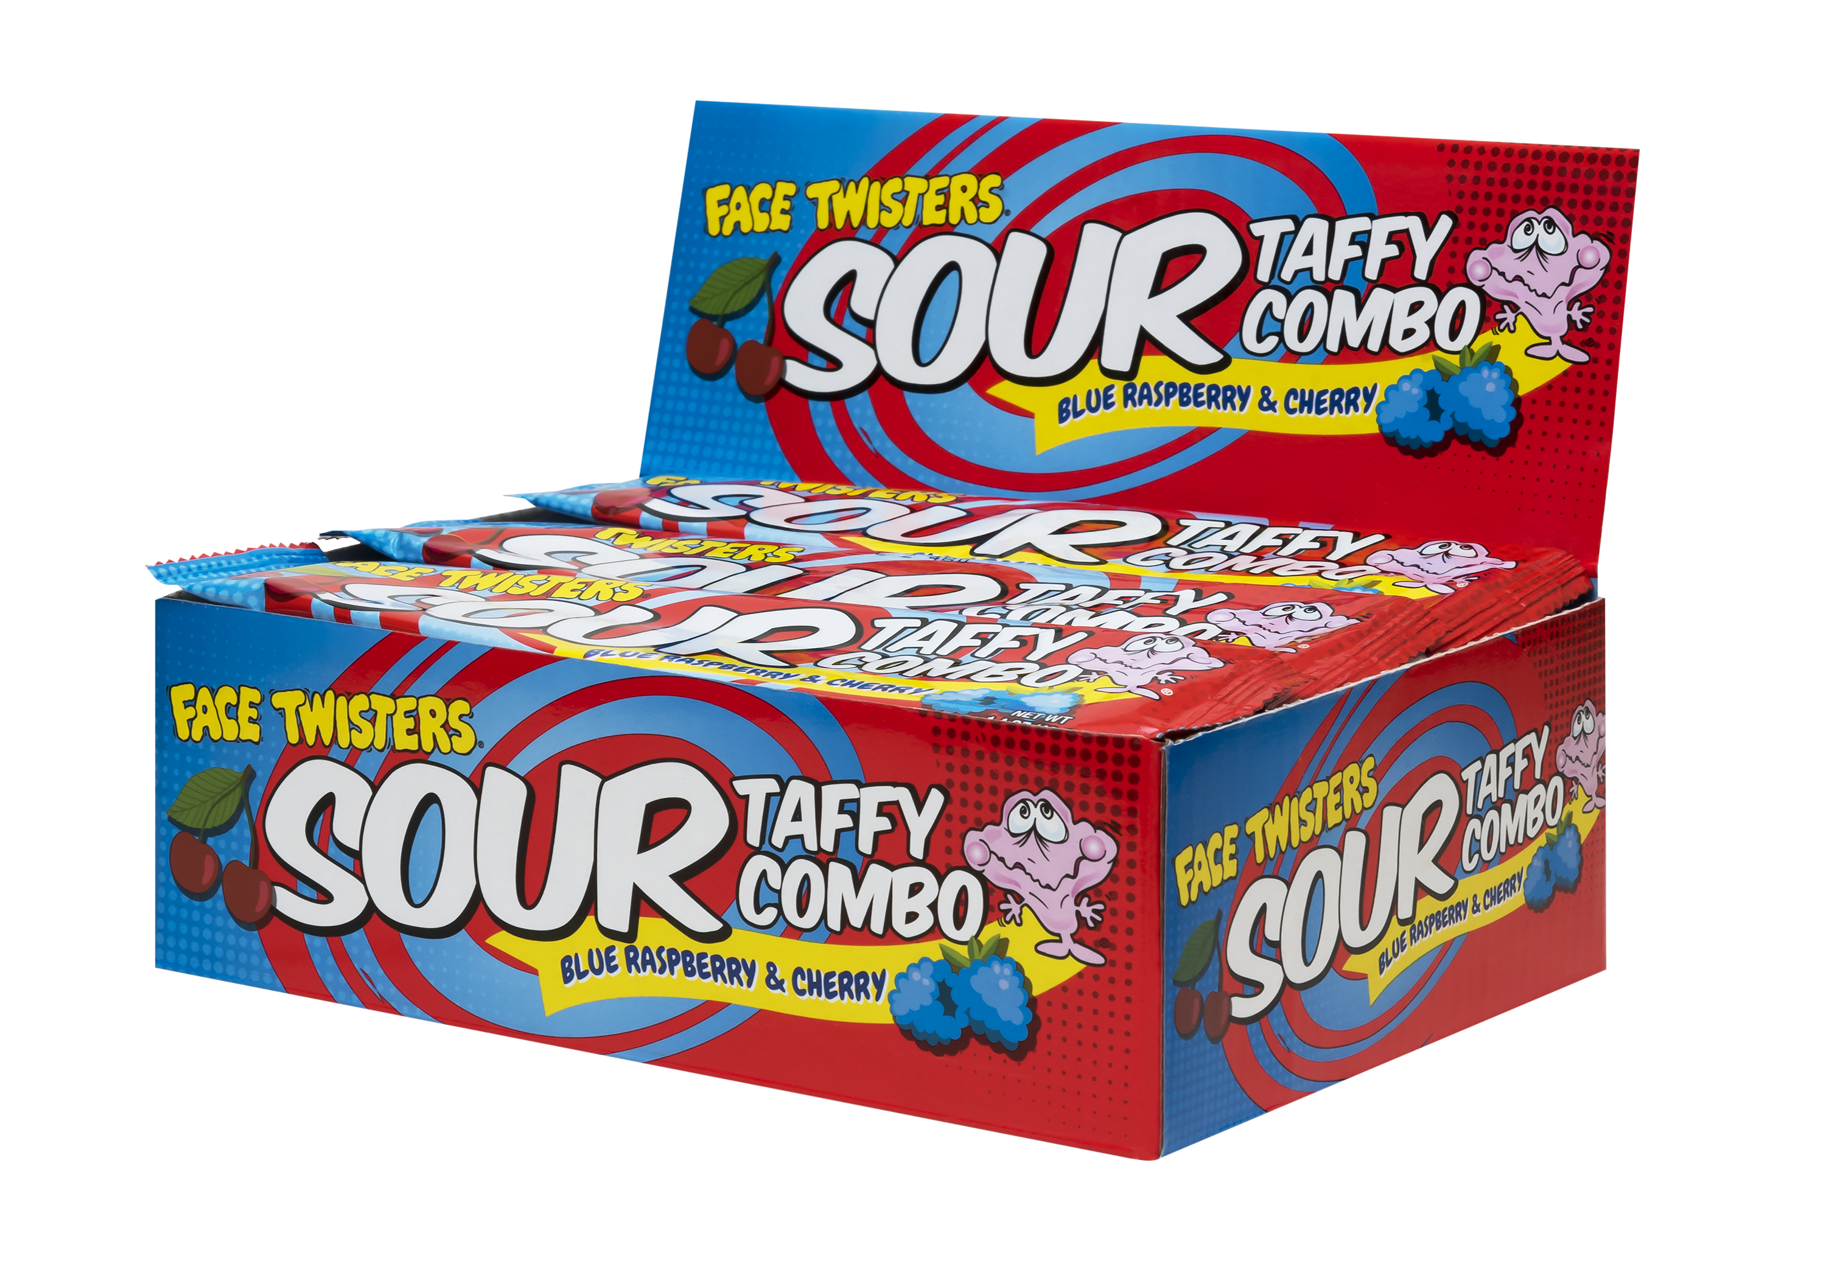
SOUR TAFFY COMBO BAR
BLUE RASPBERRY & CHERRY
2 – 24 ct Case
Super sour taffy bar that is half Blue Raspberry + half Cherry
Item # 52000
1.4 oz (40g)
Unit Cost | $ 0.76
Case Cost | $ 36.48
ITEM | UNIT UPC
Sour Taffy Combo Bar Blue Raspberry & Cherry | 7-93216-52020-1
Case GTIN | 007-93216-52000-3
Case Dimensions | 8.54” L x 6.49” W x 7” H
Case Weight | 5.28 lbs
Case Cube | 0.23

