Slide 1
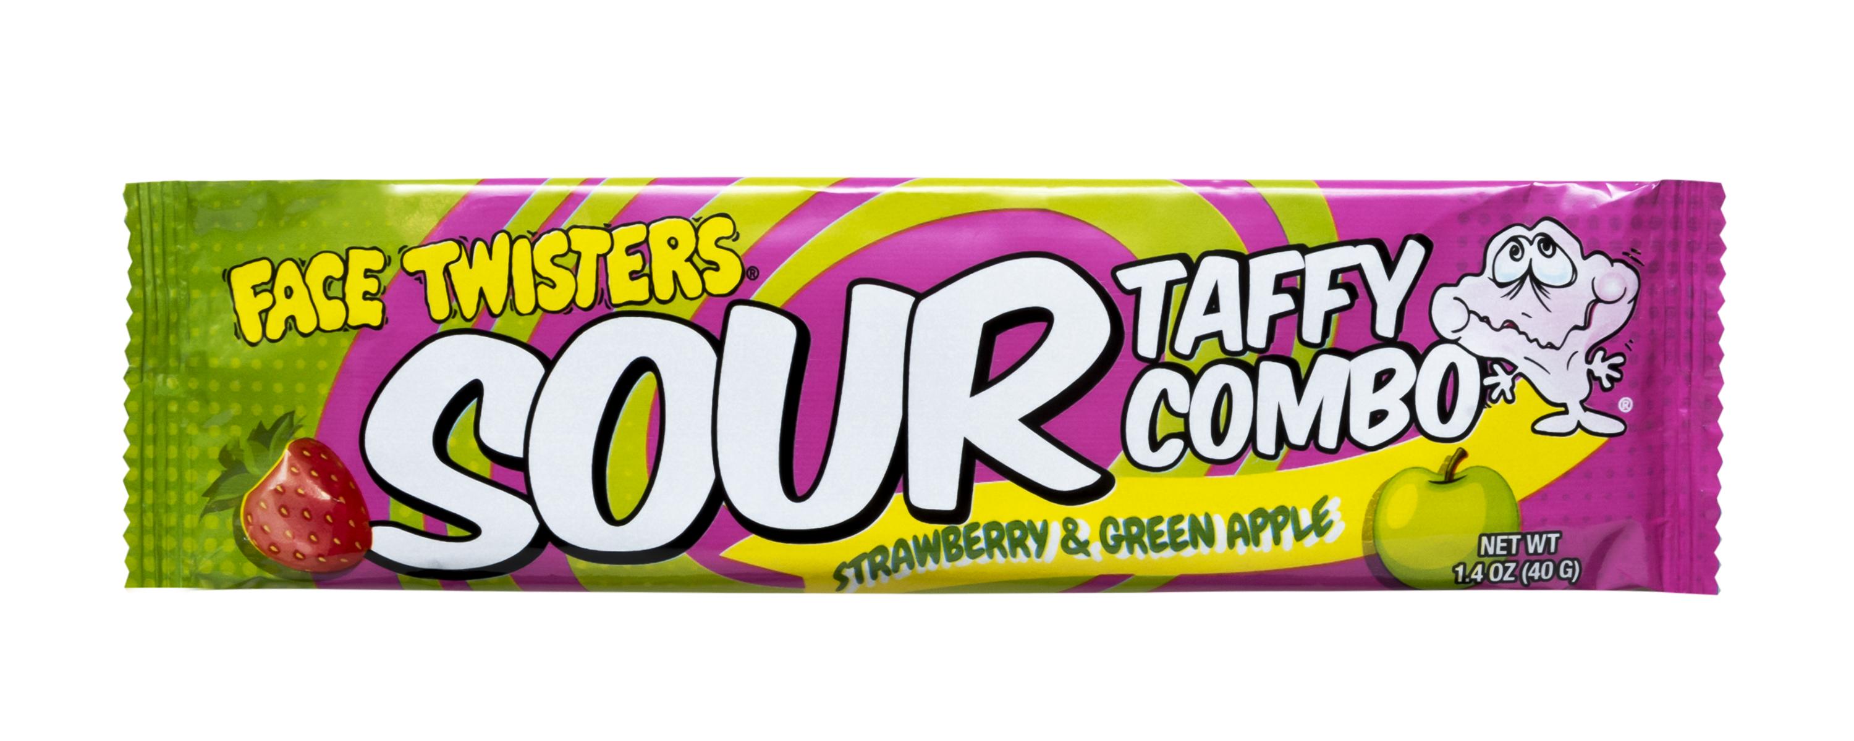
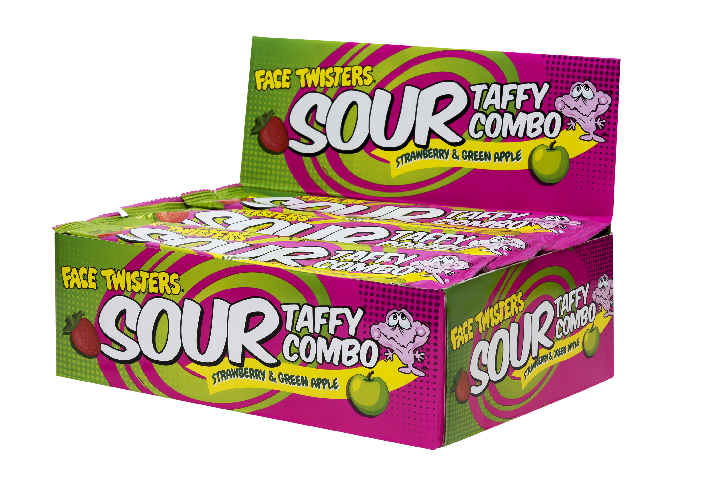
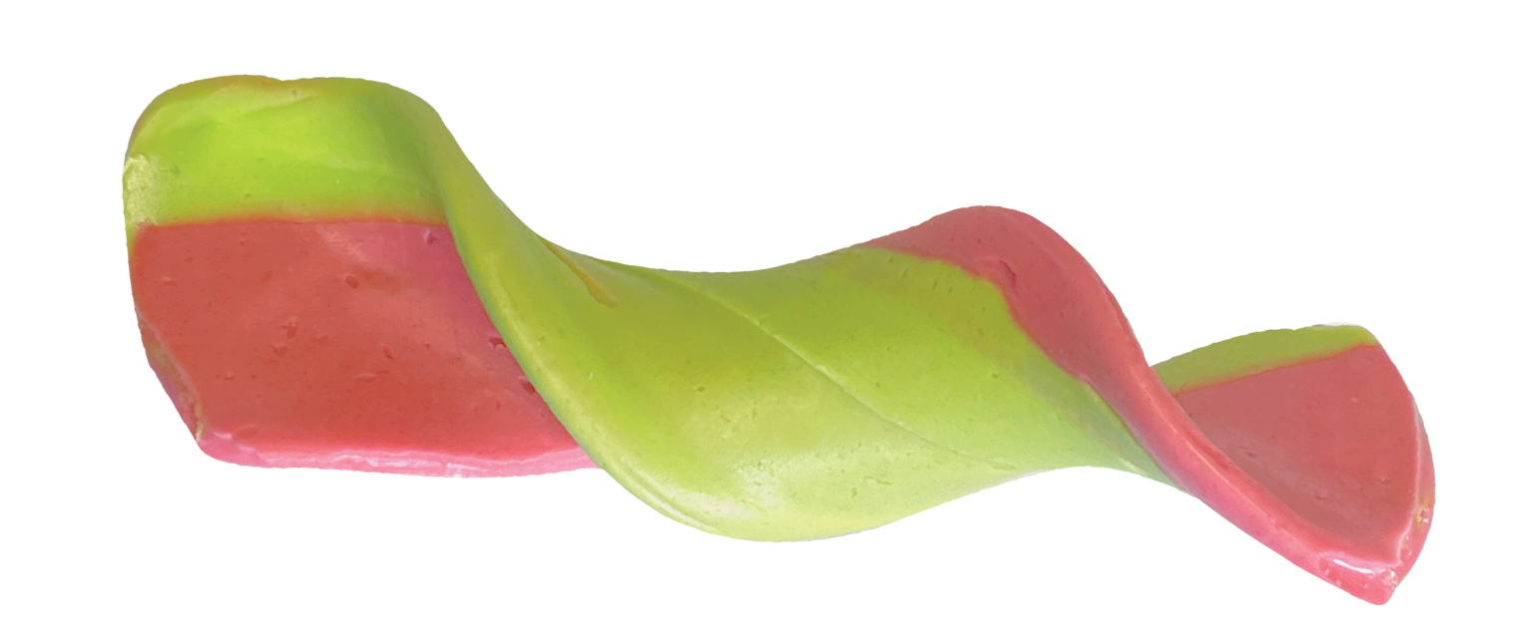
SOUR TAFFY COMBO BAR
STRAWBERRY & GREEN APPLE
2 – 24 ct Case
Super sour taffy bar that is half Strawberry + half Green Apple
Item # 51000
1.4 oz (40g)
Unit Cost | $ 0.76
Case Cost | $ 36.48
ITEM | UNIT UPC
Sour Taffy Combo Bar Strawberry & Green Apple | 7-93216-51020-2
Case GTIN | 007-93216-51000-4
Case Dimensions | 8.54” L x 6.49” W x 7” H
Case Weight | 5.28 lbs
Case Cube | 0.23

