Slide 1
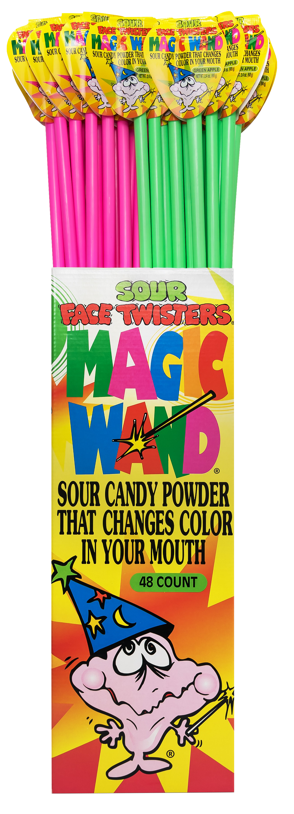
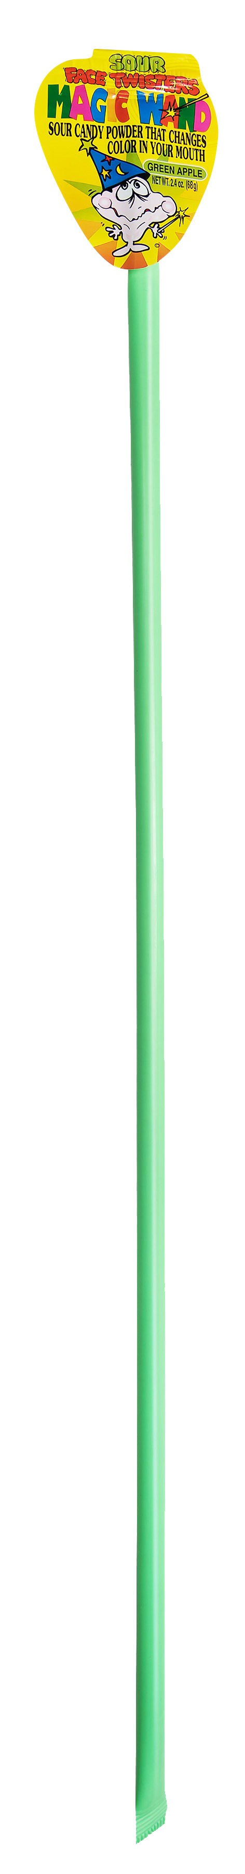
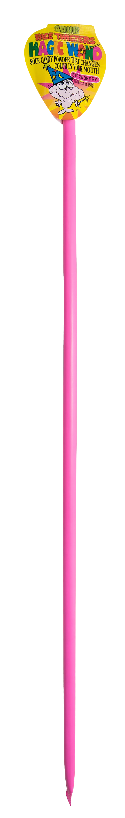
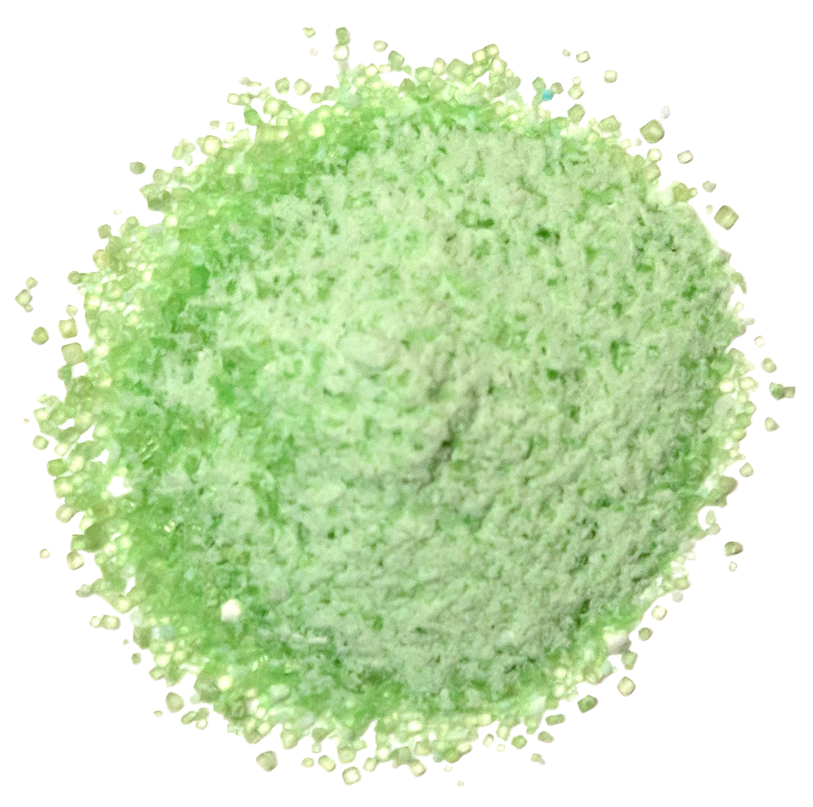
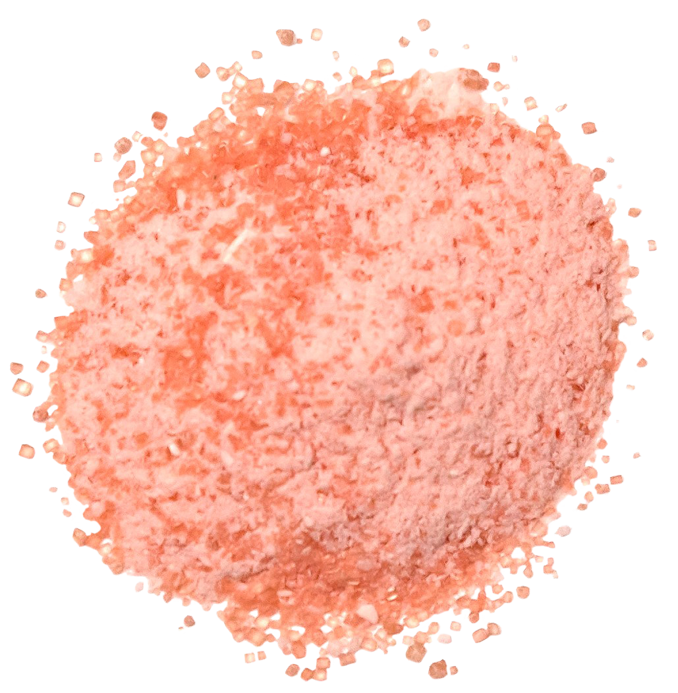
MAGIC WAND®
2/48 ct Sidekicks
Color-Changing Sour Powder in Strawberry and Green Apple
Item # 08010
2.43 oz (69g)
Unit Cost | $ 1.10
Case Cost | $ 105.60
Case GTIN | 007-93216-08010-1
Case Dimensions | 33.70” L x 6.13" W x 7.56” H
Case Weight | 18.25 LBS
Case Cube | 0.90
ITEM | UNIT UPC
Magic Wand® Strawberry | 7-93216-08031-6
Magic Wand® Green Apple | 7-93216-08030-9

