Slide 1
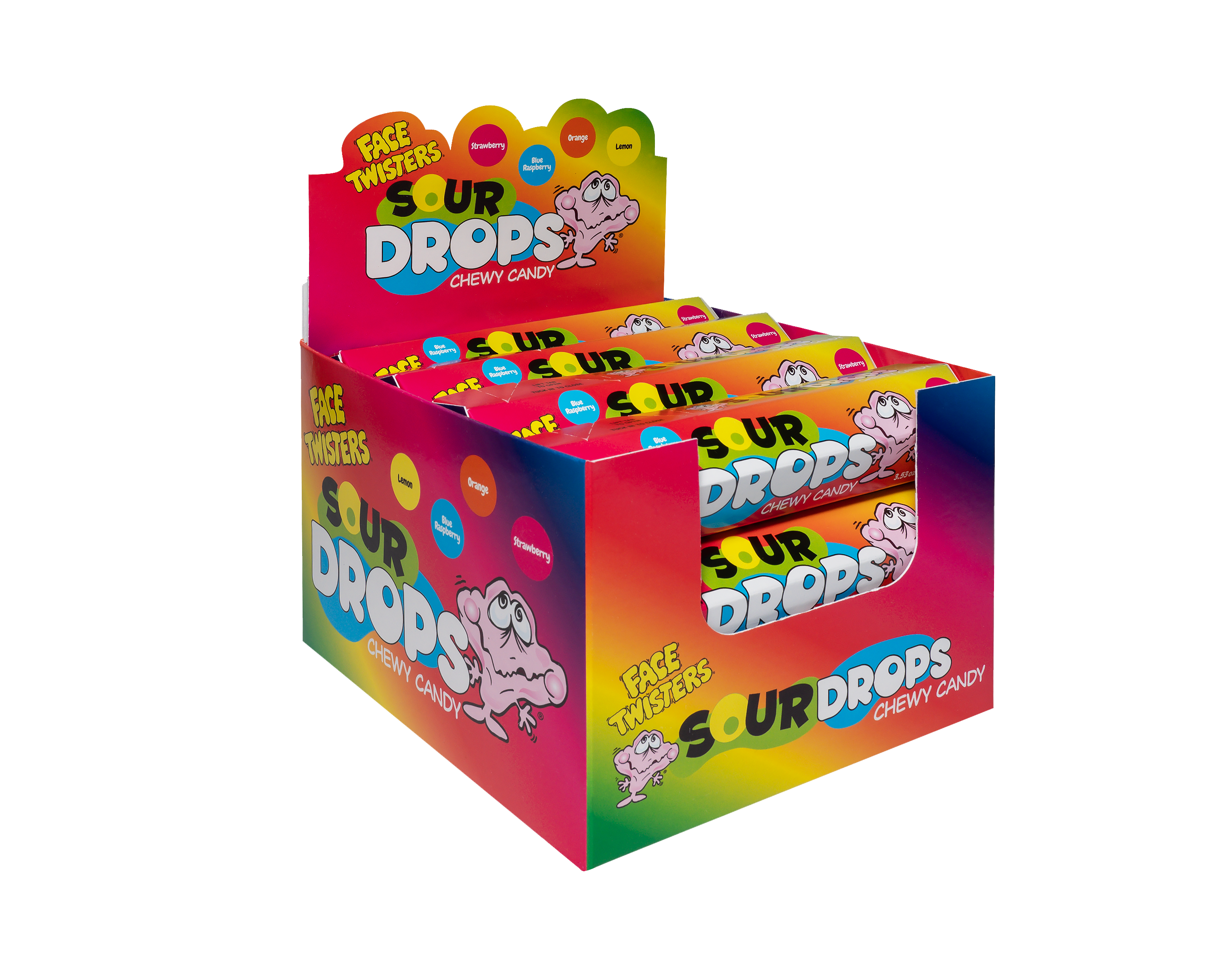
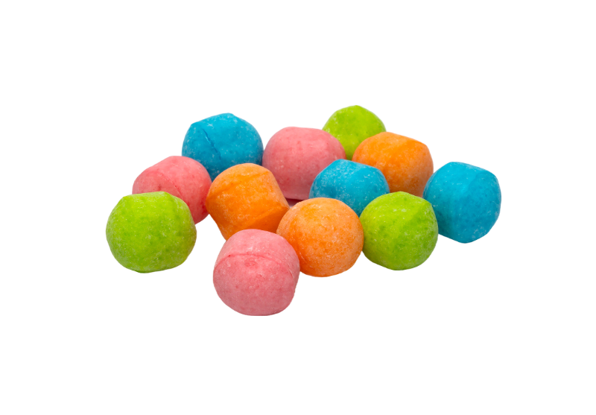
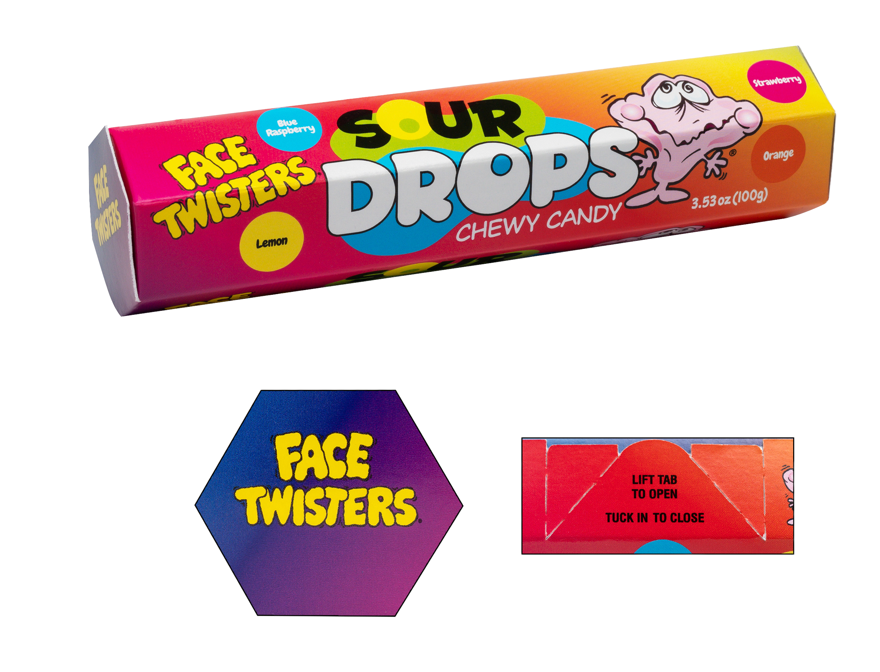
NEW!
SOUR DROPS CHEWY CANDY™ 8/12 ct Case
Item # 17010
3.53 oz (100g)
Fruit-Flavored Super Sour Chewy Candy Drops in Blue Raspberry + Strawberry + Orange +Lemon in a unique hexagonal shaped box.
Unit Cost | $ 1.09
Case Cost | $ 104.64
ITEM | UNIT UPC
Sour Drops Chewy Candy ™ | 7-93216-17030-7
Case GTIN | 007-93216-17010-9
Case Dimensions | 15.91” L x 14.57” W x 11.02” H
Case Weight | 2.69 lbs
Case Cube | 1.48

