Slide 1
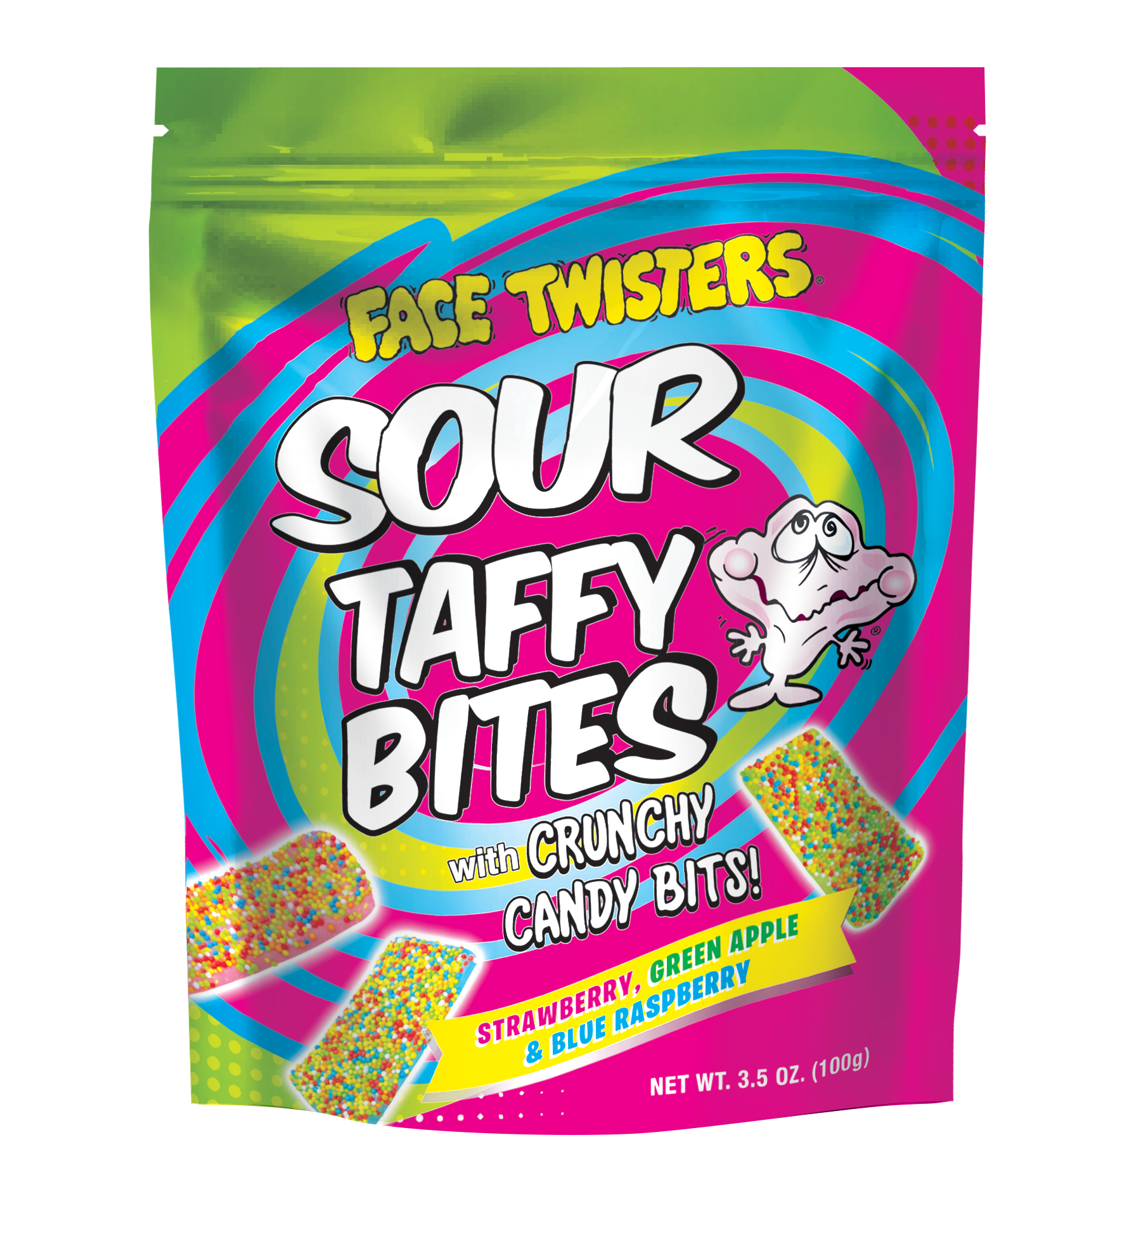
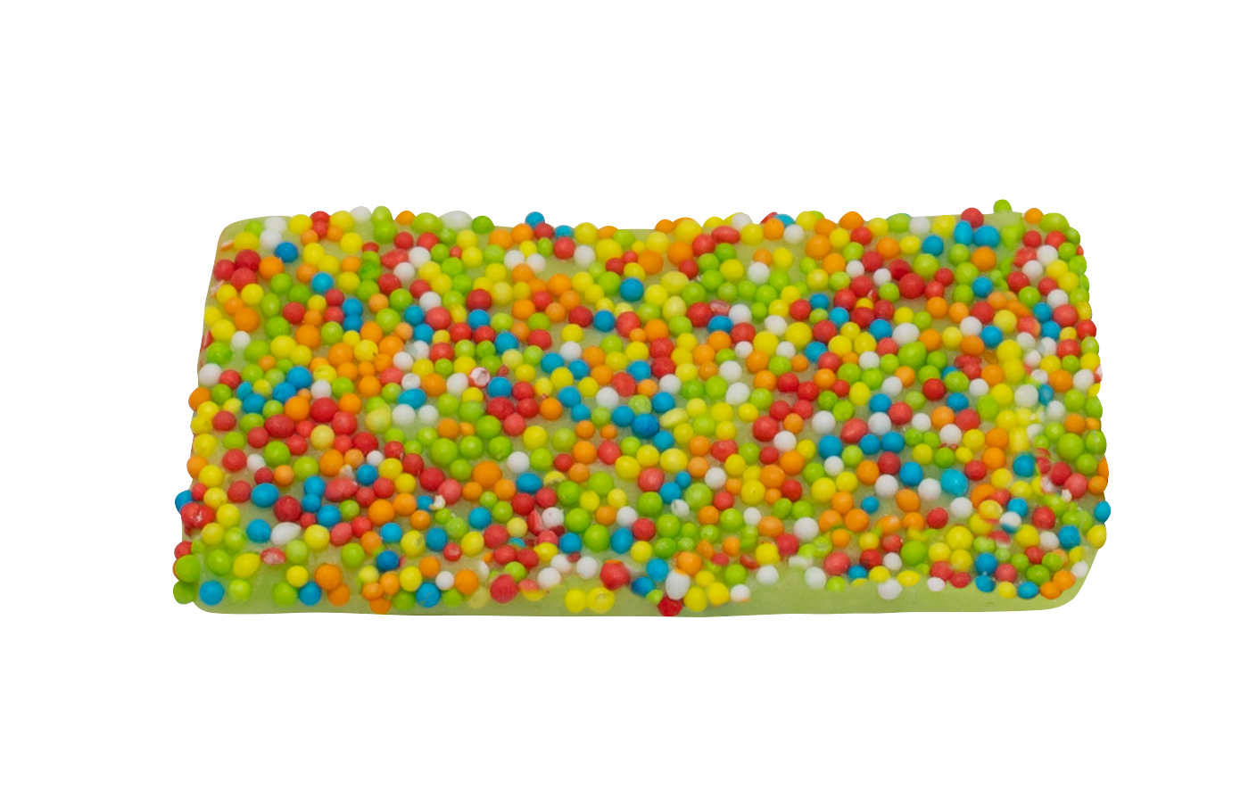
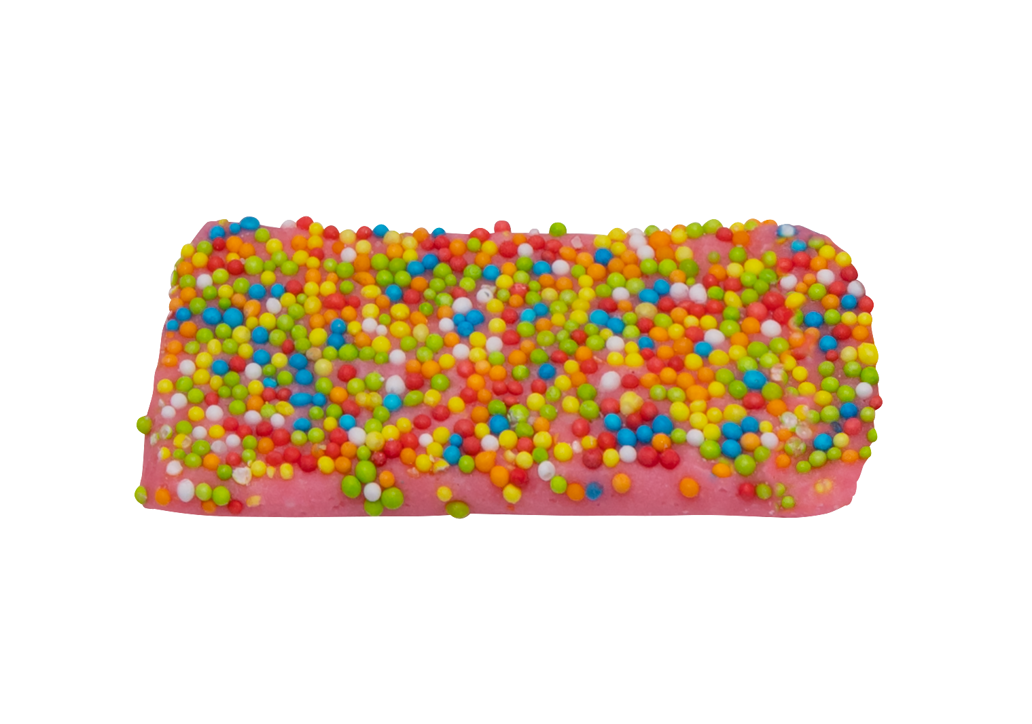
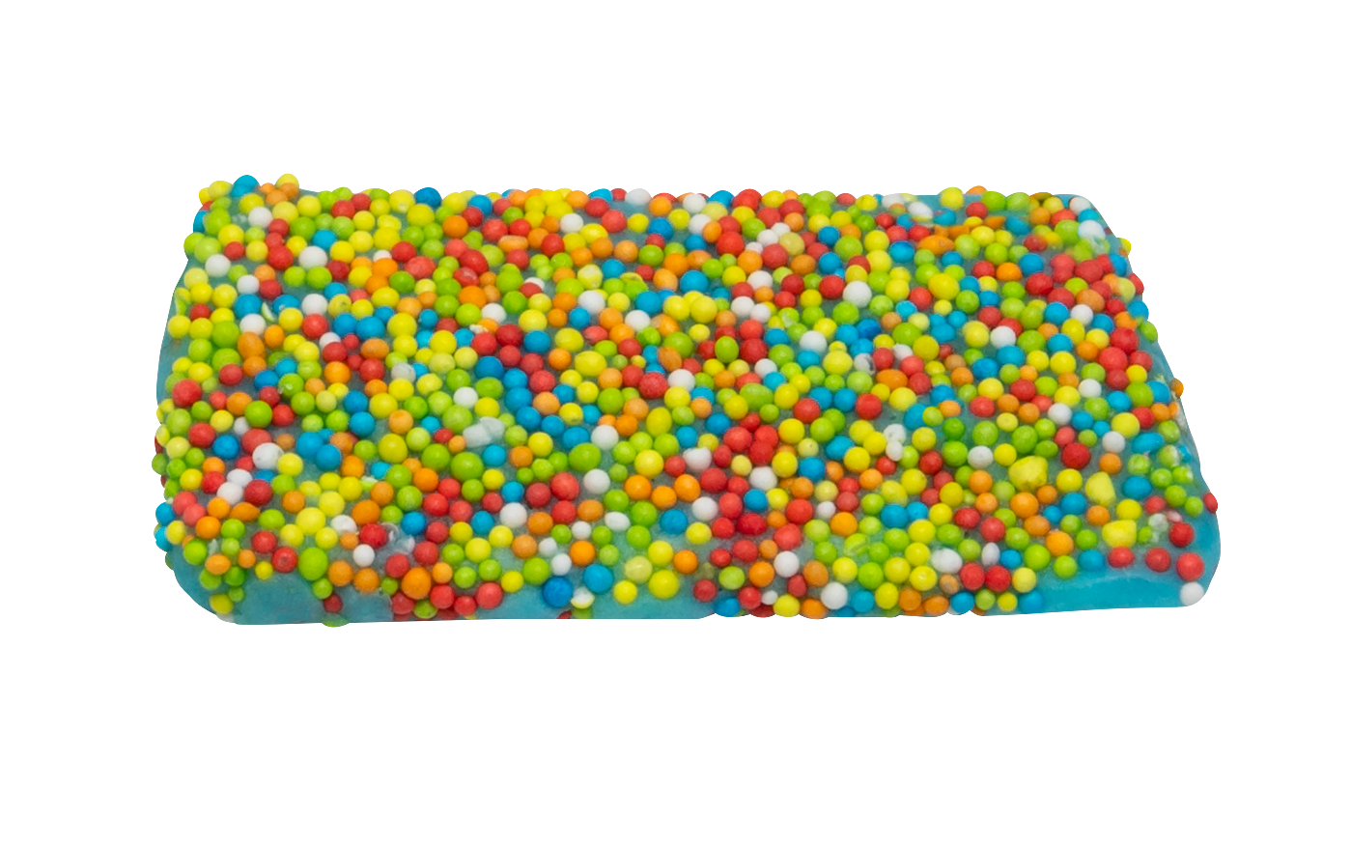
NEW!
SOUR TAFFY BITES 1/12 ct Case
Individually wrapped bite sized pieces of our sour Strawberry + Blue Raspberry + Green Apple , flavored taffy topped with crunchy candy bits
Item # 53000
3.5 oz (100g)
Individually Wrapped
Unit Cost | $ 1.75
Case Cost | $ 21.00
ITEM | UNIT UPC
Sour Taffy Bites | 7-93216-53020-0
Case GTIN | 007-93216-53000-2
Case Dimensions | 10.709” x 8.347” x 6.3”
Case Weight | 3.9
Case Cube | 0.33

