Slide 1
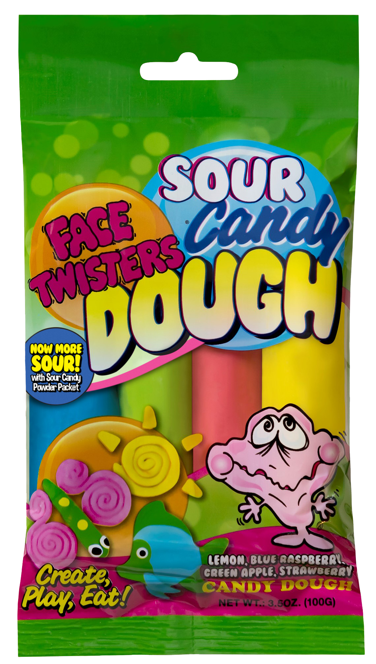
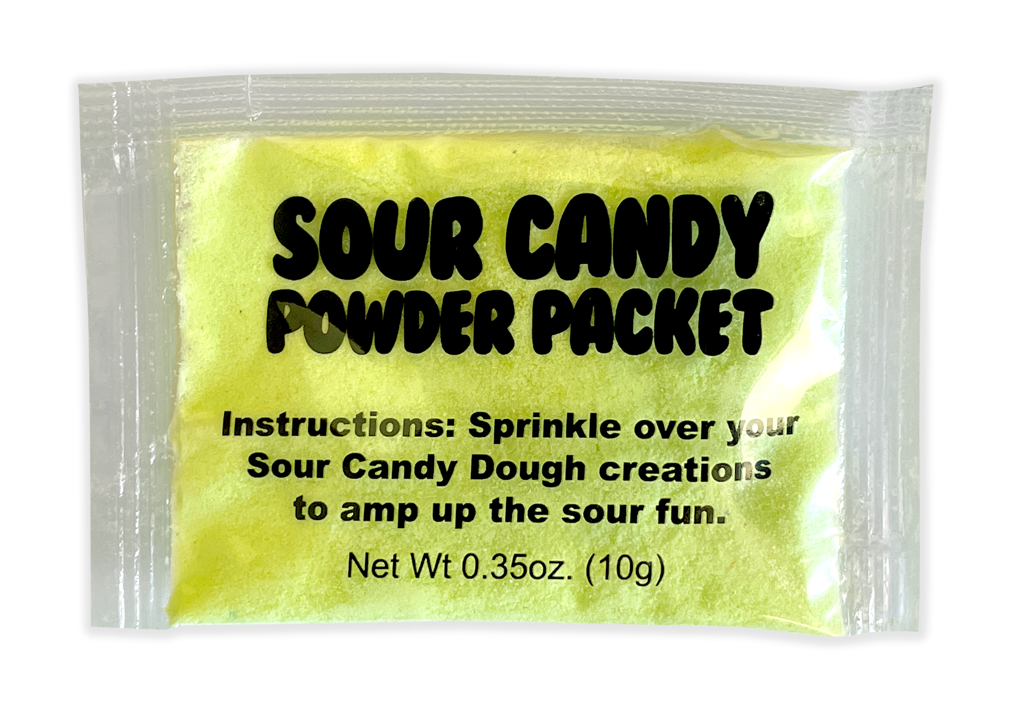
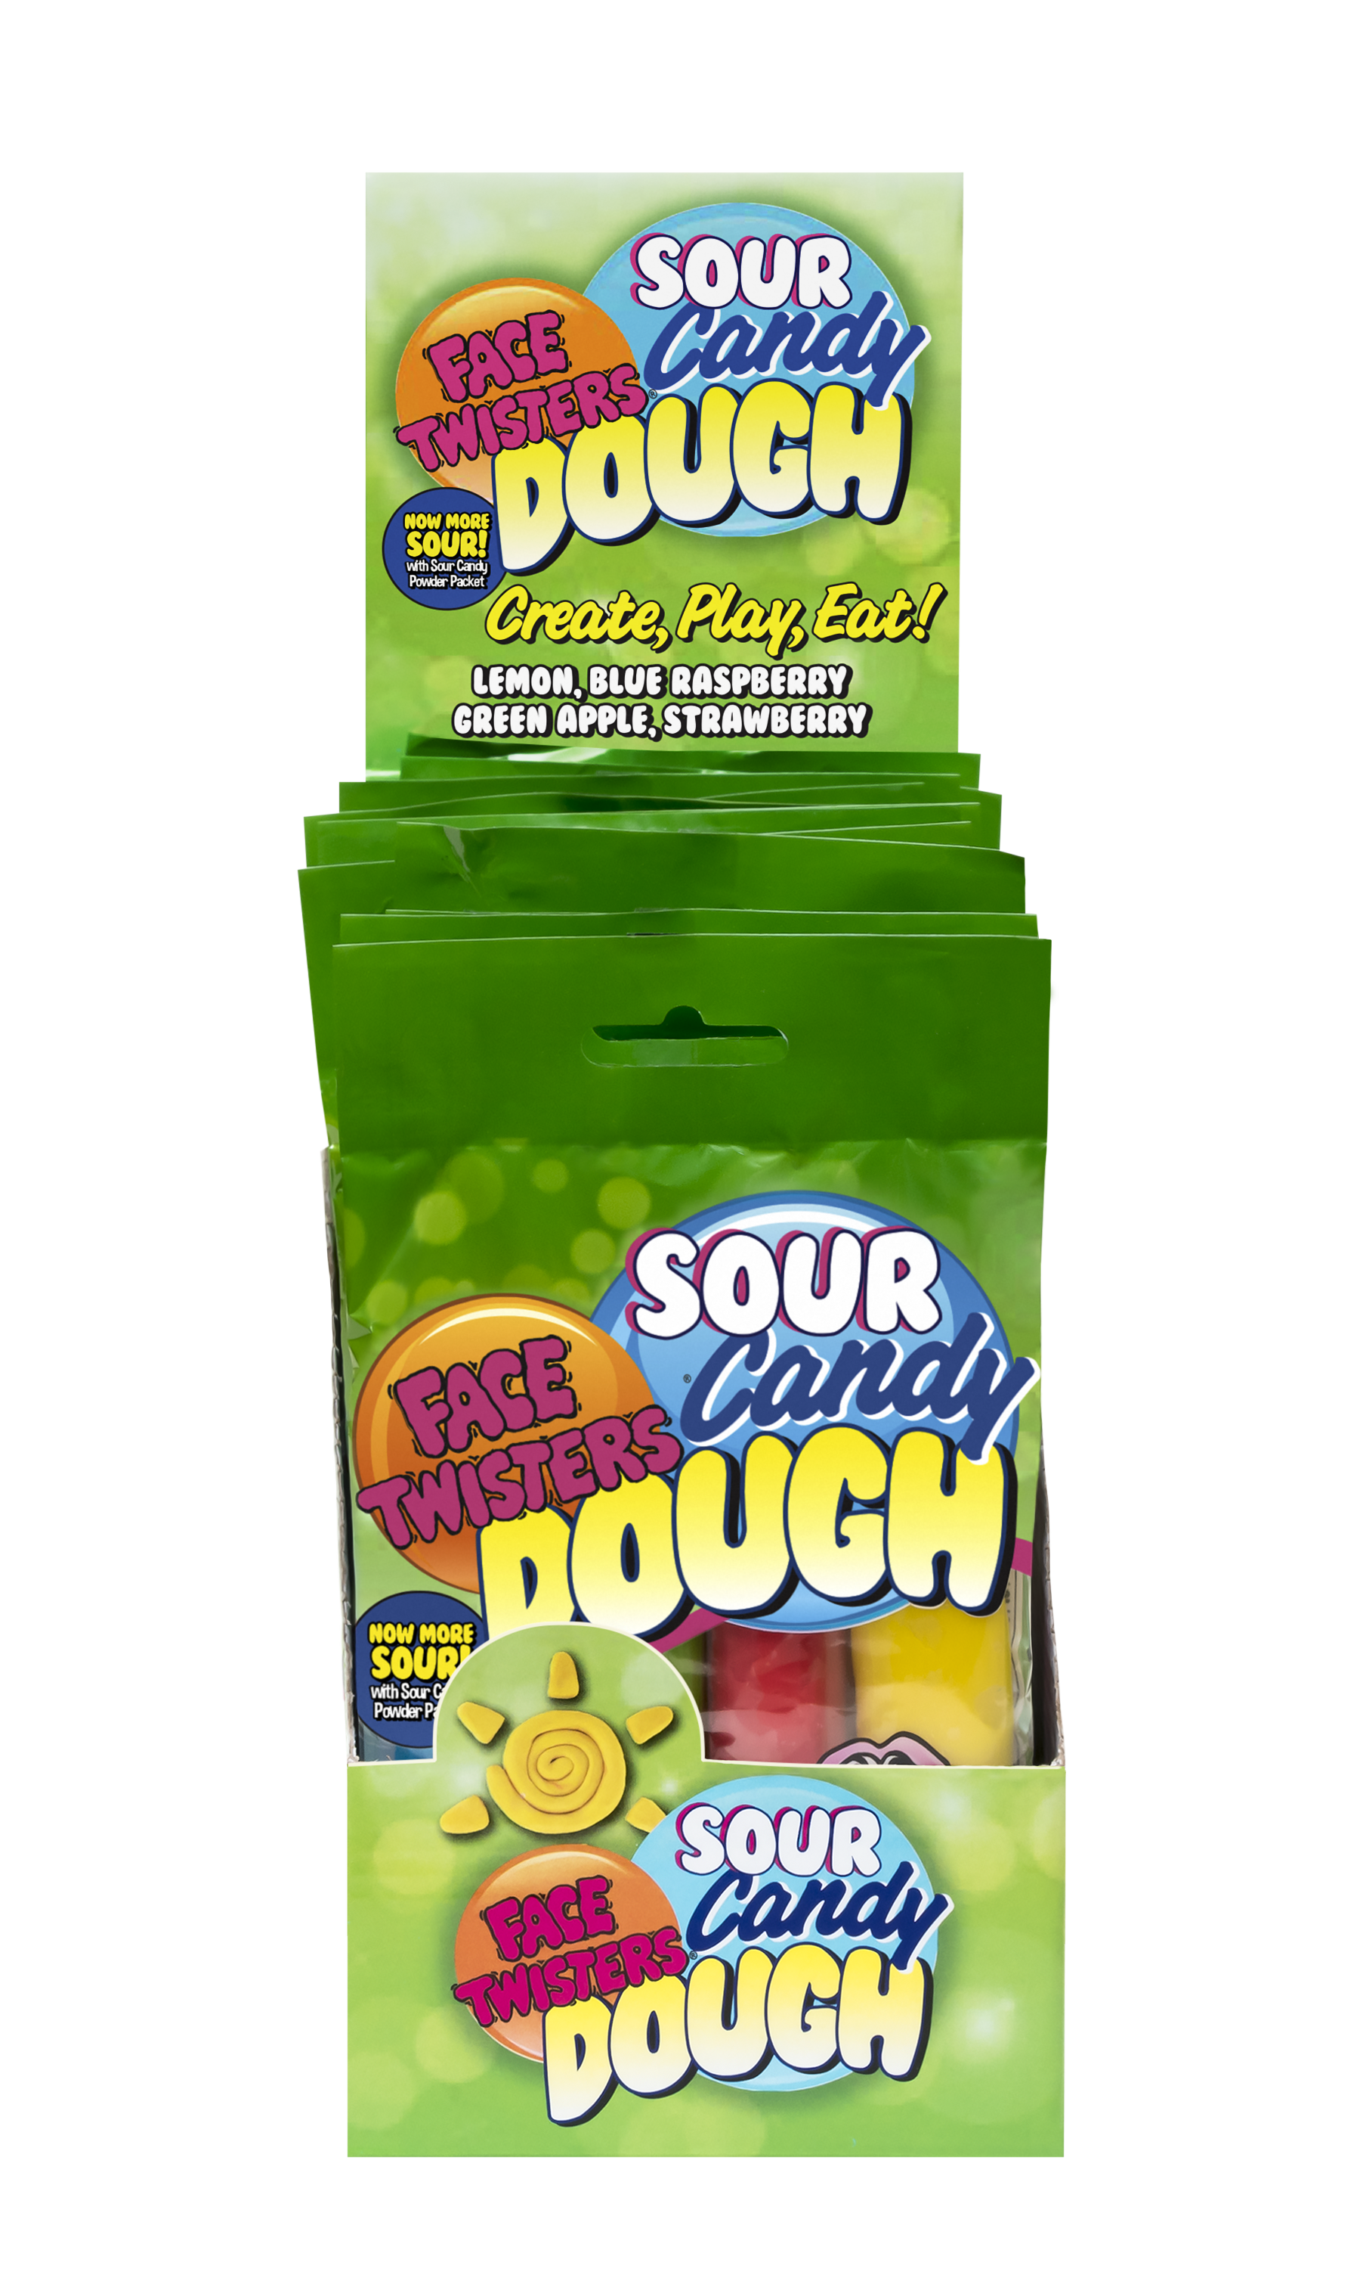
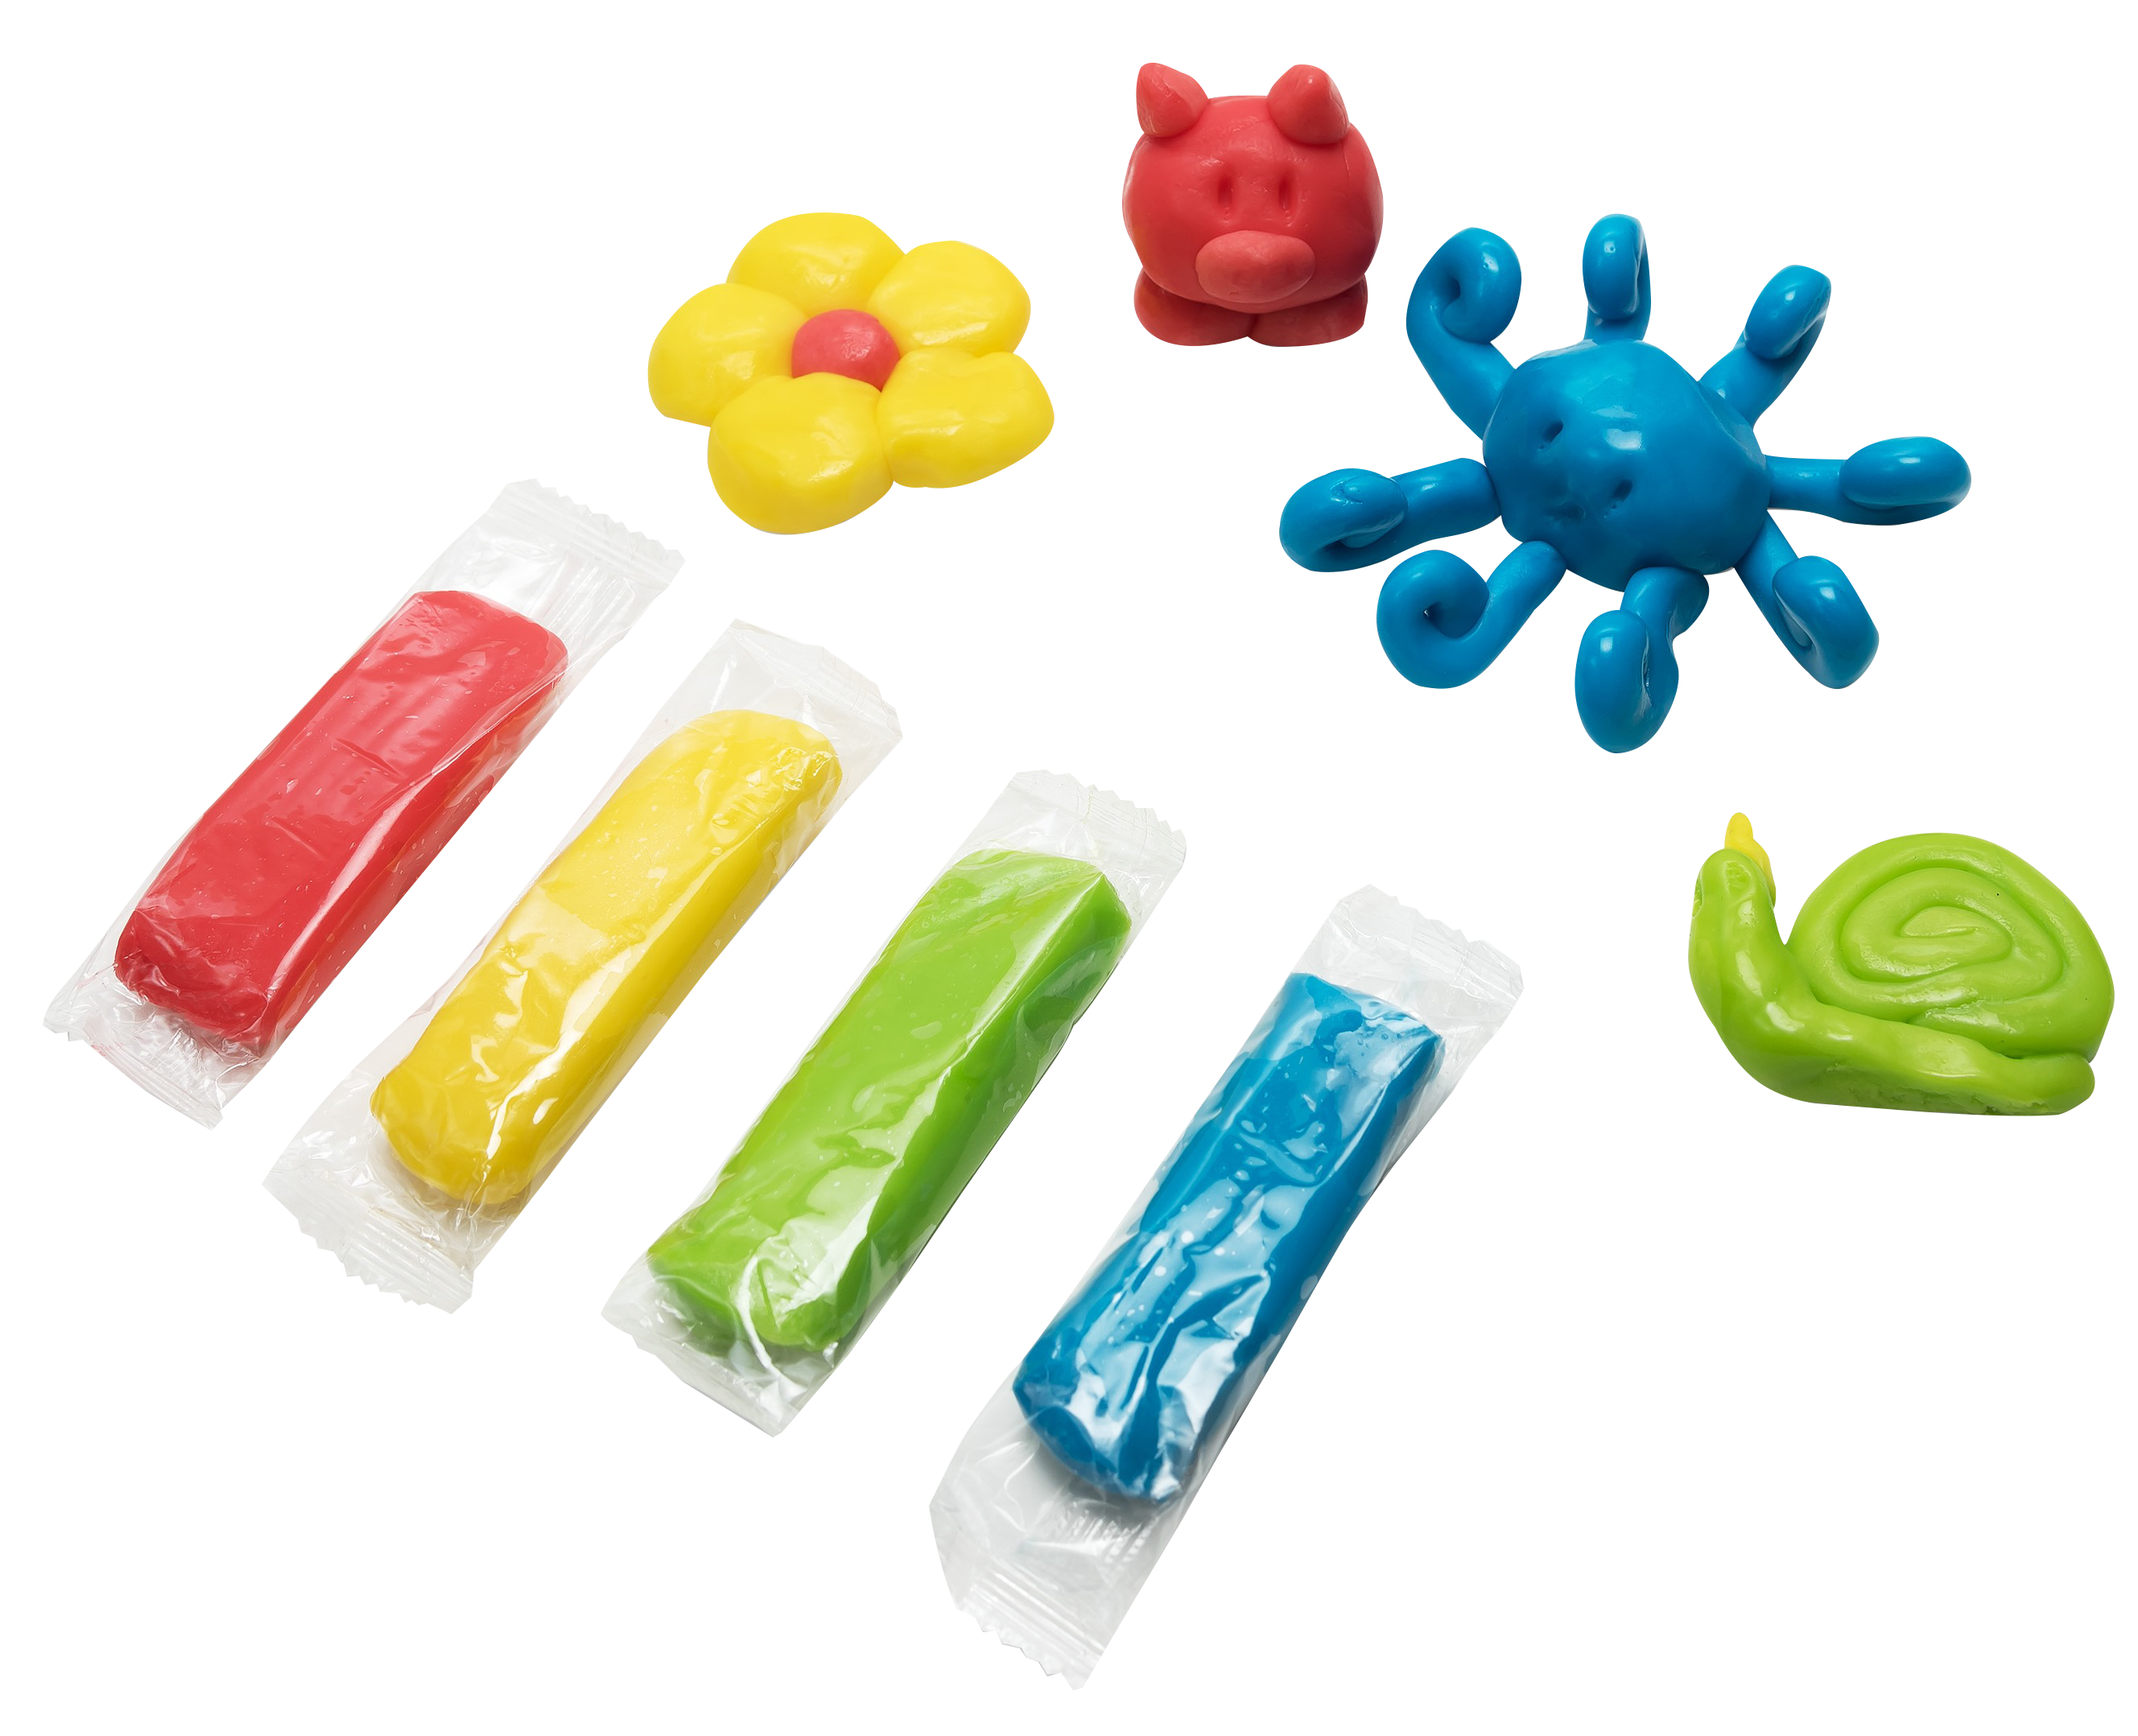
SOUR CANDY DOUGH® 12/12 ct Case
Create your own edible shapes to play with then eat!
Each unit contains one stick each of sour Strawberry + Blue Raspberry + Green Apple + Lemon flavored candy dough. That’s four large sticks of moldable sour candy dough plus a bonus packet of super sour powder to decorate your creations!
Item #11010
3.5 oz (100g)
Unit Cost | $ 1.07
Case Cost | $ 154.08
Case GTIN | 007-93216-11010-5
Case Dimensions | 19.06” L x 14.33” W x 14.17" H
Case Weight | 42.7 LBS
Case Cube | 2.24
ITEM | UNIT UPC
Sour Candy Dough® | 7-93216-11030-3

