Slide 1
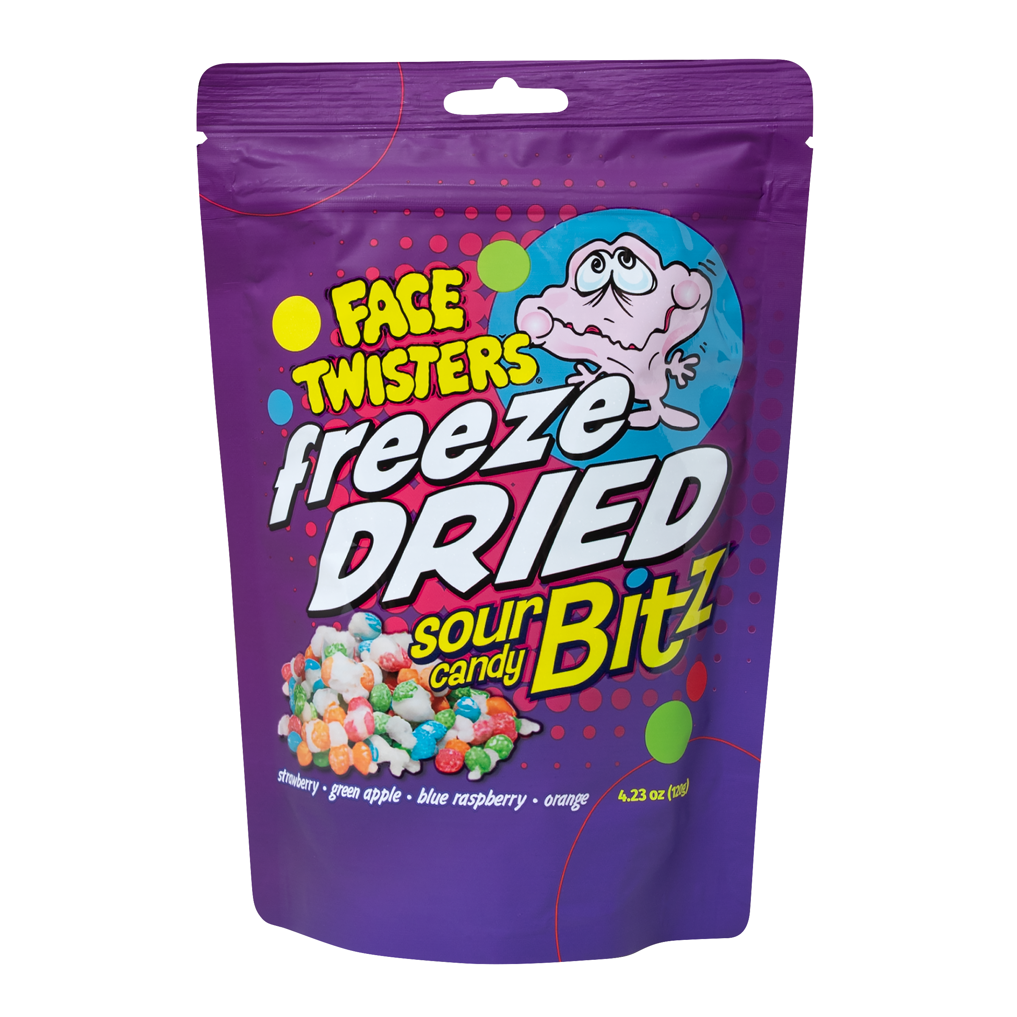
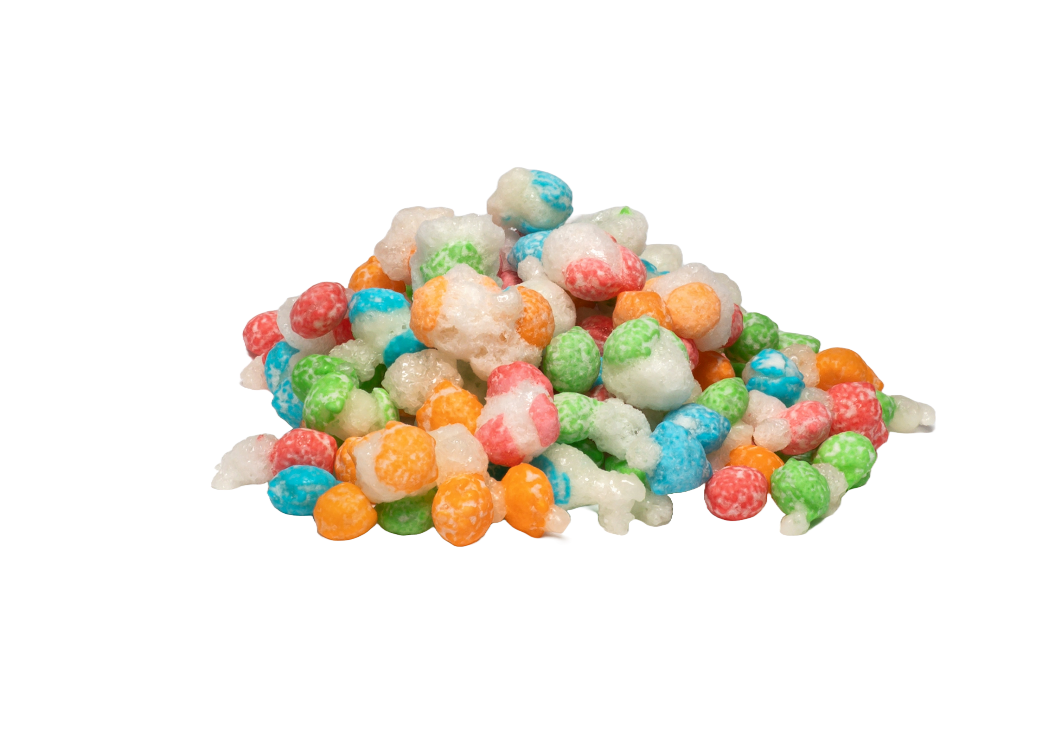
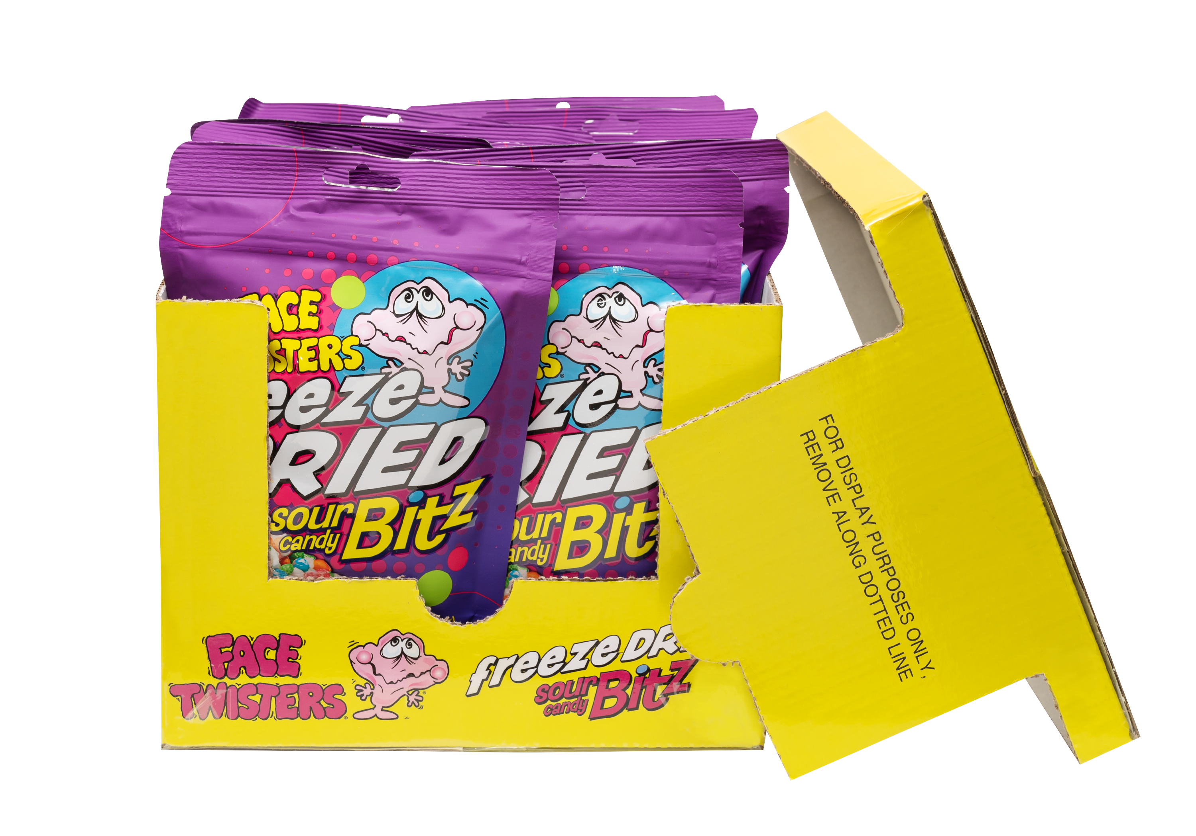
NEW!
FREEZE DRIED SOUR CANDY BITZ™ 12 ct DRC
Item 32010
4.23 oz (120g)
Freeze Dried Sour Candy Bitz™ in Strawberry + Green Apple + Blue Raspberry + Orange
Freeze Dried Reimagined. Taste the Difference!
Unit Cost | $ 4.00
Case Cost | $ 48.00
ITEM | UNIT UPC
Freeze Dried Sour Candy Bitz™ | 7-93216-32030-6
Case GTIN | 007-93216-32010-8
Case Dimensions | 9.29” W x 10.47” D x 7.87” H
Case Weight | 4.25 lbs
Case Cube | 0.44
12 ct Display
Ready Case

