Slide 1
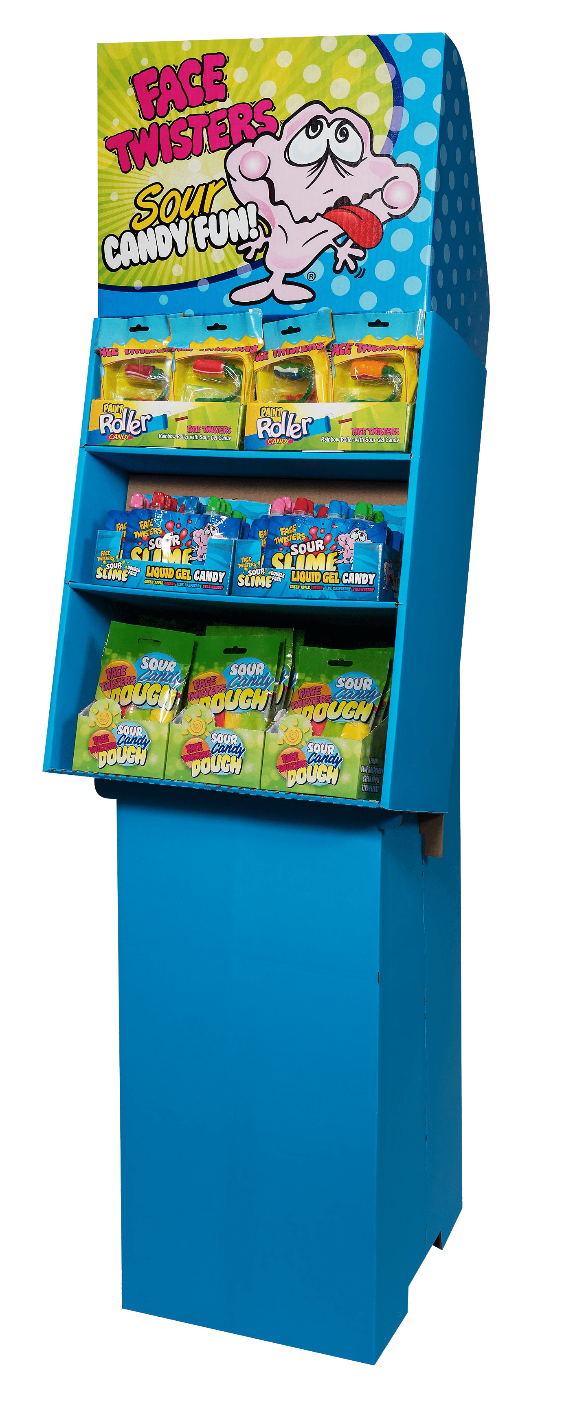
96 ct NOVELTY FLOOR SHIPPER
Item # 14010
Contains:
24 units Paint Roller® Candy
36 units Sour Slime Double Pack
36 units Sour Candy Dough®
Unit Cost | $ 1.07
Case Cost | $ 102.72
ITEM | UNIT UPC
Paint Roller® Candy | 7-93216-12030-2
Sour Slime Double Pack Strawberry/Green Apple | 7-93216-10050-2
Sour Slime Double Pack Cherry/Blue Raspberry | 7-93216-10050-2
Sour Candy Dough® | 7-93216-11030-3
Case GTIN | 007-93216-14010-2
Case Dimensions | 20.71” L x 16.22” W x 12.13” H
Case Weight | 22.4 LBS
Case Cube | 2.36

